Slide 1
Module 7: Incorporating the patient voice
into your project

Slide 2
Why does patient engagement and storytelling matter
“I learned so much about how much information you can get with a patient interview compared to our team sitting in a room debating what patients need.” (Lauren)

Slide 3
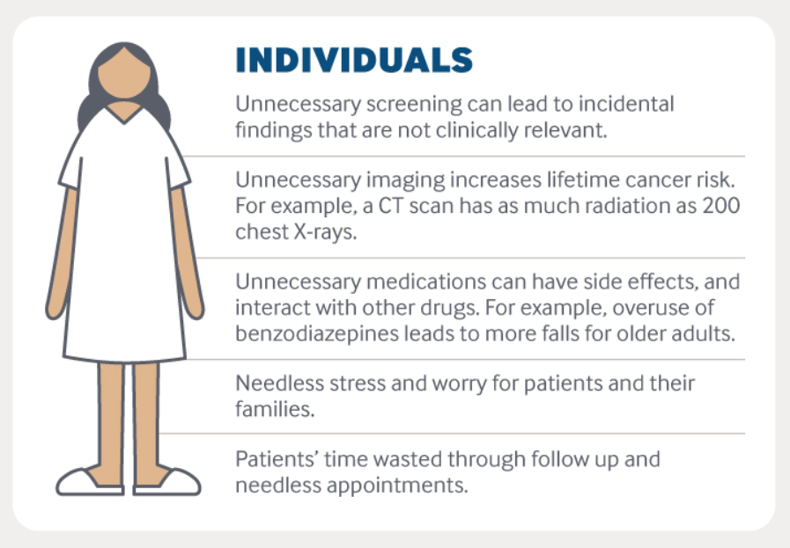
Data: Choosing Wisely Canada, Unnecessary Care in Canada (CWC, Apr. 2017); and “The Surprising Dangers of CT Scans and X-rays,” Consumer Reports, Jan. 27, 2015.
Notes:
Overuse is when the harms outweigh the benefits of a test or treatment
Harms can include: physical, psychological, the workload a patient must do to manage the disease, disruption to social life or identity, financial toxicity and dissatisfaction with the health care system
A scenario which illustrates this follows. A patient needs to get imaging for acute low back pain. First, she has to schedule the imaging which includes figuring out time off of work, who’s going to take care of the kids and how are you going to get there or back. The closest center is an hour away. In addition to the co-pay, she needs drive an hour to get the scan which costs gas and wear and tear on the car. She needs to take off work. She needs to eat out because two hours of driving plus at least an hour in the medical facility throws off mealtimes. Two hours in the car also increases her pain. And as we ask patients to take on more of these responsibilities for tests and treatments with little to no benefit we further erode their trust in the system.
Reference Kornstein’s article for more info

Slide 4
Continuum of Patient Engagement
Depth of Engagement
Consultation
Involvement
Partnership & Shared Leadership
Direct Care
Organizational Design & Governance
Given Info
Asked ?’s
Co-creates plan
Provides input
Co-leads change
Survey
Factors influencing engagement:
Patient (beliefs about their role, health literacy, education)
Organization (policies and practices, culture)
Society (social norms, regulations, policy)
Kristin L. Carman, Pam Dardess, Maureen Maurer, Shoshanna Sofaer, Karen Adams, Christine Bechtel and Jennifer Sweeney Patient And Family Engagement: A Framework For Understanding The Elements And Developing Interventions And Policies doi: 10.1377/hlthaff.2012.1133 Health Affairs 32, no.2 (2013):223-231
Notes:
Patient engagemnt is a spectrum which clinicians can help patients move along for better health outcomes
Patients may progress and regress based on severity of illness which is why it is importnat to also engage caregivers
Much of gathering storytelling lives in engaging patientds in organizational design and governance
Reference for more information: Kristin L. Carman, Pam Dardess, Maureen Maurer, Shoshanna Sofaer, Karen Adams, Christine Bechtel and Jennifer Sweeney Patient And Family Engagement: A Framework For Understanding The Elements And Developing Interventions And Policies doi: 10.1377/hlthaff.2012.1133 Health Affairs 32, no.2 (2013):223-231

Slide 5
Intrinsic | Extrinsic
Belief more care is better Lack of knowledge of harm from overuse Discomfort with uncertainty | Financial—third party payment shielding from costs Culture of avoiding mortality Media misrepresentation of research Advocacy groups Medicalization of non-disease (e.g., baldness)
Notes:
There are many behavioral levers which encourage patients to ask about treatments and tests which may not be necessary
However, research shows clinicians interpret questions about a test or treatment for demand. Often patients are requesting a conversation to better understand the option rather than requesting the option itself.
Now we’ll talk a little about navigating those conversations
Reference for more information: setting a research agenda for medical overuse.

Slide 6
What Matters to patients
“If it’s not quality care, you can get all the care you want. If it’s not quality, I’m not getting better, you’re not figuring out what’s wrong with me. As long as the care is quality, then quantity doesn’t really matter.” – Philadelphia Participant

Slide 7
Framing the Overuse Message
Patients want:
  Communication with their clinician
  Participation in making care decisions
  Access to information
Focus on safety when justified
Communicate in plain language
Use both mass media and individual consumer approaches
Communicating information about “what not to do” to consumer. John S Santa. BMC Medical Informatics and Decision Making 201313(Suppl 3):S2
Notes:
Research done by the American Board of Internal Medicine Foundation and Consumer Reports shows patients want communication and participation, and access to information.
Specifically patients want conversations which explore benefits and harms with a focus on patient safety.
Patients want to know a clear care plan; understand what next steps might happen after that care plan and need that information in both oral and written communications which accommodate their health literacy and language prference
Reference for more information communicating about overuse with vulnerable populations for more information and above cite

Slide 8
Lessons Learned on Patient Engagement
Display patient materials throughout point of care
Incorporate CW conversations into workflows
Work with marketing or community partners
Message on personal risk of physical and/or financial harm from overuse in health care
Collaborate!
Notes:
The Choosing Wisely campaign learned about patient engagement from a $5million demonstration grant which funded health system and community organization partnership to reduce three key overuse issues in the region or state.
Successes include displaying and distributing of patient materials in waiting rooms, exam rooms and throughout the health-system, integrating materials into patient portals and incorporating Choosing Wisely conversations into workflows. This emphasizes the need for patients to see a message multiple times in order to prep them for a conversation. For example if a patient makes an appointment for low back pain, it might be helpful to send them a brochure on low back pain imaging through the patient portal or have the front desk offer a printed copy to read while they wait. Cues about the need to consider multiple options can be scripted for the person doing vitals or taking the patient history. By the time the clinician comes into the room to discuss low back pain with the patient the patient has been primed for watchful waiting.
Other successes included using social media, working with professional marketers and focusing on “low-hanging fruit” of Choosing Wisely such as antibiotic overuse.
The importance of focusing on personal risk of physical and/or financial harm from overuse in health care was noted by grantees.
Another key lesson was taking advantage of internal marketing expertise.
Finally, establishing strong relationships across grantee partners and organizations was a key ingredient for success. Additional best practices included holding in-person meetings when possible; adding Choosing Wisely discussions to already scheduled meetings; crafting well-planned agendas for monthly team calls and creating written contracts for deliverables.

Slide 9
Communicating Via Decision Aids
Studies have shown that 40-80% of the medical information patients are told during office visits is forgotten immediately, and nearly half of the information retained is incorrect.
A 2011 analysis of 86 randomized clinical trials concluded that decision aids make patients better informed, improve communication with doctors, and increase participation in decisions about their care.
Stacey, D., et al. Decision aids for people facing health treatment or screening decisions. Chochrane Database Syst Rev, 2011.
Notes:
Using decision aids and appropriate patient materials aids communication.
Choosing Wisely has created over 100 pieces of patient materials to aid with these types of conversations.
An example of effectiveness is a recent study in Washington State and northern Idaho found that giving decision aids to patients resulted in 26% fewer hip replacements, 38% fewer knee replacements, and a reduction in costs of 12% to 21% during a six-month period.
Arterburn, D., et al. Introducing decision aids at Group Health was linked to sharply lower hip and knee surgery rates and costs. Health Aff, 2012.

Slide 10
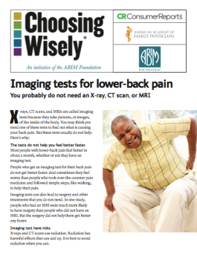
How Well Do the Topic-Specific Brochures Work?
Before reading
<16% interested in topics
After reading
50% interested in receiving more info;
66% said they would talk to their doctor about the topic; and,
43% changed their mind about a topic.
(2013; 2,669 respondents.)
Notes:
Another example of effectiveness is the above study,

Slide 11

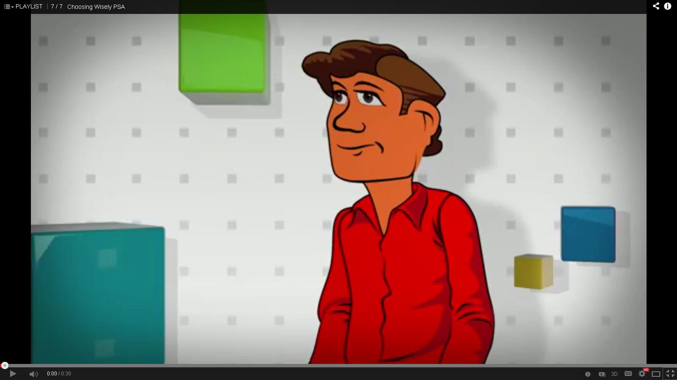
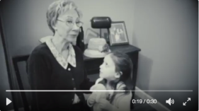
Questions to Ask your Doctor:
Several resources with similar messaging, and all easy to use.
Wallet Cards
Rack Cards
Brochures / Posters
Videos
Notes:
While many patients may want to question their clinician they may not know what to ask and they may not feel they have permission to question. To help patients, Consumer Reports developed five questions focused on overuse.
These questions were tested in 2017 with 4,519respondents who were asked to use the questions in a healthcare interaction. Respondents reported:
20% changed their opinion about what to do as a result of asking the questions;
22% said they changed their plans about their anticipated treatment;
88% said that their doctor was open to answering questions; and,
90% said they would encourage their family and friends to ask the questions.
To work most effectively, messaging should be integrated into the flow of care and multiple messengers at the point of care should be trained to engage patients and answer questions.

Slide 12
storytelling
“I’ve learned that people will forget what you said, people will forget what you did, but people will never forget how you made them feel,” Maya Angelou

Slide 13


Using Choosing Wisely Stories from
Healthcare Consumers to Make the Issues Come Alive
“…I noted in the [Choosing Wisely] brochure that colonoscopies are not needed after age 75 … With that in mind, my dad (who had survived three cancers, did not want to be treated for any additional cancers, and gets severe abdominal pain from the colonoscopy preparation process), called up his doctor and declined the test. In my opinion, he chose wisely.”
–Darla D
“…When my condition recently flared up again and my doctor insisted on a CT, I was armed with the [Choosing Wisely] fact sheet … and I avoided unnecessary radiation risk [of the equivalence to three years of natural background radiation] – and a hefty expense of nearly $1,000.”
–Jean H
Notes:
In the article the Science of what makes people care, to message effectively we must move past informing to packaging the information through the lens of a narrative. Patient stories move clinicians in an emotional way which pairs effectively with data.
The process of gathering stories also helps you better understand what a patient wants and what information to share with fellow clinicians about how to navigate the patient conversation.

Slide 14
Storytelling 101 (in healthcare)
Finding a lead …
Focus on being a listener. ...
Define your story's purpose. ...
Take time to prepare for the interview. ...
Ask the patient memory-jogging questions. ...
Make note of the details. ...
Ask for positive feedback.
  symptoms described and all the questions asked by both sides of the story?
  https://www.coffeycomm.com/blog/posts/writing-great-healthcare-stories-what-is-the-best-way-to-interview-patients/
Notes:
In order to gather stories, you need to know a few basics of what counts as a story and how to gather them.
Use these websites to expand on this slide: https://www.coffeycomm.com/blog/posts/writing-great-healthcare-stories-what-is-the-best-way-to-interview-patients

Slide 15
Using Patient and Family Advisory Council
Storytelling Goals
1. to evoke strong emotion (typically in lobbying or fundraising contexts);
2. to promote empathy and understanding (helpful in supporting culture shift and communication skills); and
3. to promote change (helpful in influencing process or policy)
Lessons Learned
Keep it short
Frame it in a positive
Use an experienced storyteller
Surfacing emotions is normal
https://www.ncbi.nlm.nih.gov/pmc/articles/PMC3783065/pdf/permj17_3pe142.pdf
Notes:
One of the best ways to gather stories is to work with your PFAC if you have one. Here are a few tips and tools on how to engage with that group on storytelling.
Use this article to expand on this slide: https://www.ncbi.nlm.nih.gov/pmc/articles/PMC3783065/pdf/permj17_3pe142.pdf

Slide 16
Patient Focus Groups or Interviews
Look for diverse viewpoints
Obtain consent
Use scripted open-ended questions
Create interview prompts
Compensate patients for their time
Transcribe sessions
Look for themes
Collaborate with a social scientist or grad student if possible
Notes:
Your organization may not have a PFAC but you can still gather stories. Here are a few tips and tools on how to ask patients for their stories either individually or as a group
Use this toolkit to expound on this slide: https://www.safetyandquality.gov.au/sites/default/files/migrated/A_toolkit_for_collecting_and_using_patient_stories.pdf

