Slide 1
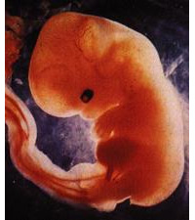
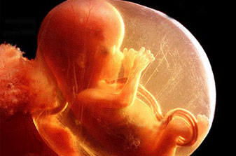
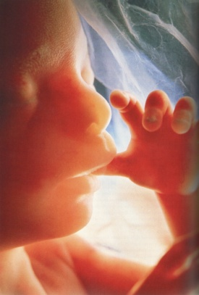
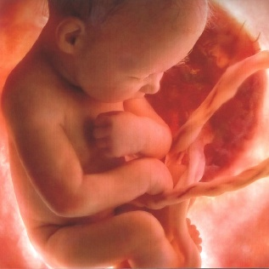
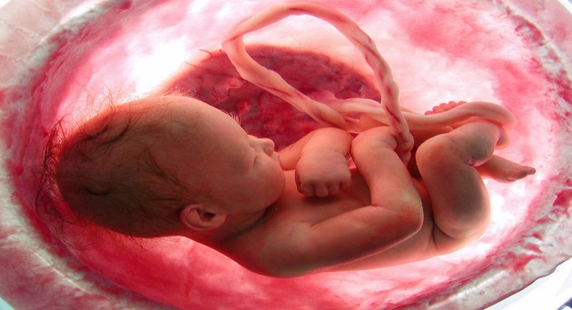
Anatomy and Physiology of the
Fetal Abdomen

Slide 2
Why do we evaluate the fetal abdomen?
 Routine Exam
 Indicated Exam
Monitor fetal growth and development
  Weight
  Age
Confirm situs
  Solitus
  Inversus
Check for anomalies/pathology

Slide 3


Evaluation of the Fetal Abdomen Depends on:
Fetal presentation
Fetal flexion
Amount of amniotic fluid
Maternal body habitus

Slide 4
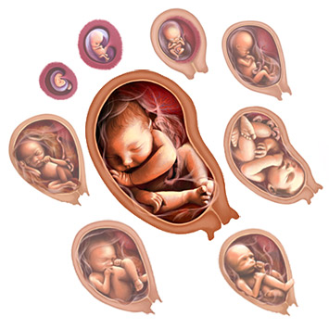
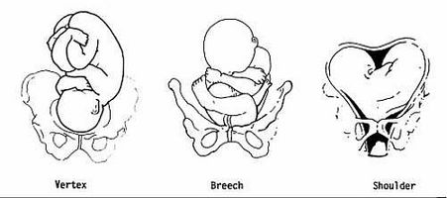
Fetal Presentation / Fetal Flexion
Vertex/Cephalic
Breech
Shoulder
Flexed side to side
Flexed forward

Slide 5
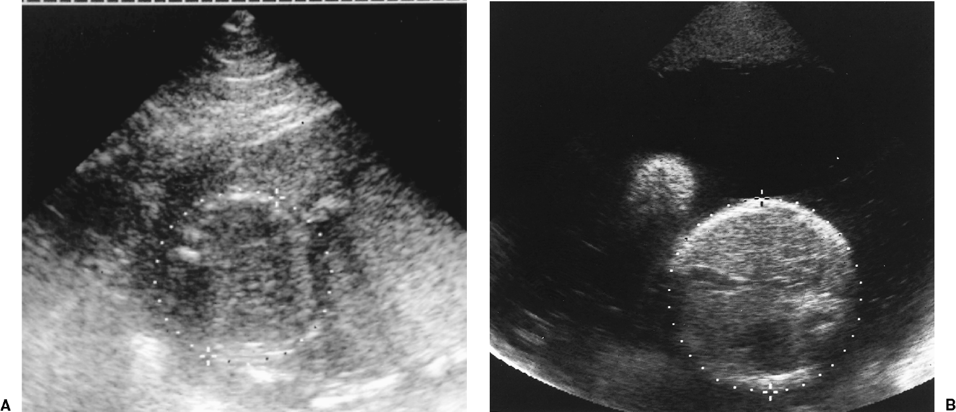
Amniotic Fluid
Polyhydramnios
Oligohydramnios
Too much amniotic fluid. Too little amniotic fluid.

Slide 6
Scanning Planes
3 →
Sagittal, Transverse, and Coronal
Sagittal
  Thorax, abdomen, and pelvis aligned to evaluate relative sizes of the body regions.
  Provides relational information on cord insertion site.
Transverse
  Confirm situs.
  Visualization of the spine to rule out splaying and ensure continuous skin covering.
  Cord Insertion evaluation.
Coronal

Slide 7
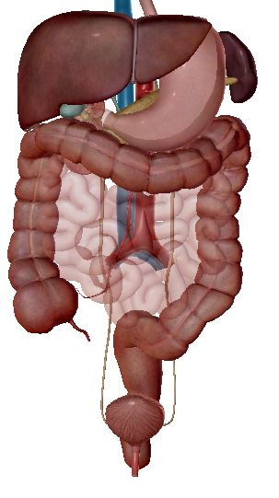
Systems/Structures Contained in the Fetal Abdomen
Digestive System
  esophagus, stomach, liver/gb, pancreas, small intestine, and large intestine
Lymphatic System
  spleen and lymph nodes
Vascular System
  abd. aorta and inferior vena cava
Biliary System
  gallbladder and bile ducts
Urinary System
  kidneys, ureters, and (distended) bladder

Slide 8
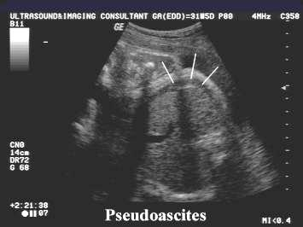
Abdominal Wall
Echogenic skin line
Hypoechoic muscle layer
  Mimics ascites
    “Pseudoascites”
      1. contained to anterior abdomen
      2. traceable to rib edges
      3. it is not found in peritoneal spaces
      4. it doesn’t outline falciform ligament or umbilical vein
      5. it doesn’t outline intra-abdominal structures
http://www.fetalultrasound.com/online/text/8-038_files/image002.jpg

Slide 9
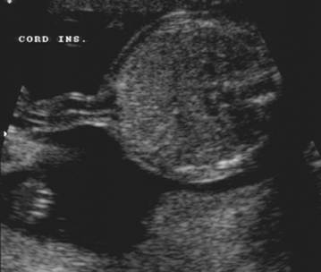
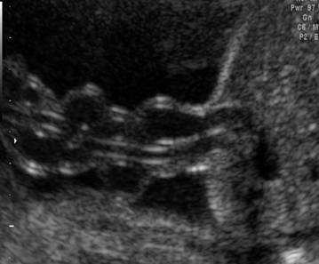
Umbilical Cord Insertion
  There should be a smooth transition between the umbilical cord and the abdominal wall
  Umbilical herniation after 12 weeks is abnormal.
  Cephalad-oblique course of the umbilical vein that enters the left portal vein.
  Caudad course of the umbilical arteries from the abdominal insertion to the common iliac arteries (lateral to the bladder).

Slide 10
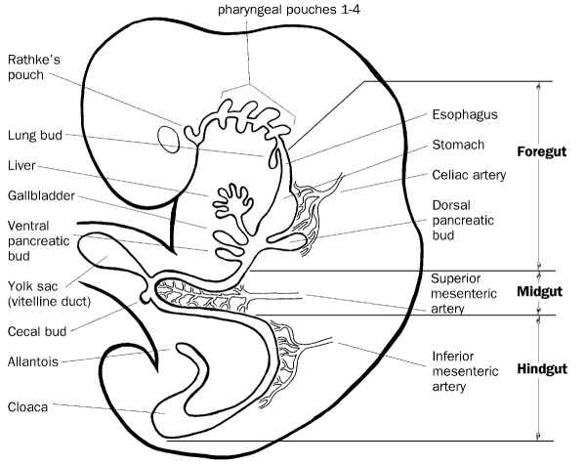
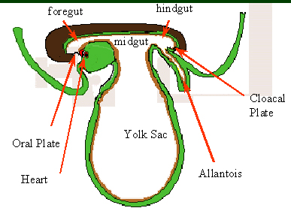
Embryology

Slide 11
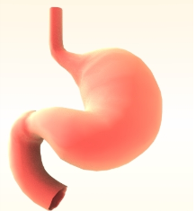
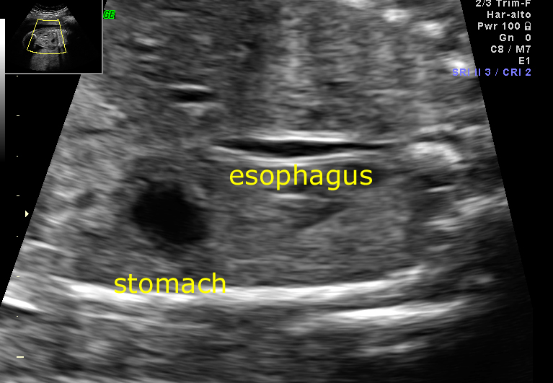
Stomach
Embryology
  Begins forming as a dilation of the gastric tube in the 4th week.
    Derives from the foregut.
  Connected to the mouth by the esophagus.
  Dorsal side grows faster than ventral side, so there is a greater and lesser curvature.
  Lies on the left side of the abdomen, below the heart and the diaphragm.
Sonographic Appearance
  Typically appears anechoic and will fill and empty over time
    If echoes are present, the AF may contain blood or vernix
    Esophagus may be seen after the fetus swallows.

Slide 12
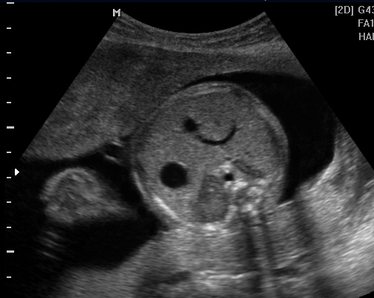
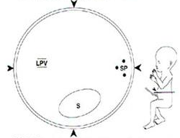
Abdominal Circumference
Taken in a true axial plane
Structures visualized:
  Stomach
  Spine (3 ossification centers)
  Umbilical vein entering the
  left portal vein.
Helps to evaluate fetal age and weight.

Slide 13
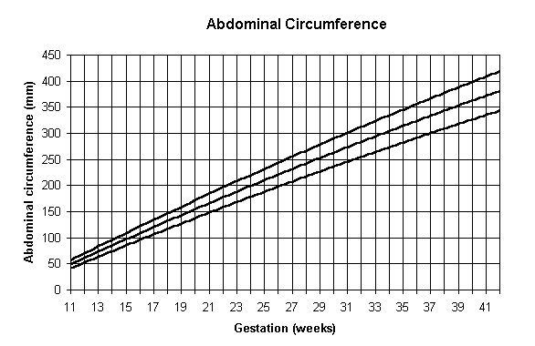

Slide 14
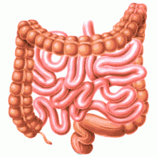
Intestines
  Distal foregut and proximal midgut form the duodenum
    Week 5-6 has the duodenal lumen closing
    Recanalization occurs at the end of the first trimester
  Midgut → HERNIATION
    Elongates in 6th week to form a gut loop and herniates into the proximal umbilical cord
      Precursor to the duodenum, small intestine, cecum, appendix, ascending colon and 2/3 of transverse colon
    Rotates while herniated
    Retreats back into abdomen by 11-12 weeks

Slide 15
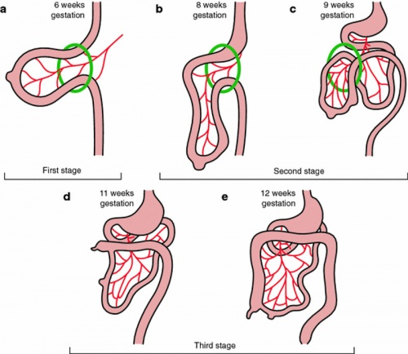

Slide 16
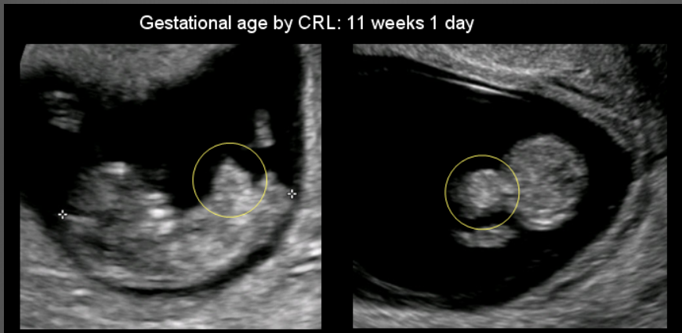
Midgut Herniation

Slide 17
Small Intestines
    Duodenum, Jejunum, and Ileum
      Duodenum connects to the stomach
      Ileum connects to the cecum
    Peristalsis may be seen.
    As pregnancy progresses, swallowing outweighs reabsorption so fluid may be present in the small bowel.

Slide 18
Large Intestines
  Ascending, transverse, and descending colon
    Hypoechoic lumen of tube structure
    Typically viewed more in the 3rd trimester
    Holds meconium during gestation
      Amniotic fluid, mucous, bile
    May be mistaken for cysts due to “pockets” of meconium that are anechoic.
  Hyperechoic to the liver, hypoechoic to the bone
    Becomes less echogenic and more defined in 3rd trimester

Slide 19
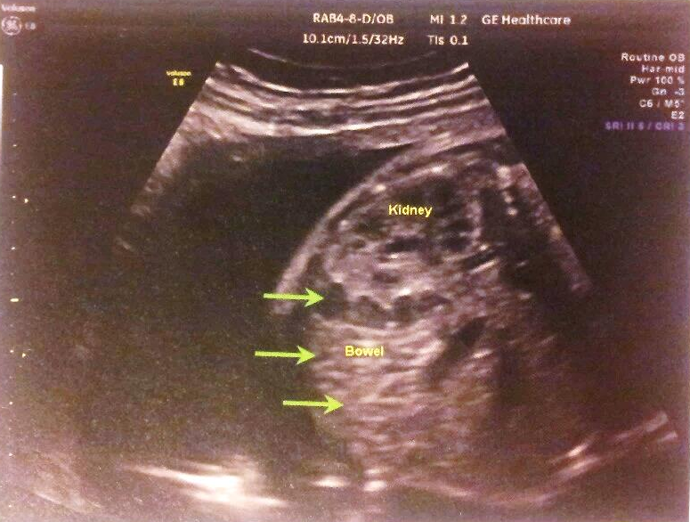
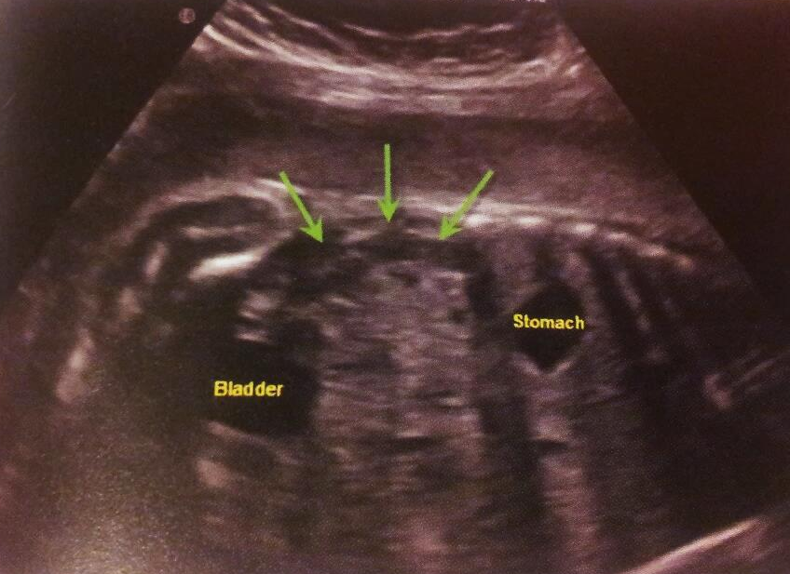
Colon
Bowel

Slide 20
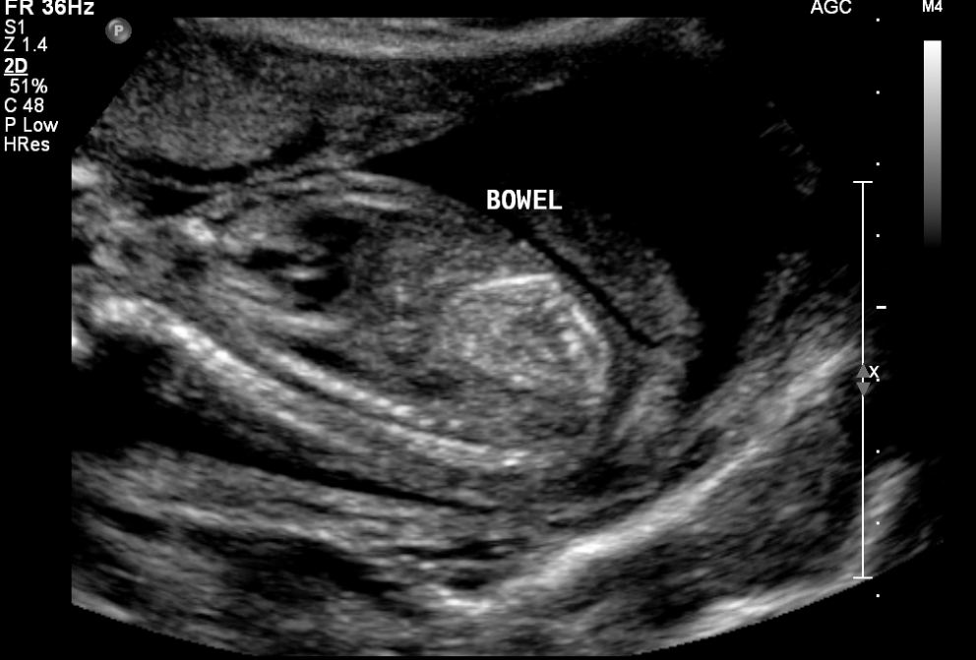
Compare the echogenicity of the bowel to the surrounding tissue (ie. liver and bone).

Slide 21
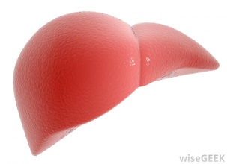
Liver
  Liver, pancreas, GB, and biliary ducts develop from the embryonic foregut.
  At the 4th week there is an outpouching of the caudal foregut.
  Hepatic Diverticulum becomes the liver
  Liver occupies most of the abdominal cavity due to rapid growth (5-10 weeks)
    liver = 10% of total weight at 2nd trimester
    liver = 5% of total weight at term
    bile secretion begins at week 12
  Homogeneous organ with a smooth texture
  Occupies RUQ
  L lobe ≥ R lobe during fetal development

Slide 22
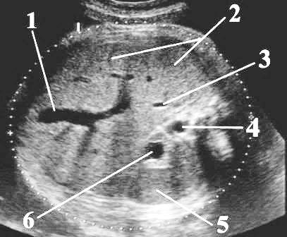
Landmarks
Umbilical Vein
Liver
IVC
Descending Ao
Spleen
Stomach

Slide 23
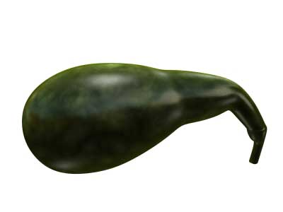
Gallbladder/Biliary Tree
  Caudal portion of Hepatic Diverticulum becomes the GB
  Biliary tree forms via the degeneration of epithelial cells
  Separates right and medial left lobe of liver (as does MHV)
  Teardrop shape
  Off-midline position
  Posteroinferior to liver
    Sits in the GB fossa
  13th week : bile dumps into duodenum
    dark green color of meconium
  PASSIVE IN FETAL LIFE → NO REACTION TO MATERNAL FAT INTAKE

Slide 24
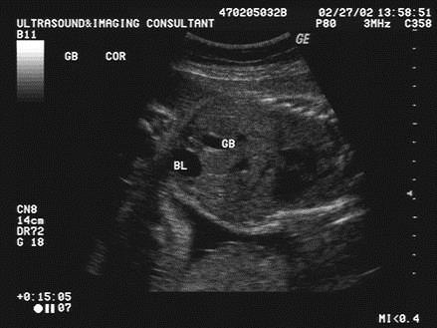

Slide 25
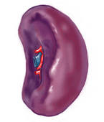
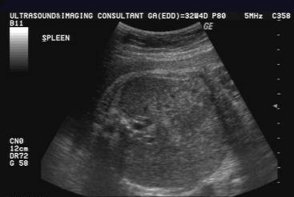
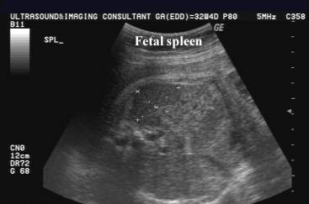
Spleen
  Lymphatic organ
  Develops during 5th week of gestation
  Posterior to stomach and superior to L kidney
  Begins at midline and then moves into the LUQ when the midgut rotation occurs and the liver moves into the RUQ
  Homogeneous “spongy” organ
  Best seen in transverse scan
  Slightly hypoechoic to the liver
  Functions include:
    Hematopoiesis in fetal life
    Immunity/defense
    Blood filter
    Reservoir

Slide 26
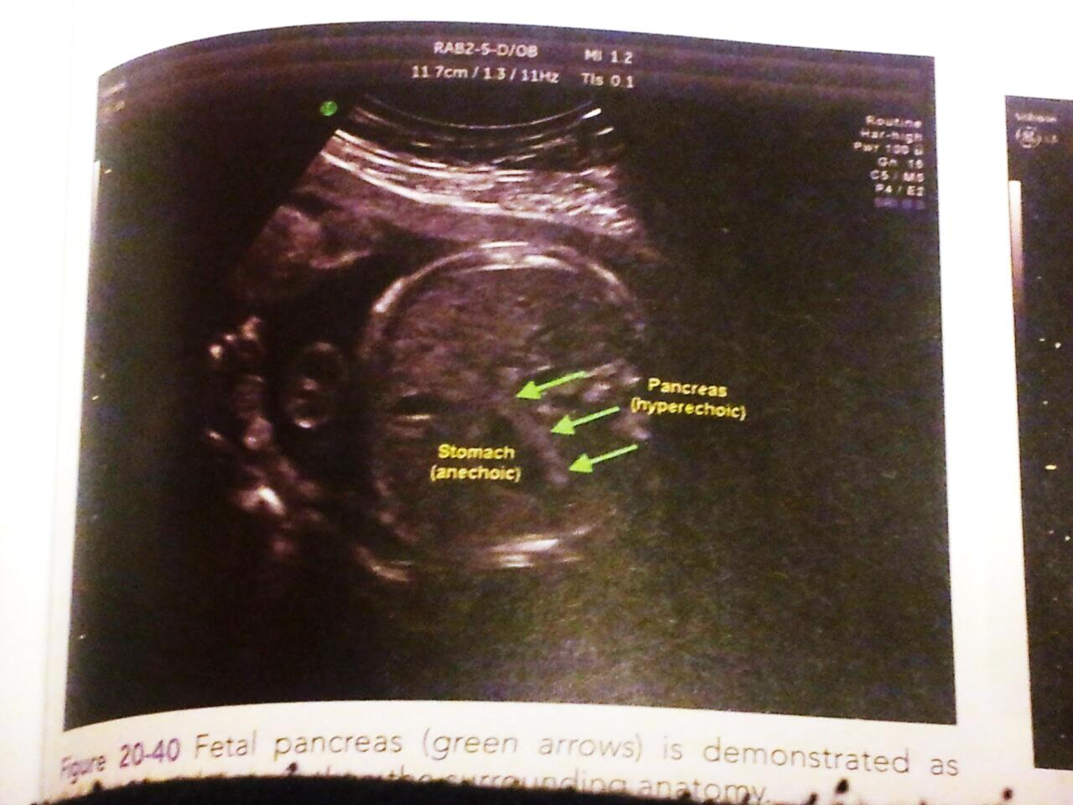
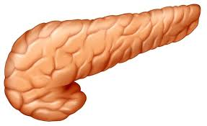
Pancreas
  Slightly hyperechoic to the liver
  2 pancreatic buds develop during the same time that the biliary system forms
  dorsal and ventral buds rotate and fuse to form the pancreas

Slide 27
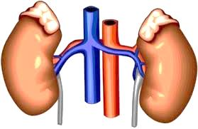
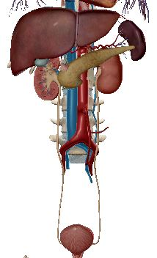
Kidneys
  Can be seen at 12 weeks but better evaluated at 14-16 weeks
  Trans: hypoechoic ovals on either side of the spine
  Long: hypoechoic, bean-shaped
  Renal pelvis and renal pyramids may be seen/prominent
  Hyperechoic sinus (fat) noted later in pregnancy
  Urine is the main source of amniotic fluid in latter half of gestation
    Oligohydramnios
      Poor urine production
    Polyhydramnios
      Poor fluid absorption

Slide 28
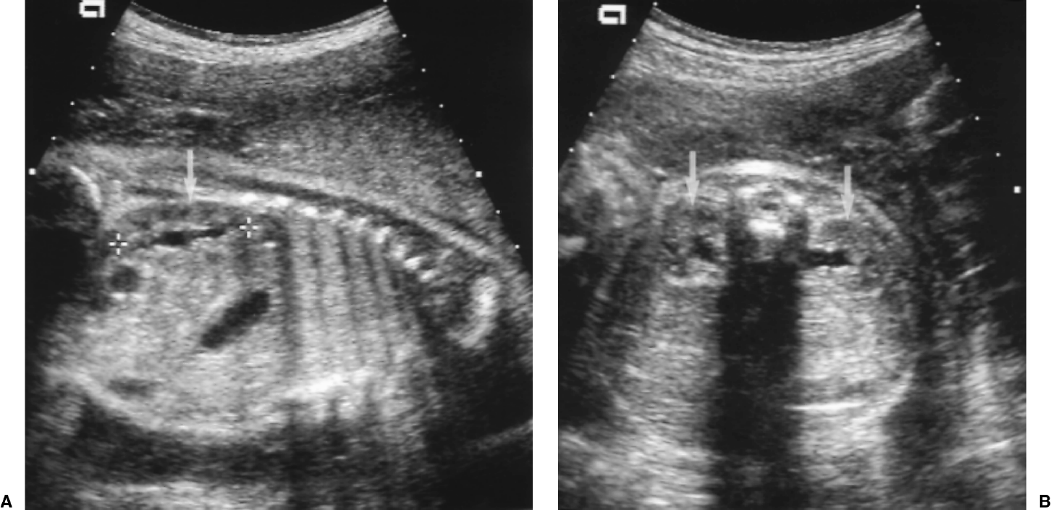
Trans
Long

Slide 29
Accompanying Structures
Adrenals
Ureters
    Triangular/heart-shaped structure sitting atop the superior pole of each kidney.
    Typically seen in Longitudinal
    Hyperechoic medulla, hypoechoic cortex
  Connect the kidneys to the urinary bladder.
  Ureters are typically not seen unless obstruction is present.

Slide 30
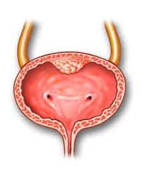
Bladder
  Bladder seen first around 13 weeks
  Anechoic circular/oval structure
  Lays within the pelvis unless it is distended with urine
    Fetus voids ~ 1/hour
    When distended, bladder lifts into lower abdomen
  Use of color Doppler proves that there are two umbilical arteries
    The umbilical arteries run along the lateral margins of the bladder.

Slide 31
