Slide 1
Abdomen and Pelvic Pathologies
Winter 2019
DMS 433

Slide 2
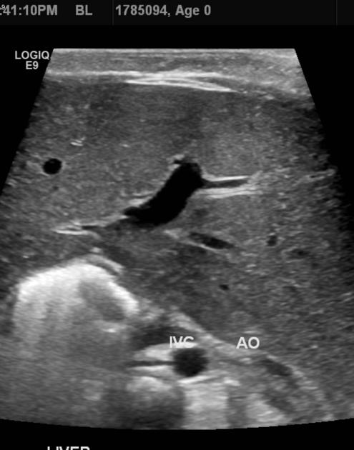
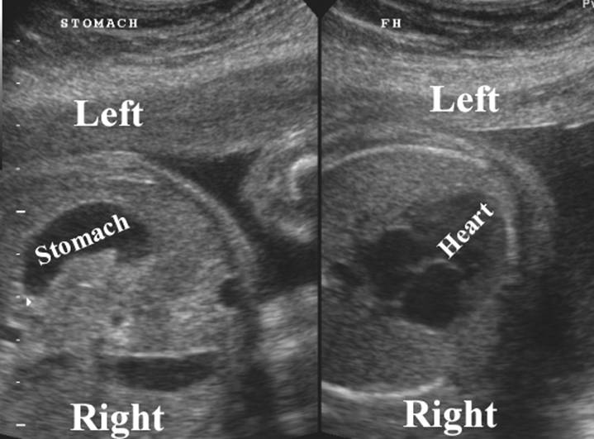
Situs Solitus
Heart on left side
Stomach on left side
Liver on right side
Portal vein on right side
Abdominal aorta on left-closest to spine
Notes:
http://www.sonoguide.com/abdominal_aortic_aneurysm.html

Slide 3
Wall Defects
Gastroschisis-herniation through an off mid-line defect in the abd. Wall.
Typically to the right of the cord insertion site
Omphalocele-occurs during normal bowel migration. Body stalk persistance . Always covered by a membrane. Cord inserts into protruding sac. Likely associated with other anomalies.
Those containing only bowel
Those containing organs
Umbilical Wall Hernia-
Linea alba defect
Protruding bowel covered by skin
Normal cord insertion
Bladder extrophy-wall did not develop over bladder.
Look in pelvis and outside of pelvis. Will sometimes have an extension outside.
More common in males
Ectopia Cordis-lower sternum and sup ant abd wall defect-sometimes involves the heart. Covered by membrane
High ass. With omphalocele, abs, limb malformations, craniofacial defects
Limb body wall defect-Complex anomalies must include:
Wall defects of thorax, abdomen, spine, limb and either cranial or craniofacial anomalies. Some thing ABS may play a role.
Amniotic Band Syndrome-may easily open the anterior wall

Slide 4
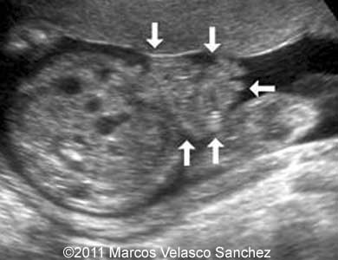
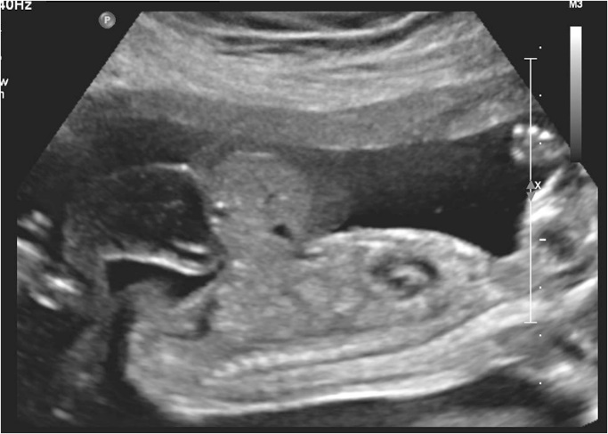
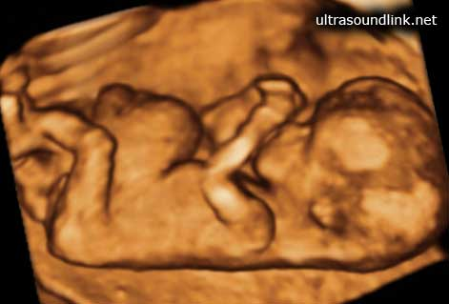
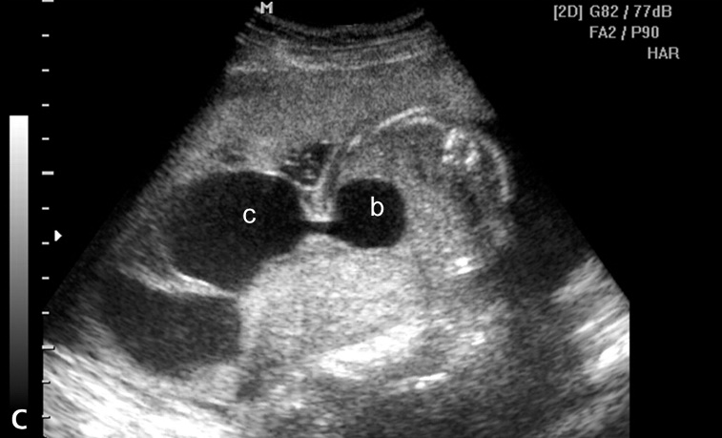
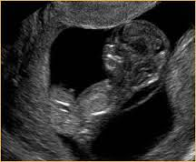
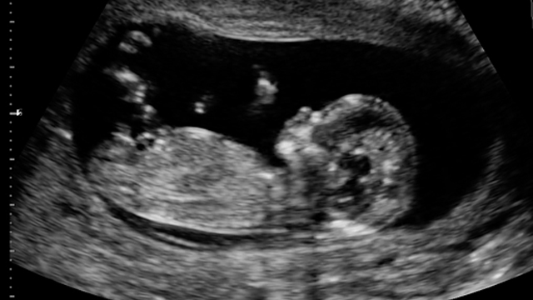

Slide 5
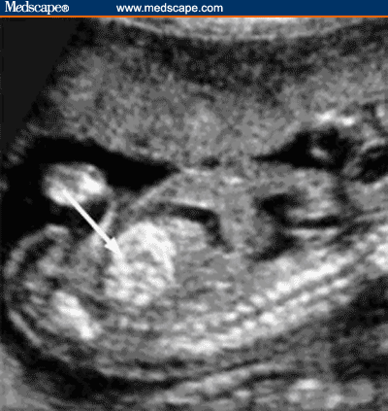
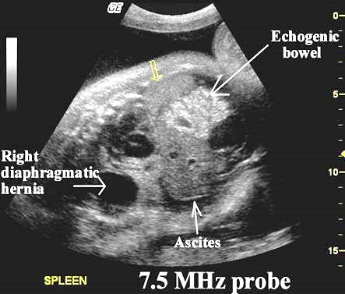
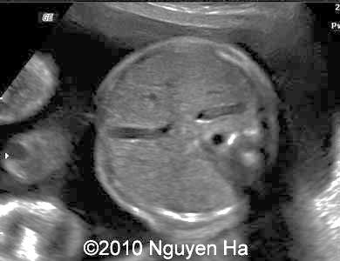
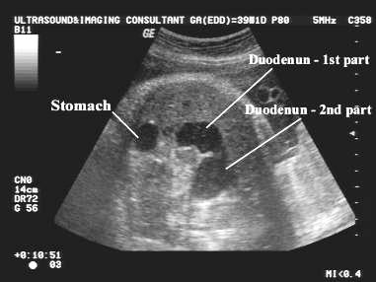
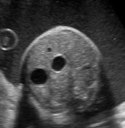
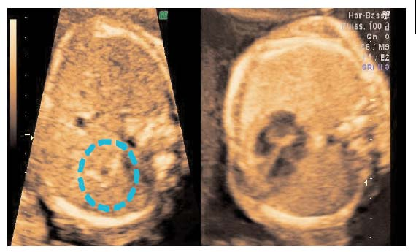
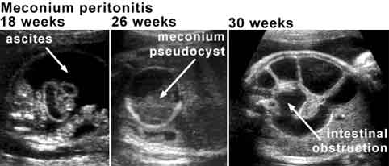
Small Bowel Issues
Absent or small stomach
Oligohydramnios
Esophageal atresia
Duodenal atresia
Dilated fluid filled loops of bowel-prox to obst.
“Double Bubble”
Commonly ass with Tri 21
Echogenic Bowel
Same echogenicity as surrounding bone tissue
Ass with fetal demise, IUGR, chrom abnml, infections, etc.

Slide 6
Hydronephrosis-blockage of flow =obstructive uropathy
Obstruction can occur anywhere-kidney, ureter, bladder, urethra
Grading for Hydronephrosis
Grade I <1cm in AP
Calyces not dilated
Grade II 1-1.5cm AP
Calyces still nml
Grade III >1.5cm AP
Calyces slight dilatation
Grade IV >1.5cm AP
Calyces mod dilated
Grade V >1.5cm AP
Calyces severe dilatation
Cortex atrophied
Up to 32 weeks <5mm is nml
>32 weeks 6mm is nml
Anything >10mm is considered hydro at any age.

Slide 7
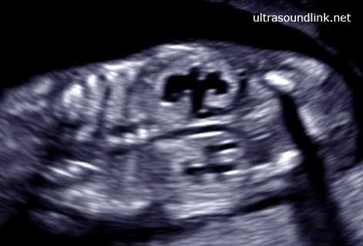
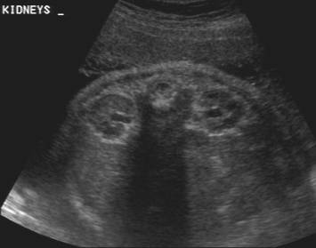
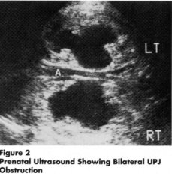
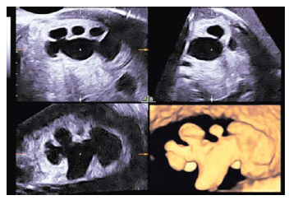
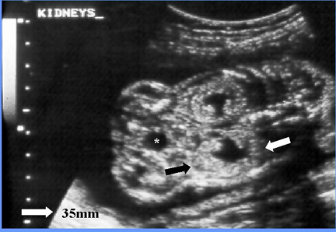
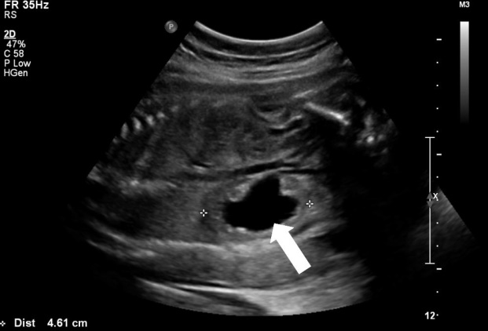
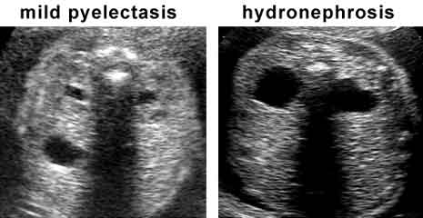

Slide 8
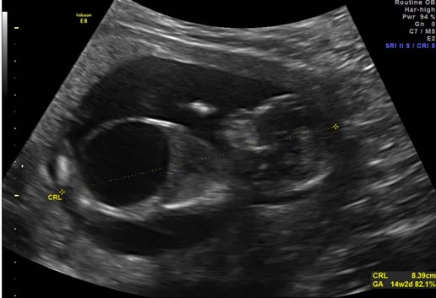
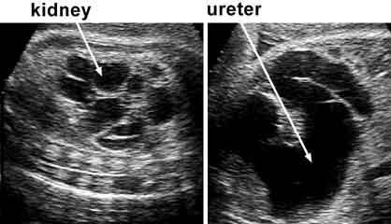
Causes for Obstructions?
Ureteropelvic Junction UPJ-Most common
Occurs at junction of renal pelvis and ureter
See hydro without ureter dilatation
Ureterovesical Junction UVJ-dilatation of ureter at bladder
Often see megaureter
Posterior Urethral Valves-predominantly male finding (redundant membranous folds in urethra).
Thick walled, dilated bladder
Dilated posterior urethra
Key hole appearance
Bladder outlet Obstruction-any condition that blocks flow out of the bladder
Megacystis
Dilated ureters, kidneys
Bladder should fill every 30 min

Slide 9
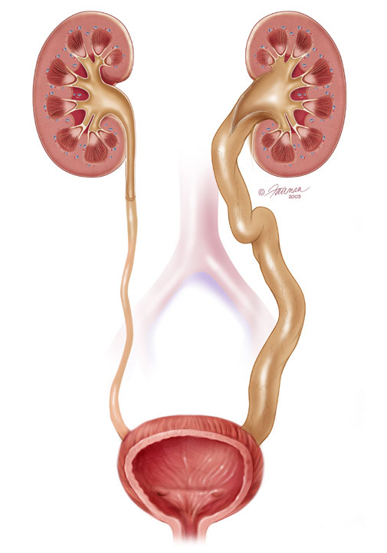

Slide 10
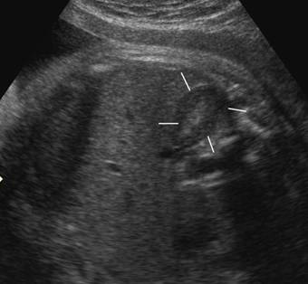
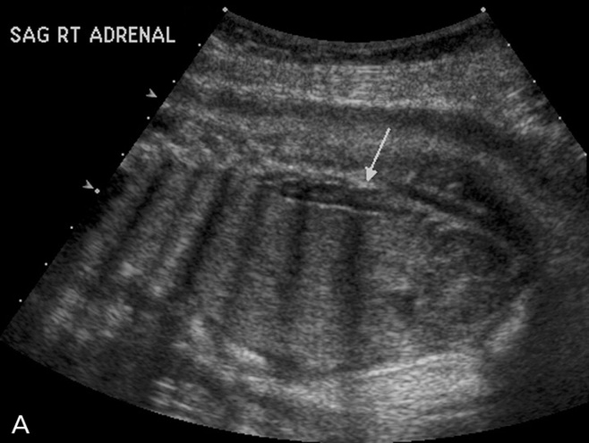
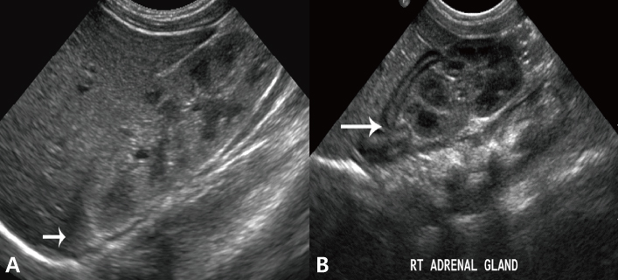
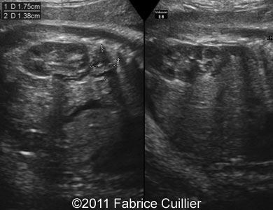
Adrenal Glands
Will compensate with renal agenesis

Slide 11
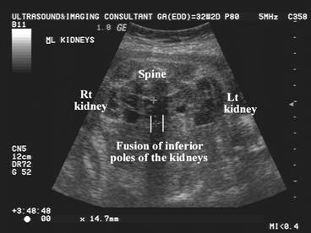
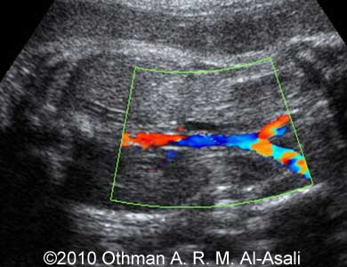
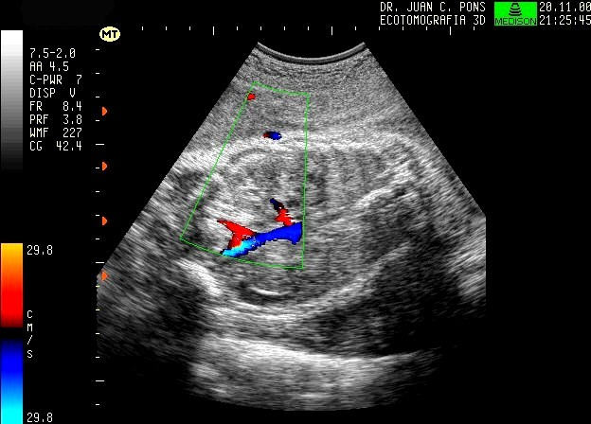
Genitourinary System Anomalies
Renal agenesis-
Unilateral or bilateral
Oligohydramnios
Empty bladder
Eval for renal arteries
Beware of adrenal glands
Ectopic kidneys-anywhere
Horseshoe Kidney-fused poles at midline
Renal Tumors

Slide 12
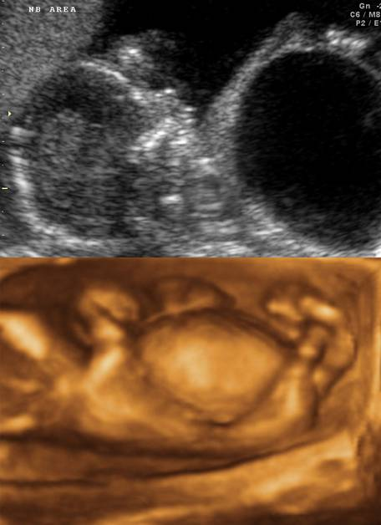
Prune Belly Syndrome (Urethral Obstruction Malformation)
Distention of Abd Wall
Obstruction of urinary tract
Cryptorchidism
Often see ascites or very distended bladder. Thick wall bladder, hydro, megaureter.

Slide 13
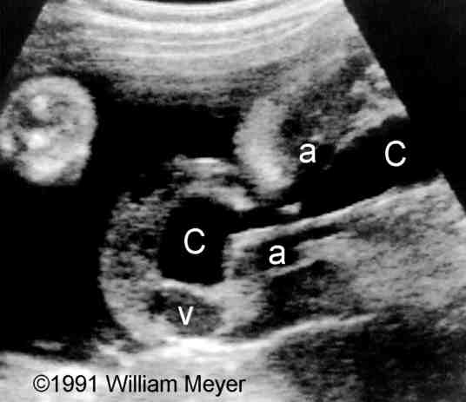
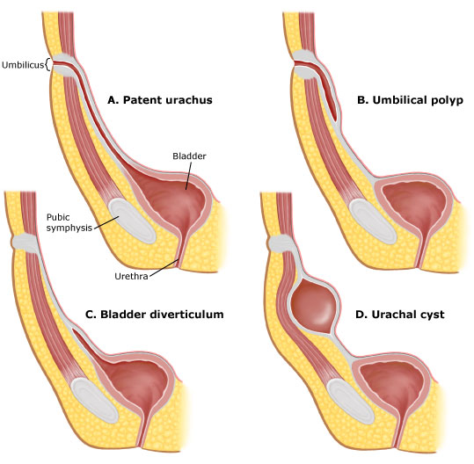
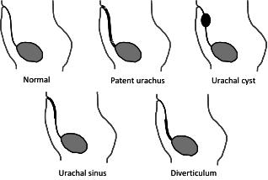
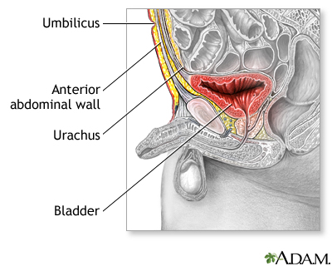
Patent Urachus
Urachal cyst
Cystic mass along the duct
No communication with bladder
Urachal Sinus
Cystic mass communicates with the abd wall
No communication with bladder
Partially patent urachus
Cystic tubular structure communicating with the bladder but not the abd wall
Cystic structures leading from the bladder to the umbilicus
Anterior abd wall

Slide 14
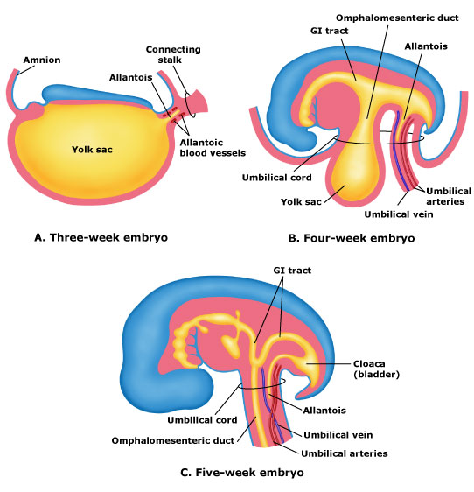

Slide 15
Cystic Kidney Diseases
Multicystic dysplastic disease
Obstructive cystic dysplastic disease or Cysts
Polycystic Kidney Disease (PKD) or Potters Sequence
Autosomal Dominant
Higher incidence
Adult polycystic kidney disease
Autosomal Recessive
Infantile polycystic KD

Slide 16
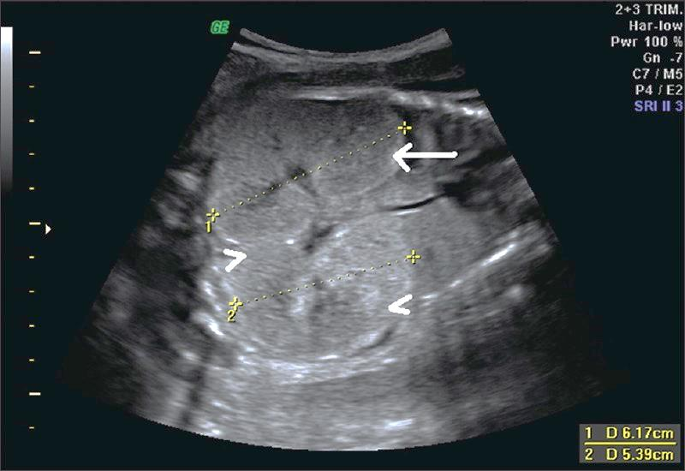
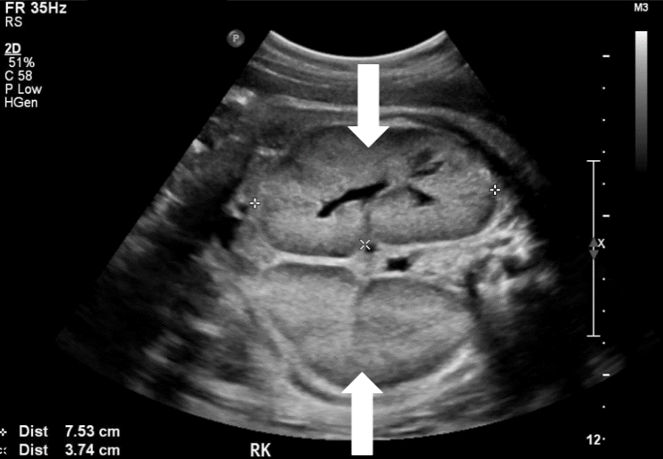
ARPKD
25% recurrence rate
Multiple small cysts due to saccular dilatations (1-2mm)
Too small to be seen as cysts-looks like echogenic solid lesion
Very enlarged bilateral echogenic kidneys
Oligohydramnios with no bladder

Slide 17
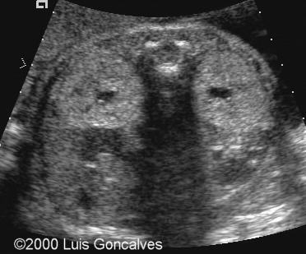
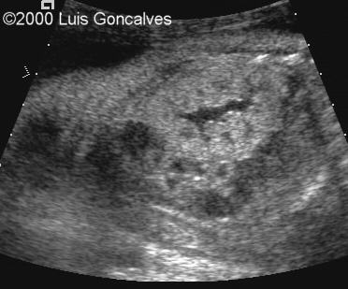
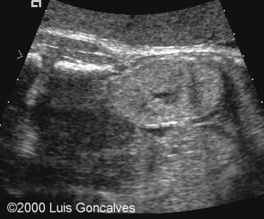
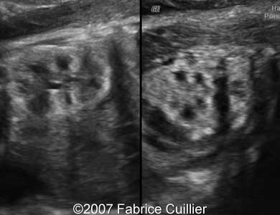
ARPKD
Rarely seen in utero
May present with family history of polycystic kidney disease
Liver, pancreas and spleen will typically also have cysts
http://sonoworld.com/fetus/page.aspx?id=539

Slide 18
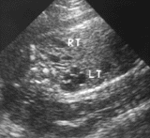
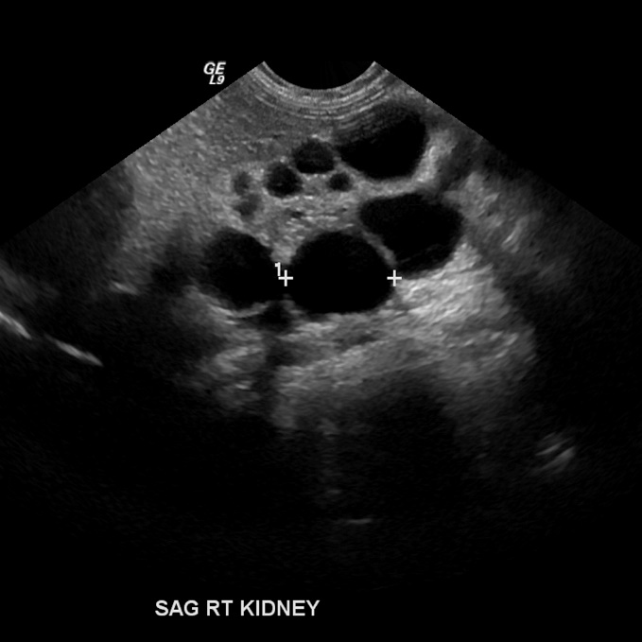
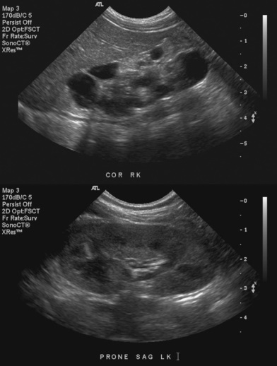
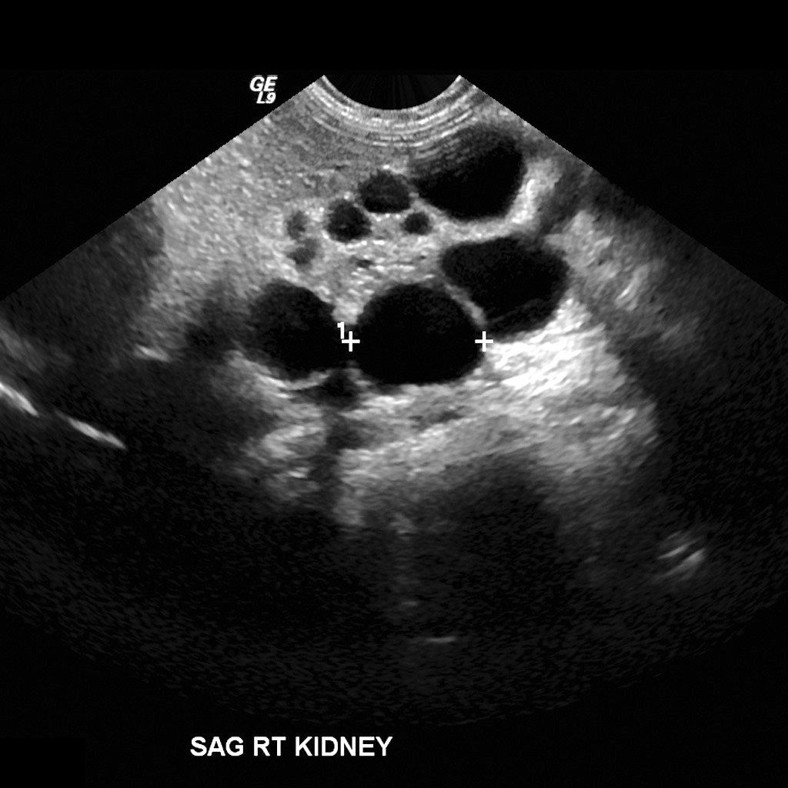
Multicystic dysplastic kidney disease
Most common form
Typically unilateral-therefore often nml fluid levels
Multiple large anechoic cysts
Kidney may vary is size

Slide 19
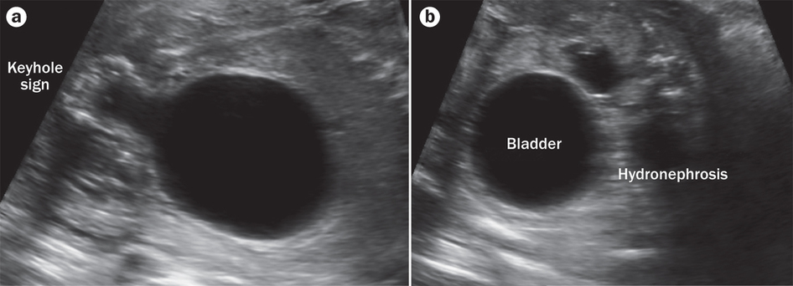
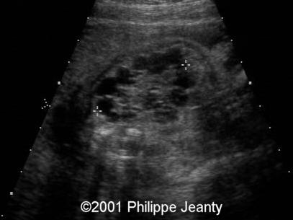
Obstructive cystic disease
Obstruction or atresia of one of the ureters extending from a duplicated renal system
Typically present with oligohydramnios
Enlarged kidneys with smaller cortical cysts seen sometimes
Bladder wall thickening
Ureteral dilatation, with tortuous course

Slide 21
Genitalia Ideas
Hermaphroditism
Both male and female genitalia are present
Hypospadia
Abnml urethral opening
Cryptorchidism
Failure of testes to descend
Hydrocele
Fluid in scrotum
Small amt is normal
Fetal ovarian cysts
Typically not serious

