Slide 1
Week 6 Review
Skeletal Dysplasia

Slide 2
Over 450 skeletal dysplasias……
4 disorders comprise 70%
Achondroplasia-Non-lethal. Resembles thanatophoric dysplasia.
Thanatophoric dysplasia-most common. Lethal.
Poly, narrow thorax, cloverleaf skull, bowed femurs,
Osteogenesis Imperfecta-Type II most severe. Fractured long bones and ribs. Little shadowing, poorly mineralized skull.
Achondrogenesis-Lethal. Poorly non-ossified spine and skull. Absent sacrum/pubis.
Abnormalities of cartilage and bone growth
Other lethal:
Hypophosphatasia-poorly mineralized bones
Short-rib polydactyly syndromes-narrow thorax, short ribs, polydactyly

Slide 3
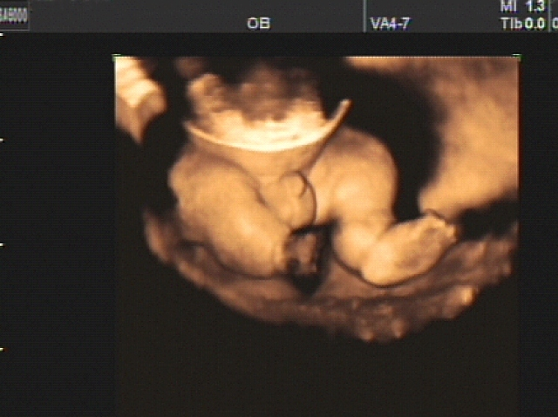
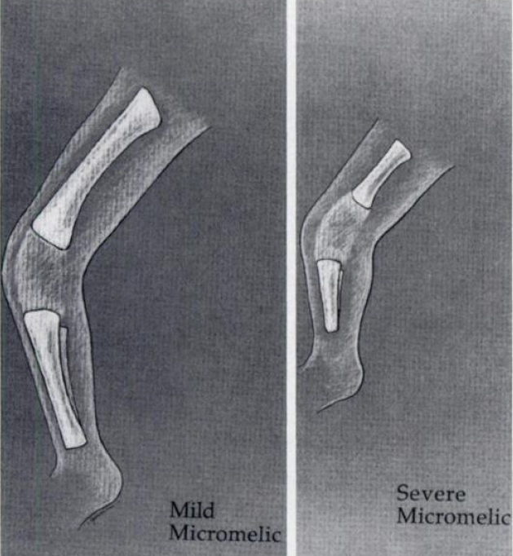
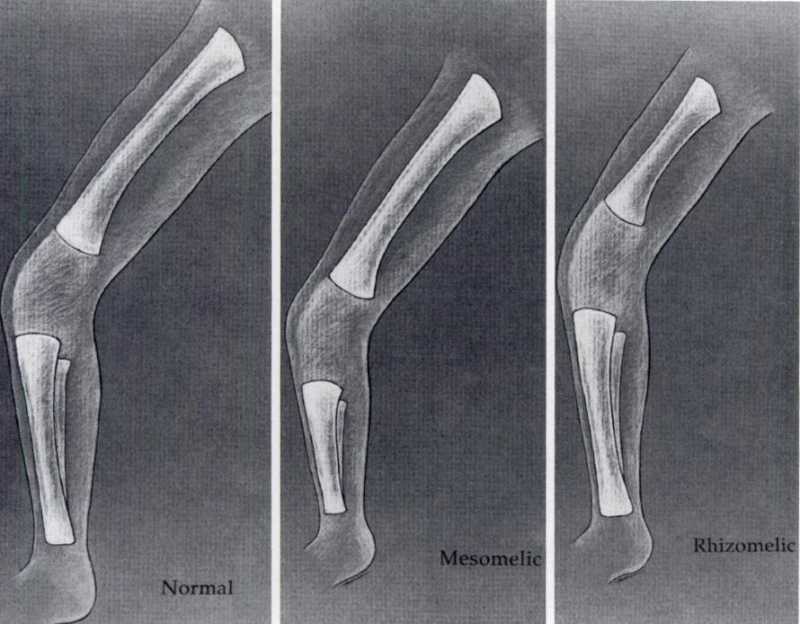
Terms:
Dysplasia: Abnormal growth
Micromelic: Shortening of the entire leg
Rhizomelia: Long bone shortening
Mesomelic: Disproportinate shortening of tib/fib

Slide 4
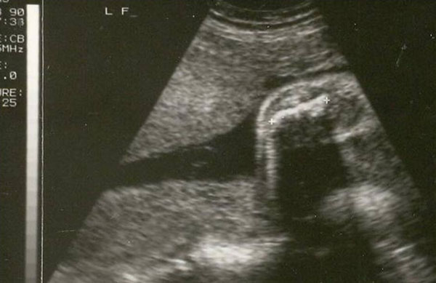
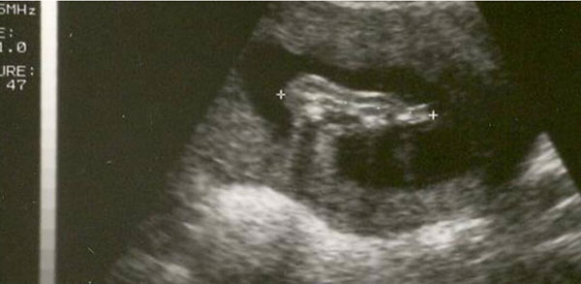
Sonographic Approach……….
FL <2 SD or <95th centile. But what else can that mean??
Normal physiologic variation, IUGR, Abnml karyotype
In a normal fetus the femur length and foot are generally equal. Growth of the foot is not affected by severe skeletal dysplasias-do a ratio and check with charts.

Slide 5
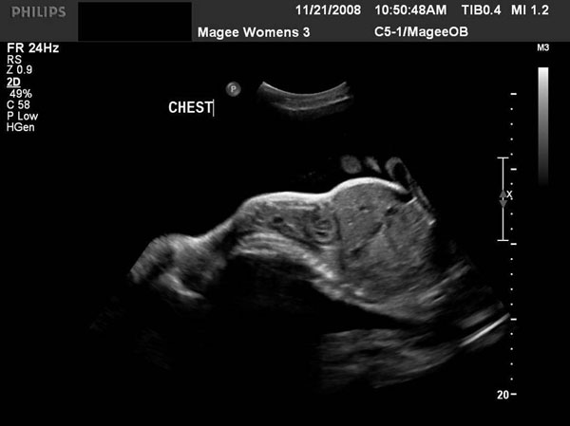
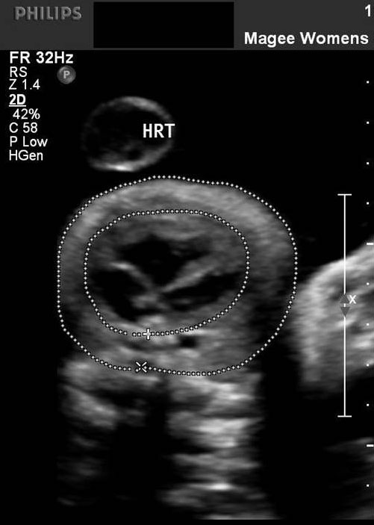
Sonographic Approach……….
Chest Circumference:
Measured at the 4ch view level
One rib should be seen
Normally a rib extends 2/3 around the thorax
Normal sized heart will take up most of the space

Slide 6
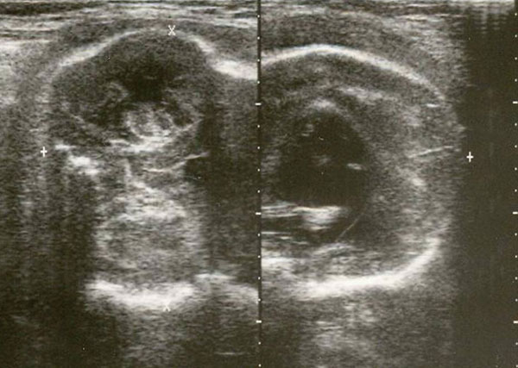
Fetal Profile
Frontal bossing
Micrognathia
Cloverleaf skull
Hypertelorism

Slide 7
Must Do:
Measure all long bones
Bowing, fracture, mineralization, size
Decreased echogenicity or weak acoustic shadowing
Measure cardiothoracic ratio
Image Head and Face
Measurements
Shape, Mineralization, Fractures. Trans/Sag images
Unusually prominent falx
Measure orbits
Look for hydrocephaly
Evaluate Spine
Mineralization and curvature
Absent or decreased visualization
Flattened vertebral bodies
Document hands and feet
Polydactyly, hitchhiker thumb and clubbing
Joint contractures

