Slide 1
Fetal Thorax

Slide 2
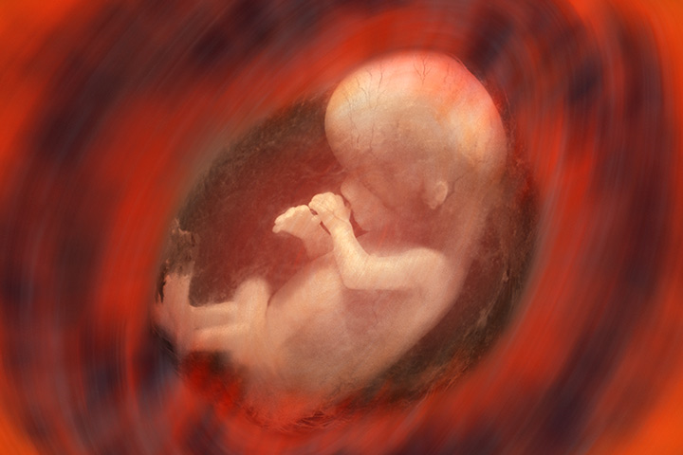
Embryology
The survival of the fetus in the ex utero environment is dependent on maturity of the lungs.
Immature lungs younger than 24 weeks, not viable.

Slide 3
Lungs / amniotic fluid
Ultrasound does not assess maturity, but color flow is able to show the vasculature pattern.
ultrasound provides the ability for the sonographer to check echogenicity of the lungs, if lungs are compressed, or evaluate chest cavity
fluid is from the amniotic cavity, tracheal glands, and lungs.

Slide 4
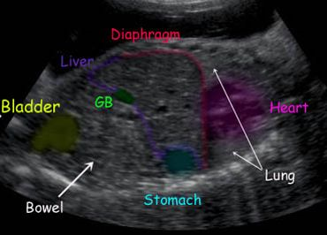
Anatomical structures
Clavicle- upper margins
Ribs are lateral margins
Lungs superior to diaphragm
Lungs- lateral borders of the heart
Diaphragm- lower margin

Slide 5
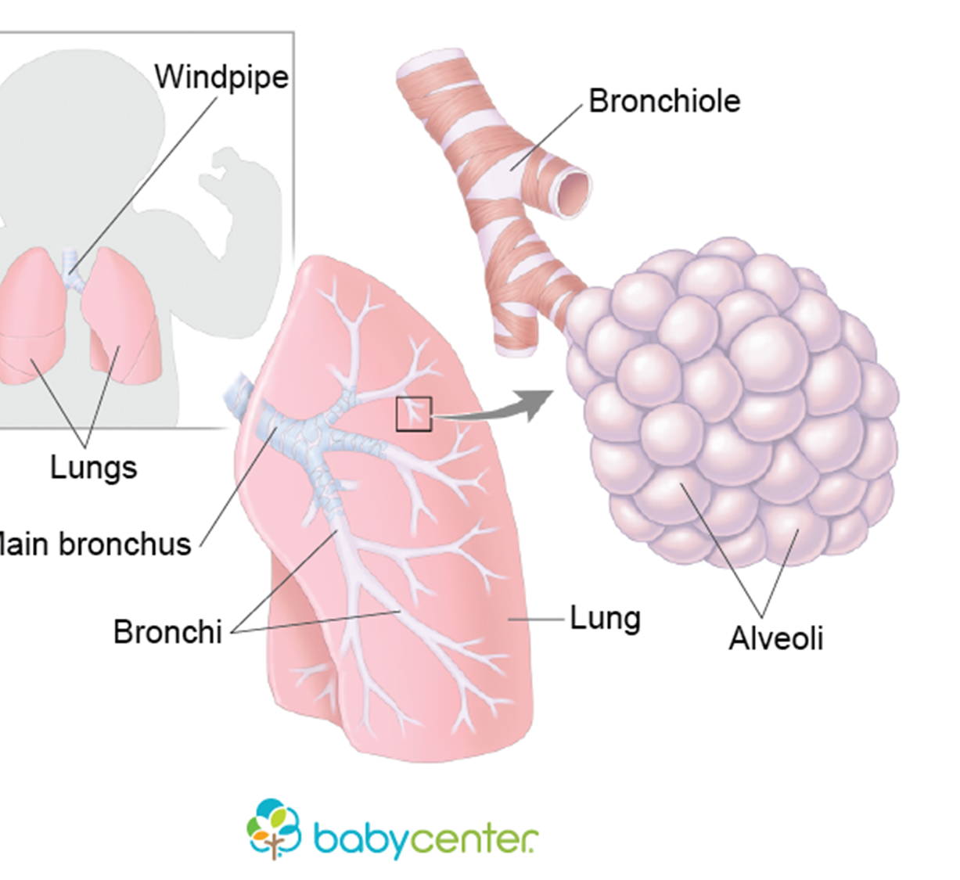
Pulmonary Development
Mesenchymal bud from the trachea is apart of the division and budding development: bronchi, bronchioles, alveolar ducts, alveoli
16-20 weeks: Bronchi formed
16-24 weeks: more Bronchi’s develop and complexity of air spaces.
Post 24 weeks: Epithelia cells lining the air spaces flatten.
This development promotes gas exchange after birth.

Slide 6
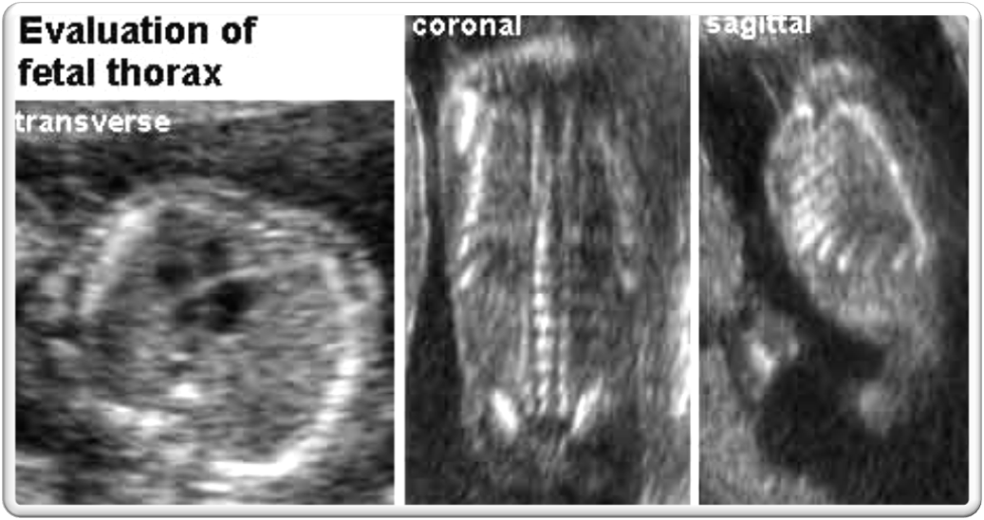
Evaluate Thoracic cavity
CHEST SIZE, SHAPE, SYMMETRY.
SIZE SHOULD BE SLIGHTLY SMALLER THAN ABDOMINAL CAVITY.
PULMONARY TEXTURE
MEDIASTINUN BETWEEN THE LUNGS

Slide 7
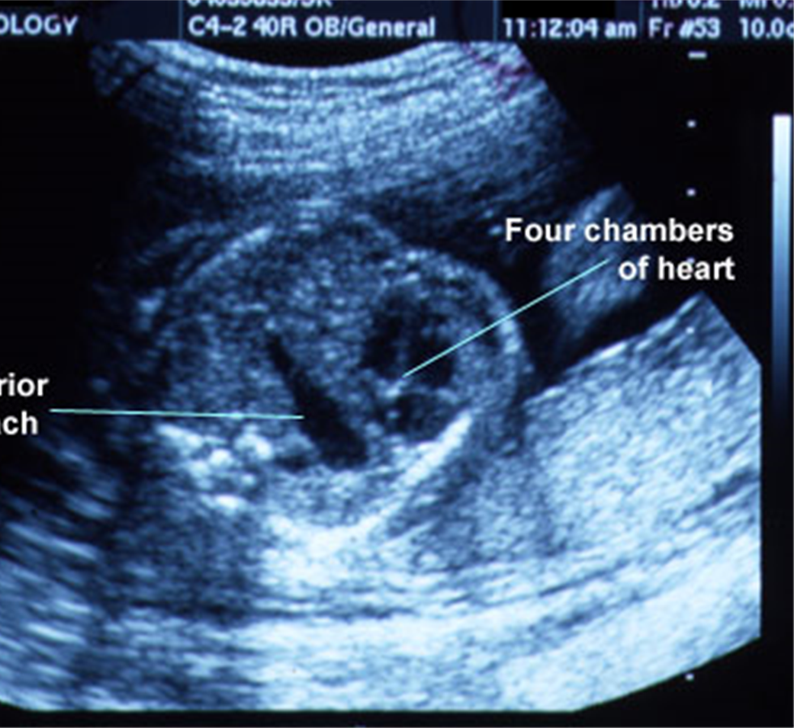
Methods
Chest circumference: Transverse plane at the level of the four-chamber heart.
Predict Pulmonary Hypoplasia:
Chest area-heart area x 100/ chest area.
Significant narrow diameter= asphyxiating thoracis dystrophy.
Associated with thanatophoric dwarfism. (short limbs)
(Death within first few hours after birth.)

Slide 8
Normal Landmarks of diaphragm
Between the thoracic and abdominal cavity and forms between 6th and 14th week gestation.
Normal: curvilinear running anterior to posterior.
Caudal to diaphragm: fetal stomach/ liver
Cephalad to diaphragm: lungs and heart
Not in usual location, red flag. Potential diaphragmatic defect

Slide 9
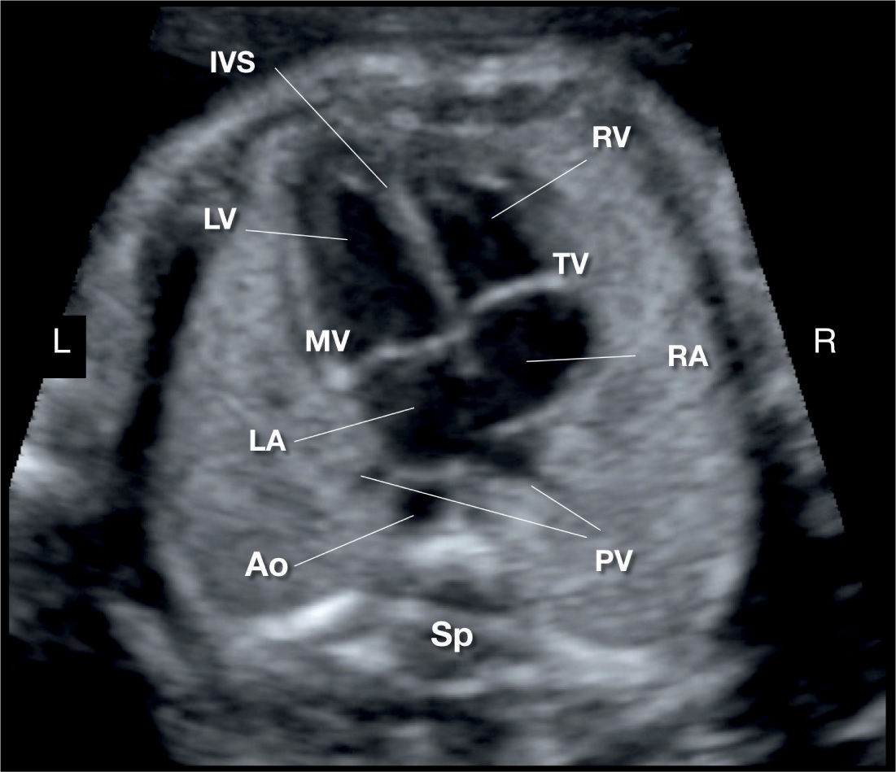
position
mediastinum
Majority of heart-midline and left chest
Apex of heart- toward spleen
Base of heart- horizontal to diaphragm.
Be cognizant of heart location- abnormal position can indicate chest mass, pleural effusion, cardiac malformation.

Slide 10
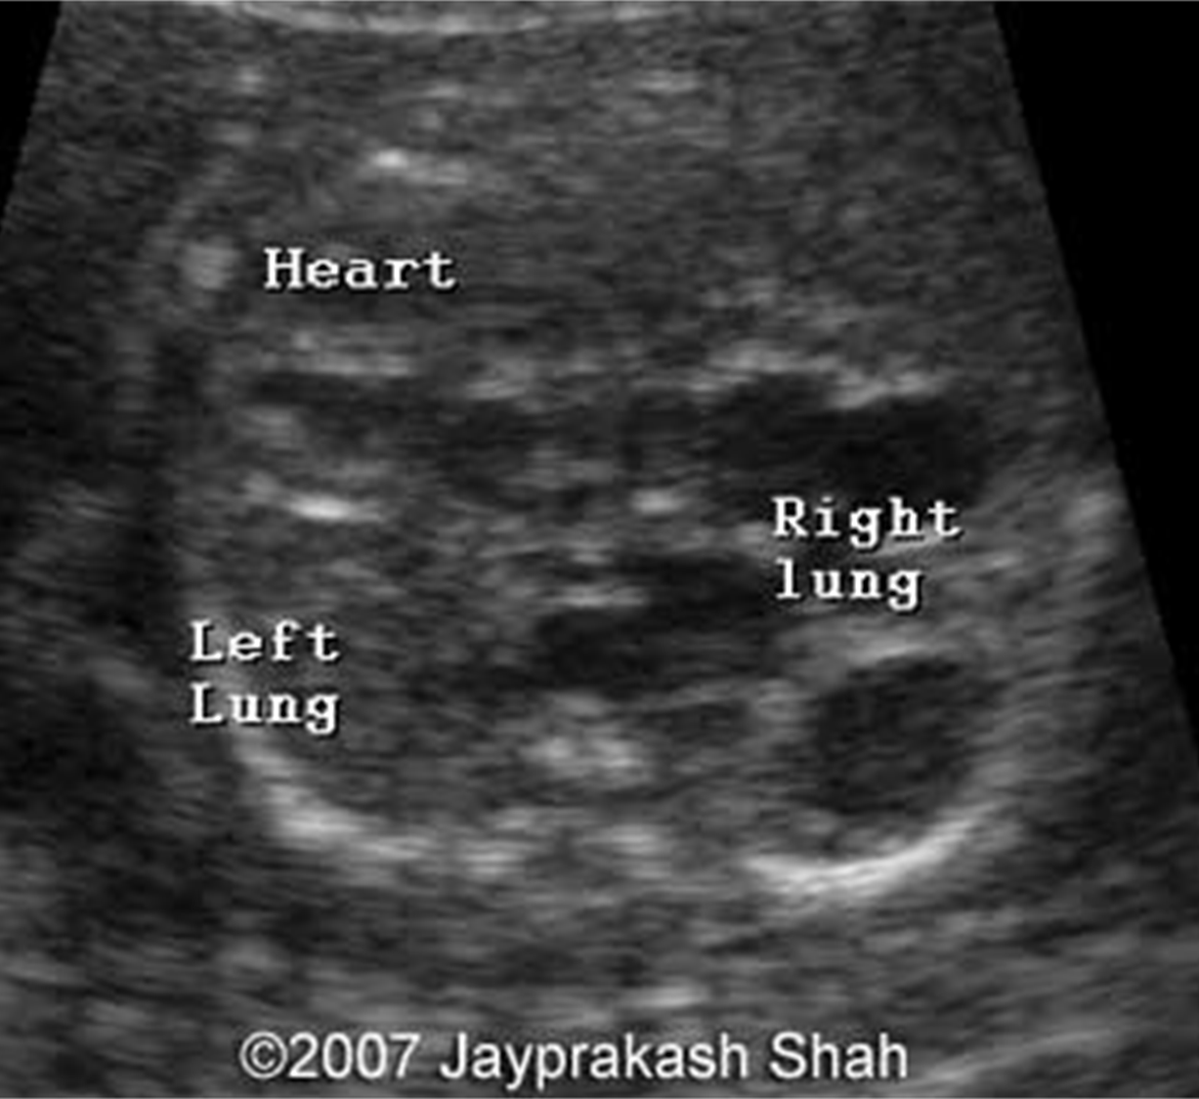
Lung tissue/Texture
HOMOGENOUS
EARLY IN GESTATION-SIMILAR OR LESS ECHOGENIC THAN tHE LIVER.
Moderate echogenicity
lUNGS INCREASE in ECHOGENICITy AS FETUS GETS OLDER.
COMPLICATONS DETERMINING ECOGENICITY: OVERLYING RIBS OR ACOUSTIN ENHANCEMENT PRODUCED BY BLOOD IN THE HEART.
Distinguish type of lesion
Extrapulmonic
Diaphragmatic hernia
Intrapulmonic
Congenital cystic adenomatoid malformation

Slide 11
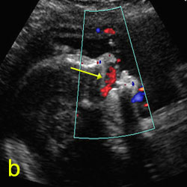
rESPIRATION
2ND AND 3RD TRIMESTER –PROMINENT TO VISUALIZING.
MATURE FETUS SPENDS 1/3 OF ITS TIME BREATHING.
EVAL BREATHING FOR AT LEAST 20 SECS. IF NO MOVEMENT USE COLOR DOPPLER AND LOCATE FETAL NOSTRILS. THIS WILL HELP DETECT FETAL ACTIVITY.
Seesaw movement of chest and abdomen
Should see every 20-30 minutes in the second and third trimester

Slide 12
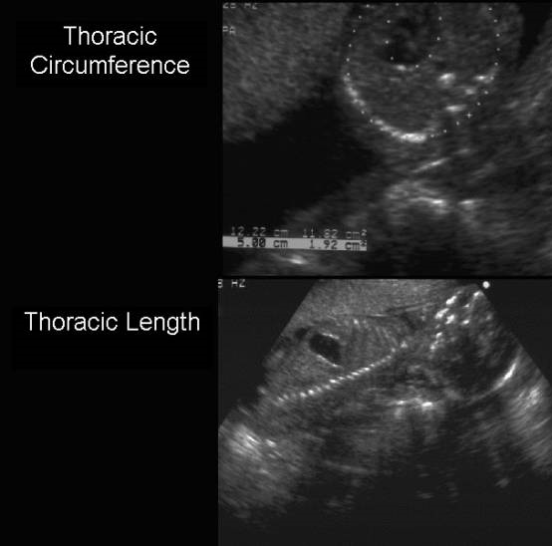
Methods to measure
-Measure of thoracic circumference predicts small chest cavity and secondary pulmonary hypoplasia.
-3d lung measure includes length, area, and volume.
-Right lung volume is slightly greater than the left lung.

Slide 13
Thoracic Circumference
Heart should occupy approx 1/3 of the fetal thoracic cavity
Lung should occupy approx 2/3
Take circumference measurement in the same plane as the 4 chamber

Slide 14
Method to exclude cardiac involvement
Fetal echocardiography
Evaluate the intact of the diaphragm to exclude diaphragmatic hernia.

Slide 15
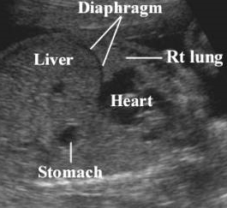
ABNORMALITIES
LUNGS MAY HAVE LESIONS THAT ARE SOLID, CYSTIC, OR COMPLEX.
USUALLY ABOVE LEVEL OF DIAPHRAGM
TO EXCLUDE PLEAURAL MASSES- EVAL TEXTURE AND HOMOGENICITY.
EVALUATE POSITION OF HEART, ORIENTATION OF CARDIAC AXIS, MEASUREMENT OF THORACIC CIRCUMFERENCE, NORMAL CARDIAC AXIS.
NORMAL CARDIAC AXIS: AVERAGE 45 DEGRESS ( RANGE: 22 TO 75 DEGREES.)
ANY DEVIATION FROM THIS RANGE, CONSIDER INTRATHORACIC MASS.

Slide 16
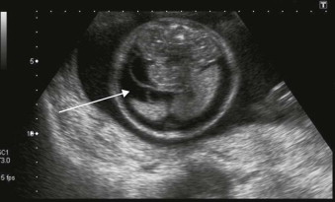
Lung masses
May indicate abnormalities with cardiac rhythm and fetal hydrops.
there is a compression of the venous return and cardiac failure.
Pleural effusion commonly found with lung masses.
Has poor effects on lung development
Misplaced structures such as the heart or mediastinum
Lungs may be compressed/ damaged

Slide 17
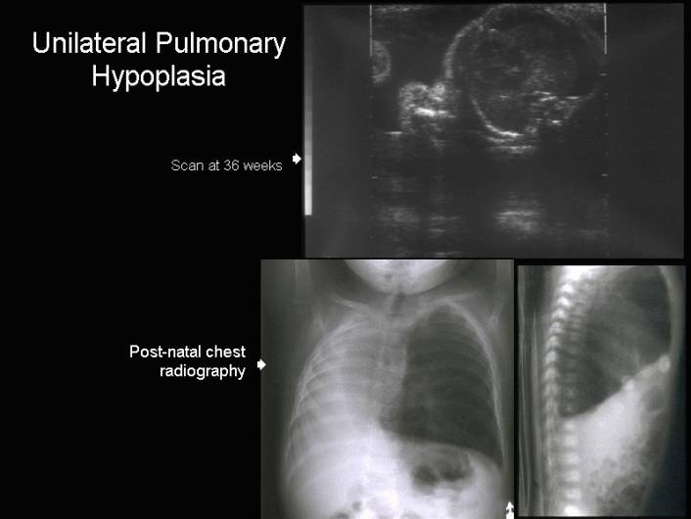
Small thoracic cavity
Lead to severe oligohydramnios / polyhydramnios
Abnormal Balance between tracheal and airway pressure / fluid volume
Breathing habits are not being practiced by the fetus
If polyhydramnios, decrease in lung cells, airways, alveoli, organ size, weight, increase amniotic fluid, small lungs. Oligohydramnios- decrease Amniotic Fluid
Caused by structural or chromosomal abnormality

Slide 18
Pulmonary Hypoplasia
Small lung volume
Causes
Oligohydramnios/anhydramnios
Mass effects
Congenital anomalies-esophageal anomalies
Earlier occurrence=worse prognosis
Sonographically
Small
Echogenic lungs
Small chest circumference
Thick placenta.
Thick placenta may be found in maternal diabetes mellitus, Rh immunization, non-immune hydrops or in normal pregnancies.
Thin placenta.
Pregnancies with non-immune hydrops complicated by IUGR, pre-eclampsia or diabetic angiopathy may result in a thin placenta.
Polyhydramnios may also result in thinning of a normal or thick placenta.
Hepatomegaly - Table of normal liver length.
Polyhydramnios or oligohydramnios.
Dilatation of the umbilical vein.
A detailed survey of the fetus is essential to determine the underlying cause.
Doppler finding in non-immune hydrops.
REFERENCES
Hutchinson AA, Drew JH, Yu V et.al. Nonimmunologic hydrops fetalis: A review of 61 cases. Obstet Gynecol 1982;59:347.
Levy R, Weissman A, Blomberg G et.al. Infection by parvovirus B19 during pregnancy: A review. Obstet Gynecol Survey 1997;52:254-259.
Fourouzan I. Hydrops fetails: Recent advances. Obster Gynecol Sur 1997;52(2):1997.
Notes:
Pulmonary hypoplasia results from an abnormal decrease in lung size and weight, which doesn’t allow for the proper growth of the lungs causing them to be undeveloped.
Most often this occurs as a result of oligohydramnios and definitely it occurs with conditions of anhydramnios when it lasts over a period of time, but it can also occur when a mechanical process occurs in which the fetal thorax is impinged upon, like by a mass-which we will learn about shortly, or maybe when the fetal thorax is not allowed to reach its full potential in size as what happens with some skeletal dysplasias.
Typically when we see pulmonary hypoplasia its bilateral, but may be unilateral, like again when a mass occupies the pulmonary bed on one side.
Unfortunately infants with pulmonary hypoplasia have a poor prognosis, unless it occurs later in the pregnancy. In other words the earlier the occurence, the worse typically the outcome.
Sonographically we would expect to see a smaller lung volume, and youre probably wondering how that’s achieved. Typically the thoracic circumference can be obtained by measuring the circumference with our calipers and charting this number out based on gestational age.
Also look for small echogenic lungs, that are located laterally to the four chamber view in the fetal thorax.

Slide 19
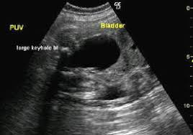
What can lead to pulmonary hypoplasia?
Bilateral renal agenesis
Bilateral renal disease
Severe renal obstruction
Posterior urethral valve
Unilateral renal agenesis
Severe obstruction of trachea or esophagus
Inability to swallow formations
Intrinsic or extrinsic
Macroglossia
Small thoracic cavity

Slide 20
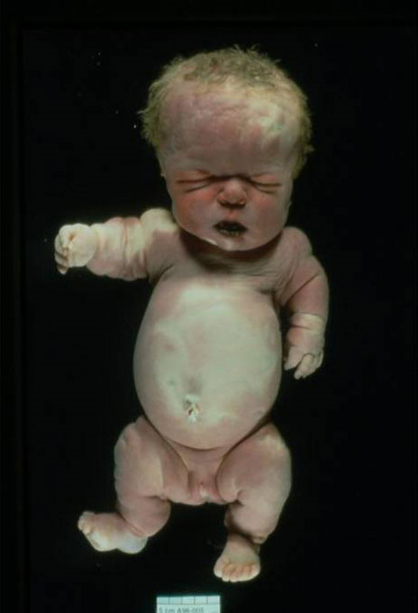
Cardiac defects that can occur simultaneously with pulmonary hypoplasia
Skeletal dysplasia (Dwarfism)
Central nervous disorders
Chromsomal trisomy’s (13, 18, 21)

Slide 21
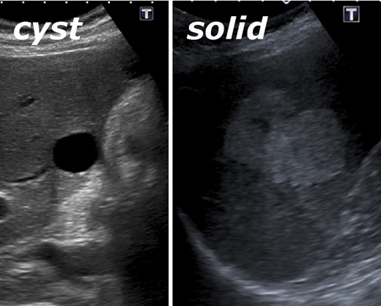
Cystic or solid
Determine number of cystic structures
Identify if mediastinal visualized or absent
Assess lung size
Fetal hydrops present?
Exclude cardiac masses
Any fetal anomalies?

Slide 22
Rare anomaly/ differential
Unilateral pulmonary agenesis or hypoplasia.
Differential diagnosis: absent lung with every fetus with mediastinal shift, chest mass, when in cahoots with defects of esophageal abnormalities.

Slide 23
Abnormality of diaphragm
CDH- Congenital Diaphragmatic Hernia: abdominal viscera herniation into the chest.
10th to 12th week gestation, the gut coming back into the abdominal cavity comes back and the primitive diaphragmatic structure that is not fully formed herniates into the thorax.
There is a fusion of four structures that must be developed to minimize defects.
1. septum transversum (future central tendon)
2. pleuroperitoneal membrane
Dorsal mesentery of the esophagus (future crura)
Body wall; primitive diaphragm should be intact by end of the 8th week.

Slide 24
CLUES OF DIAPHRAMATIC HERNIA
SOLID MASS IN THE CHEST.
PERISTALsIS IN THE HERNIATED INTESTINES
LUNG AND MEDIASTINAL MASSES, CYSTIC ADENOMAOID MALFORMATION CAN BE HARD TO DIFFERENTIATE FROM DIAPHRAGmATIC HERNIAS.
(USE PERITONEAL ORGANS AS YOUR LANDMARK TO DIFFERENTIATE THE TWO. )

Slide 25
Summary
Mass effects
Displace cardiac structures
Evaluate cardiac axis
Assess cardiac size
Scan for fluid collections
Notes:
So in closing, Anything abnormal in the thorax, has the potential to displace lung and cardiac structures so its important to be aware of potential causes for a cardiac shift.
Again this harbors on the basic knowledge of being aware of cardiac size and axis, these are fundamental points that every sonographer must be aware of during a fetal cardiac study.

Slide 26
Summary
Homogenous tissue surrounding heart
Evaluate cardiac axis
Assess cardiac size
Scan for fluid collections
Is the diaphragm contiguous
Great Vessels where they should be
Respiratory Variations
Notes:
So in closing, Anything abnormal in the thorax, has the potential to displace lung and cardiac structures so its important to be aware of potential causes for a cardiac shift.
Again this harbors on the basic knowledge of being aware of cardiac size and axis, these are fundamental points that every sonographer must be aware of during a fetal cardiac study.

Slide 27
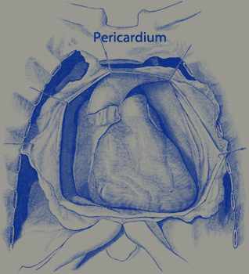
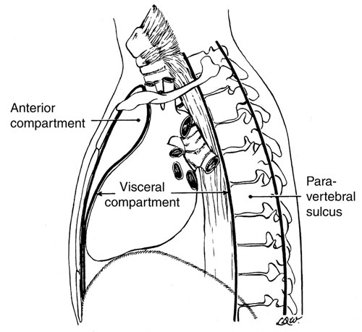
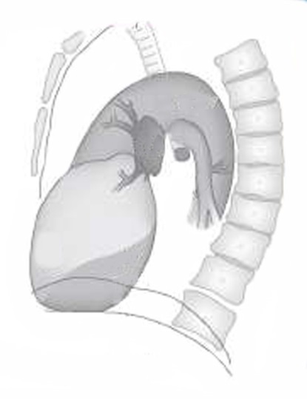
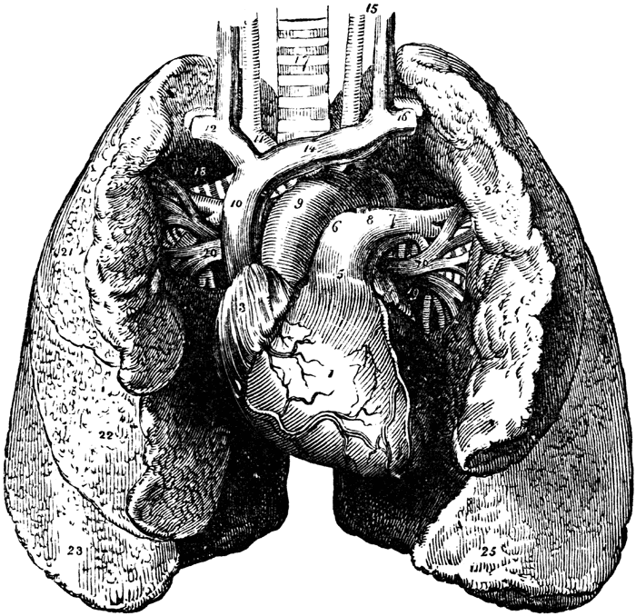
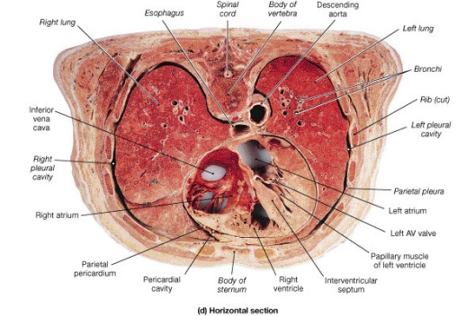
Summary Fetal Chest

Slide 28
References
Hagen-Ansert, Sandra L. "Fetal Thorax." Textbook of Diagnostic Sonography, 2018 ed., Hagen- Ansert, 2018, pp. 1406-1418, www-clinicalkey-com.kaiserpermanente.idm.oclc.org/#!/content/book/3-s2.0-B9780323353755000704?indexOverride=GLOBAL. Accessed 26 Oct. 2019.
https://images.app.goo.gl/LtDg24VB1iQNeXBF6
https://images.app.goo.gl/aeiKYmBReh9xnMog9
https://www.bing.com/images/search?view=detailV2&ccid=y0eqELen&id=1566D4D8F976DBA24EA516BBBDD187A03FA975DF&thid=OIP.y0eqELenfmwhqVmVqjJmzQHaFs&mediaurl=https%3A%2F%2Fsonoworld.com%2Fimages%2FFetusItemImages%2Fimages2007%2FRespiratory%2FCAM_I_Shah%2FFig-1.jpg&exph=300&expw=390&q=fetal+bilateral+lungs+ultrasound&simid=607993907438227215&selectedindex=92&adlt=demote&shtp=GetUrl&shid=a9a1fc62-365b-44c8-8717-8d4239691407&shtk=SW1hZ2UgMyA6IDJEIHVsdHJhc29ub2dyYXBoeTsgMTggd2Vla3Mgb2YgcHJlZ25hbmN5LiBQYXJhc2FnaXR0YWwgc2NhbiBzaG93aW5nIGN5c3RpYyBzdHJ1Y3R1cmVzIC4uLg%3D%3D&shdk=Rm91bmQgb24gQmluZyBmcm9tIHNvbm93b3JsZC5jb20%3D&shhk=LVXQ2Cl0wm9Fy36cZq%2BEYHAJ5KKX3PC6zAtQPMkGHgo%3D&form=EX0023&shth=OSH.3DfKuEg3NEj8EEW6Fpvm4Q

Slide 29
References
https://www.bing.com/images/search?view=detailV2&ccid=W7Z6ajcY&id=798DF6AE6F81ED0244DDFC852741903910F58AD2&thid=OIP.W7Z6ajcY1cxjoxD17Yv3PwHaHa&mediaurl=https%3A%2F%2Fsonoworld.com%2FClient%2FFetus%2Fhtml%2Fdoppler%2Fcapitulos-html%2Fimagnes-cap-13%2Fcleft-02.jpg&exph=250&expw=250&q=FETAL+DOPPLER+ON+NOSTRILS&simid=608021227746230915&selectedindex=42&adlt=demote&shtp=GetUrl&shid=5964a736-49fd-401c-bcb4-a28fb777e3b3&shtk=RG9wcGxlciBpbiBPYnN0ZXRyaWNz&shdk=Rm91bmQgb24gQmluZyBmcm9tIHNvbm93b3JsZC5jb20%3D&shhk=4gcj3FaXp%2BDTjskEskMcAC8zjZfHoupwQyj8%2F6Kuwak%3D&form=EX0023&shth=OSH.zXVrmVT6bsKLH9geuGmdFQ
https://images.app.goo.gl/RNCgy3pRFaRwan6X8
https://www.bing.com/images/search?view=detailV2&ccid=%2FWlthzWy&id=3C62A1FB9E02824B690903695B5DE7AEA4FD8156&thid=OIP._WlthzWyqV39GLSpAn6AiAHaD2&mediaurl=https%3A%2F%2Fsonoworld.com%2Fclient%2Ffetus%2Fhtml%2Fchapter-09%2Fskeleton_files%2Fimage006.jpg&exph=240&expw=461&q=thoracic+abdomen+ratio+for+fetal+ultrasound&simid=608017461040254677&selectedindex=17&adlt=demote&shtp=GetUrl&shid=6df69e4f-d80a-4b4b-8488-811d40f76b44&shtk=U2tlbGV0b24gLSBESUFHTk9TSVMgT0YgRkVUQUwgQUJOT1JNQUxJVElFUyAtIFRIRSAxOC0yMyBXRUVLUyBTQ0FO&shdk=Rm91bmQgb24gQmluZyBmcm9tIHNvbm93b3JsZC5jb20%3D&shhk=BugKH4QSSLaDpx8KoXnlVBz5CNL95v%2BpV32ZxG3OCO4%3D&form=EX0023&shth=OSH.s1Q%252Bpw%252FeH4mnOu%252Fbt1F%252FAQ
https://images.app.goo.gl/itr3RuHQDxjGQvDJ6
https://images.app.goo.gl/NbVUp4M1ArZAfzz27

