Slide 1
PA Fluoroscopy
Digital Fluoroscopy

Slide 2
Terminology
Matrix – grid made of pixels
Pixel – picture element
SNR / CNR
CCD – Charge coupled device
PACS – Picture Archival and Communication System
HIS / RIS
HIPAA

Slide 3
Terminology
Flat panel detector
Contrast resolution / Dynamic range
DICOM gray-scale function
WW/WL function
DSA
Sampling frequency
DEL (detector element size)

Slide 4
Matrix
Every image is made of small squares called pixels (picture element)
Within a specified field size, an increased matrix will equate to a more detailed image
Let’s say we have a 9” square field
If the field has a matrix of 16 x 16, the pixels are large
If the same field has a matrix of 512 x 512, the pixels are considerably smaller

Slide 5
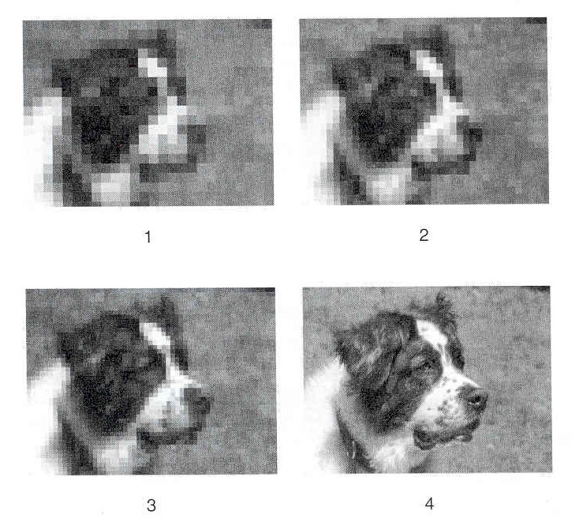
http://www.picturemosaics.com/gallery/zoom.php?i=30&rows=4&page=2&term=

Slide 6
Charge Coupled Device
Would be used instead of a TV camera at the output phosphor
Mounted on the output phosphor, the light is transferred through fiberoptics
The sensitive layer of the CCD is composed of crystalline silicon

Slide 7
Charge Coupled Device (cont)
When the silicon is illuminated, an electrical charge is generated
Electrical charge is put through the ADC (analog-to-digital converter) then sent to the computer

Slide 8
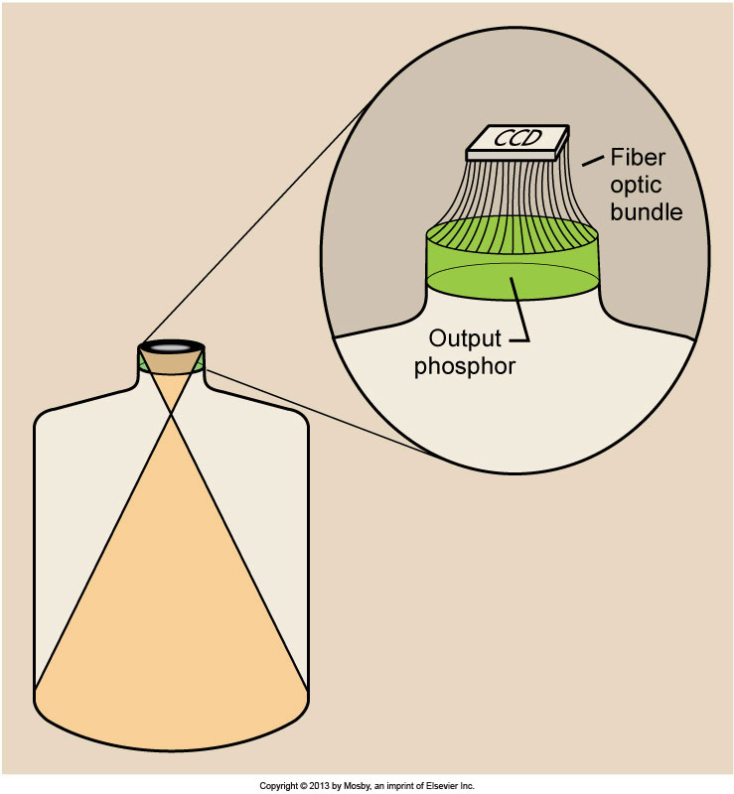
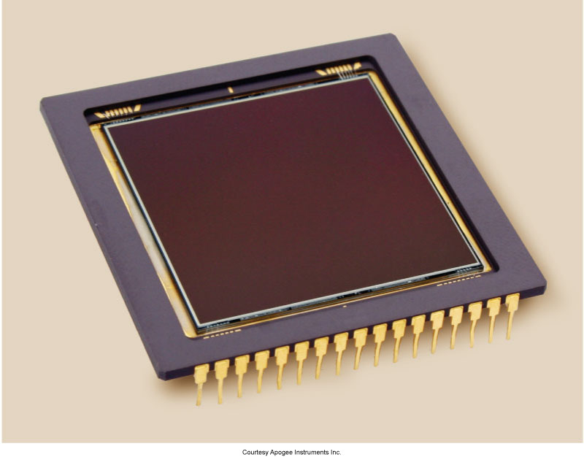

Slide 9
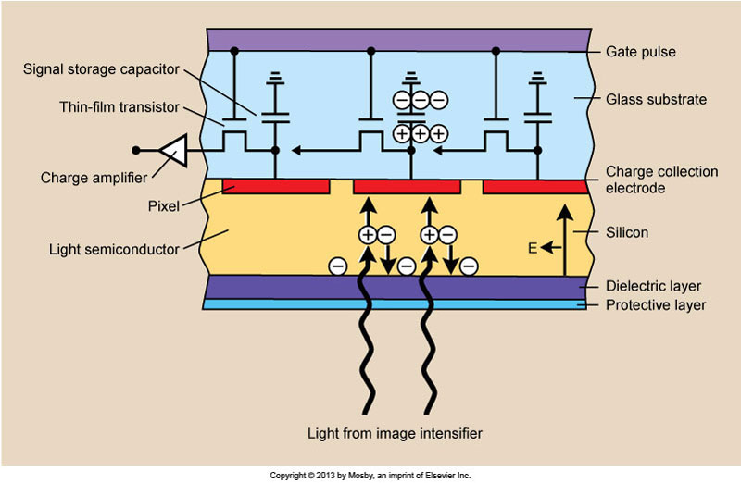

Slide 10
Charge Coupled Device (cont)
The CCD contains pixels arranged in a matrix
Each pixel is sampled and manipulated to produce a digital image
No lag or blooming
No spatial distortion (pincushion)

Slide 11
Charge Coupled Device (cont)
No warm up time
Lower patient dose
Image quality depends on the matrix of the CCD

Slide 12
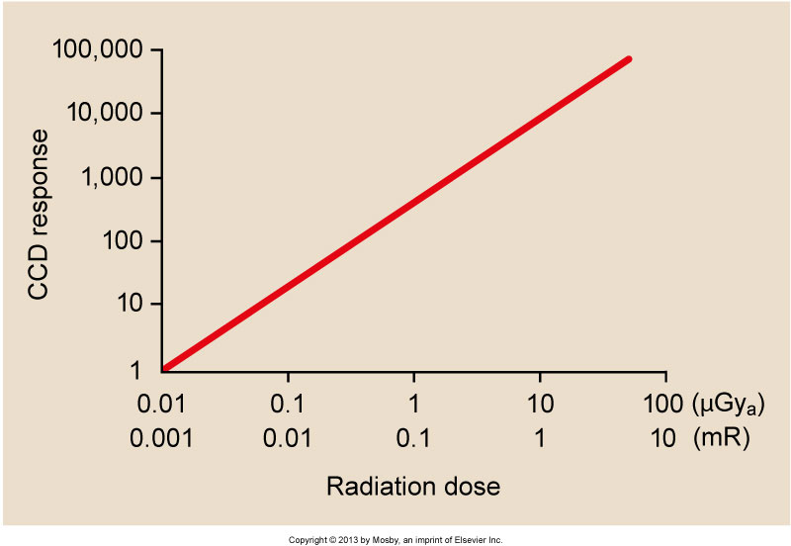

Slide 13
Flat Panel Detector
Flat Panel Image Receptor (FPIR)
Used in place of an image intensifier
Composed of CsI / a-Si detector elements (DEL)
Each DEL represents a pixel
Size of the pixel will help determine spatial resolution
Pixel size = FOV divided by matrix

Slide 14
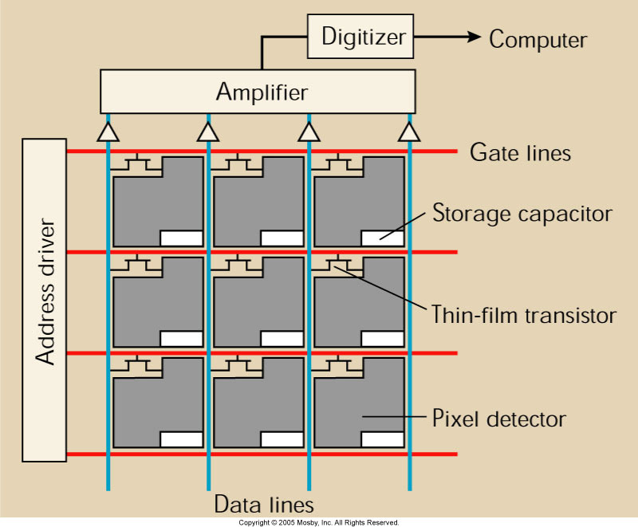
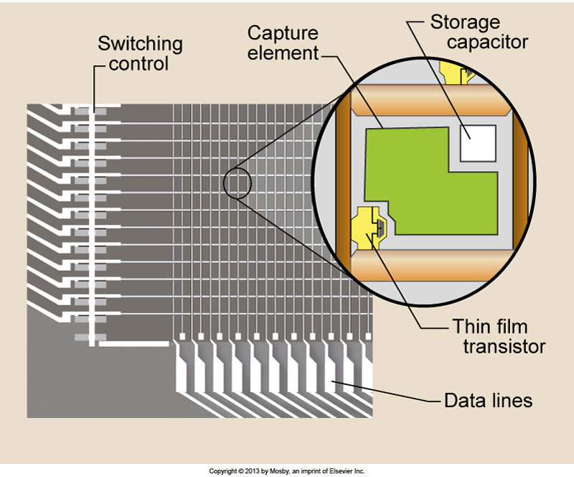

Slide 15
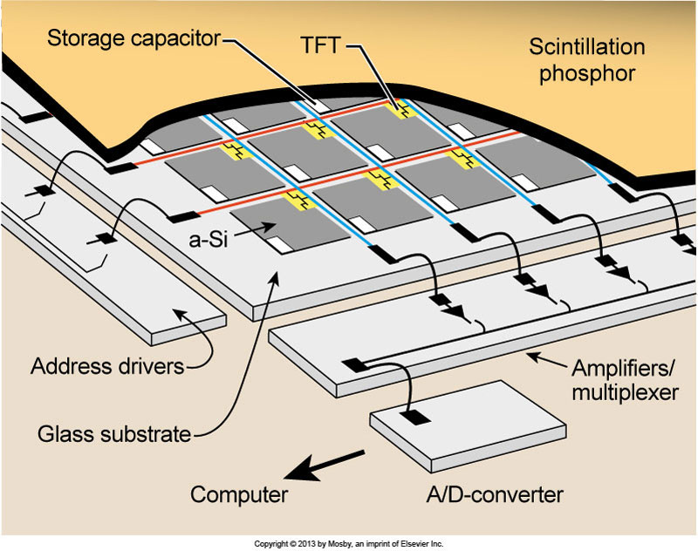

Slide 16
FPIR
Digital fluoroscopy operates in radiographic mode
Tube current measured in hundreds of mA instead of 1 to 5 mA
Images are obtained in a manner called pulse-progressive fluoroscopy
Imaging rates between 1 and 10 frames per second

Slide 17
FPIR (cont)
Exposures can be continuously varied for dose reduction
Each time the flat panel is exposed, it is read immediately and the image is projected until the next image is acquired
X-ray generator must be capable of switching on and off very rapidly

Slide 18
FPIR (cont)
Interrogation time is the time required for the x-ray tube to be switched on and reach selected levels of kVp and mA
The time required for the x-ray tube to be switched off is the extinction time
HF generators are used to keep interrogation and extinction times (total on/off cycle) to less than 1 ms

Slide 19
FPIR (cont)
The fraction of time the tube is energized is the duty cycle
The next graphic shows the x-ray tube is energized for 100 ms every second
This represents a 10% duty cycle
Can result is significant dose reduction

Slide 20
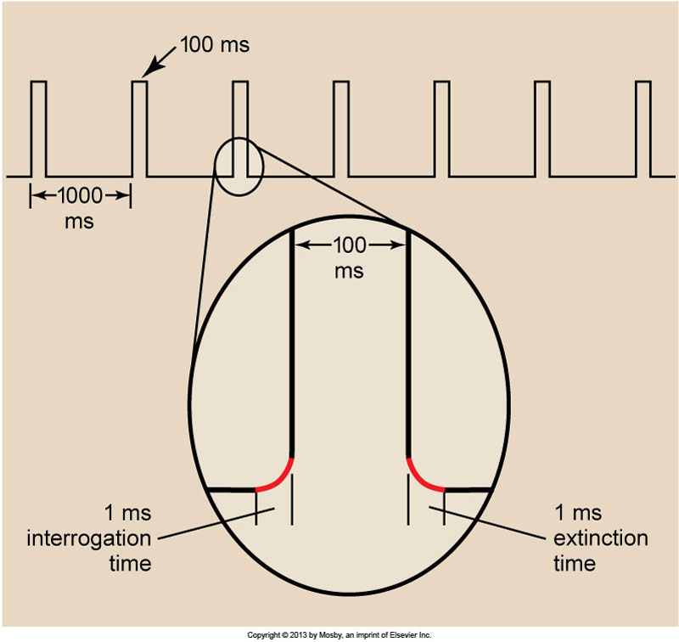

Slide 22
FPIR Quality
Higher DQE than CCD
Distortion-free images
Improved contrast resolution
The ability to distinguish many shades of gray from black to white
Grayscale (dynamic range)
A rectangular image area can be matched with a rectangular display

Slide 23
Conventional vs. Digital
Typical imaging chain in conventional fluoroscopy
X-ray tube is below table
Light from x-ray photons are “intensified” through the image intensifier
Light at the output phosphor is split between a TV monitor and a recording device

Slide 24
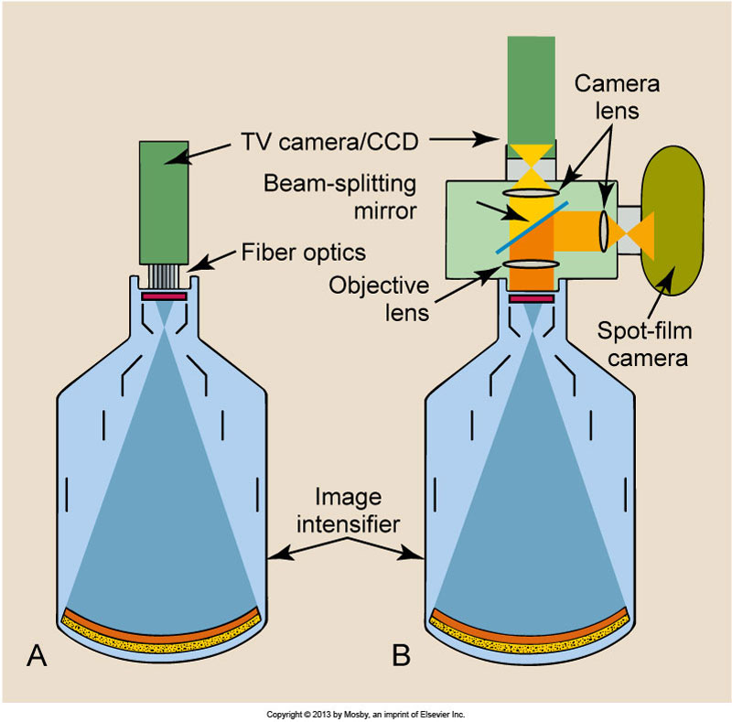
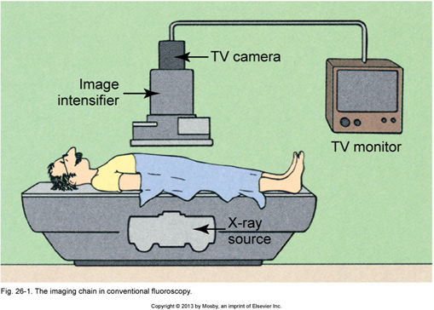

Slide 25
Conventional vs. Digital
Typical components of a digital system
Instead of a TV camera attached to the output phosphor, a CCD or flat panel is used
A computer is used to allow manipulation of images
Brightness of the image is based on the pixel values

Slide 26
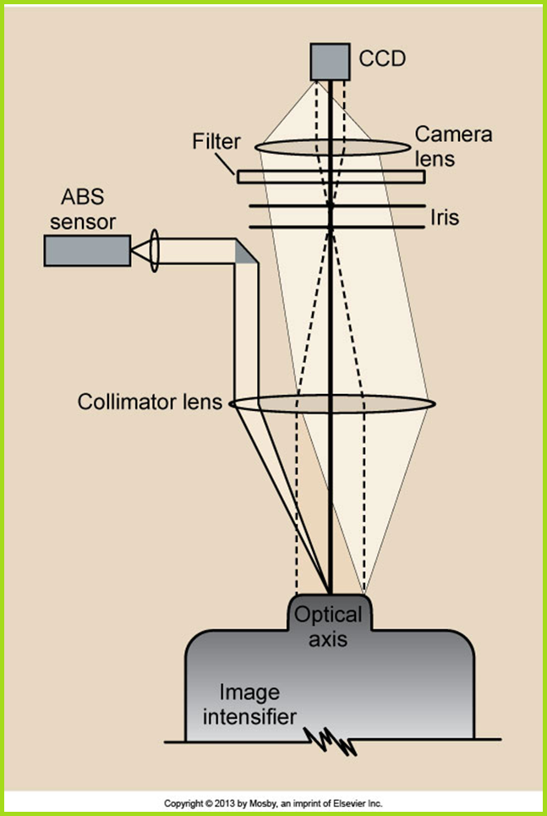
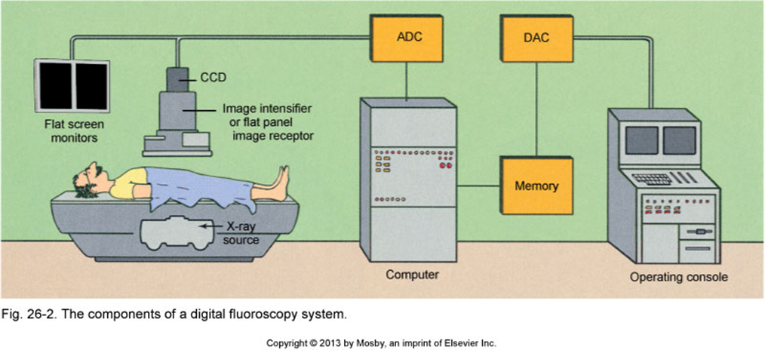

Slide 27
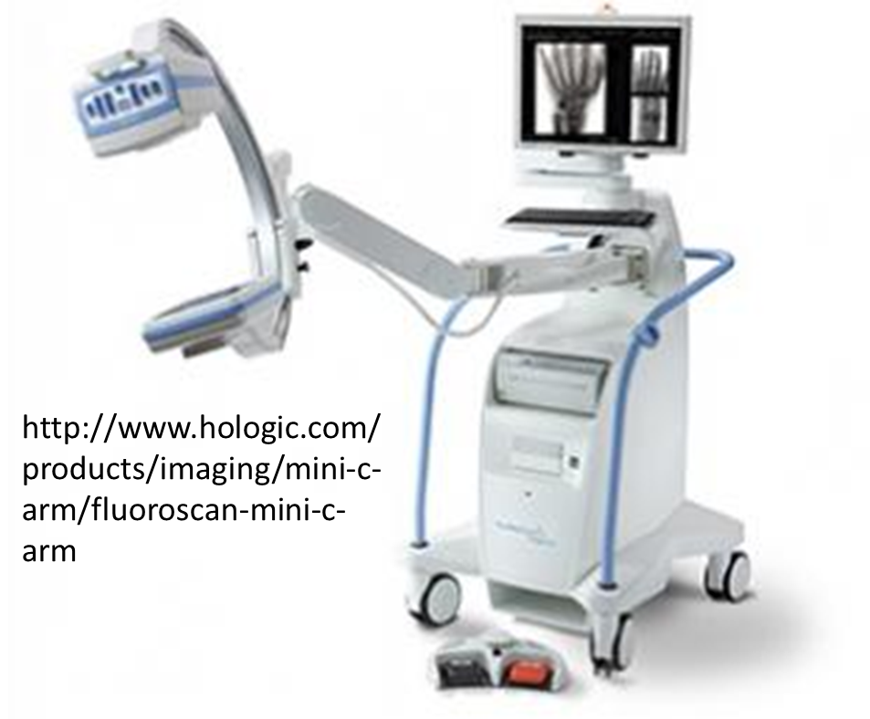
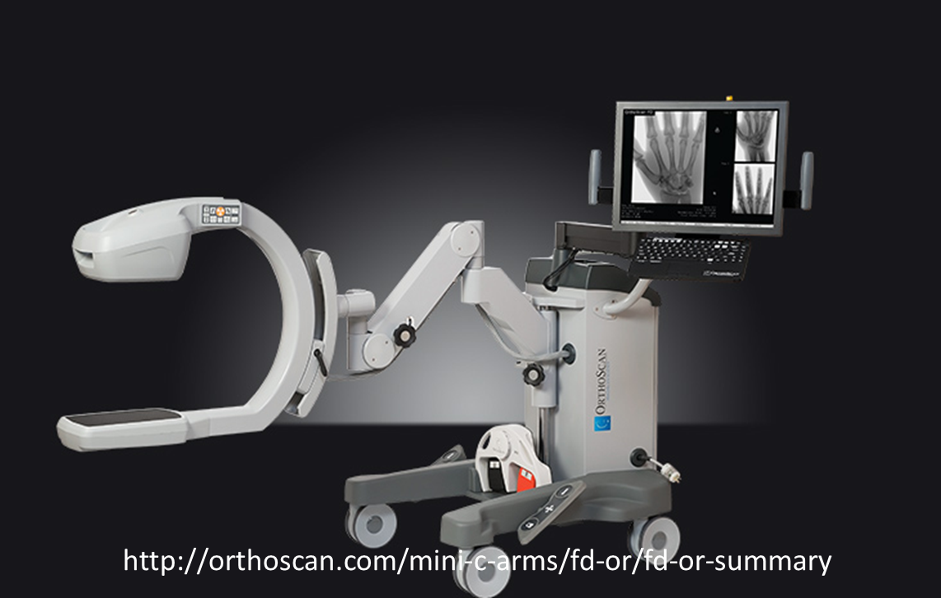

Slide 28
SNR / CNR
SNR – Signal to Noise Ratio
Signal from the unit scaled against inherent noise of the system
1000:1 is needed in DF

Slide 29
SNR / CNR (cont)
CNR – Contrast to Noise Ratio
Relationship of signal intensity differences between two regions scaled to image noise
Increased CNR increases perception of distinct differences between two areas
Both pertain to video display

Slide 30
Video Display
Typical display monitors (CRT) with interlaced mode (525 lines per frame consisting of two fields of 262.5 lines each)
Interlacing action of a display degrades the image
Television cameras are noisy
SNR is about 200:1

Slide 31
Video Display (cont)
DF TV camera tubes reads in progressive mode
Video signal sweeps from top to bottom in 33 ms
There may not be a TV camera if the signal goes to the computer first
No flickering
Sharper image

Slide 32
Video Display (cont)
Many systems use flat panel displays
Easier to view and easier to manipulate
Better image quality
Lightweight and easy to see
Can be suspended from the ceiling
Digital imaging allows image manipulation

Slide 33
Window and Level
Most common method of image manipulation
Dependent on bit depth of the system
Bit processing will determine how many shades of gray can be manipulated
For instance, an 8-bit system would have 256 shades available while a 10-bit system would have 1024

Slide 34
Window and Level (cont)
Contrast in different regions of interest can be enhanced as long as the computer system has a sufficient dynamic range
With digital, we can alter the display window and level
Window is the number of gray shades (controls image contrast)
Level (center) is where that window is centered along the gray scale (controls image brightness)

Slide 35
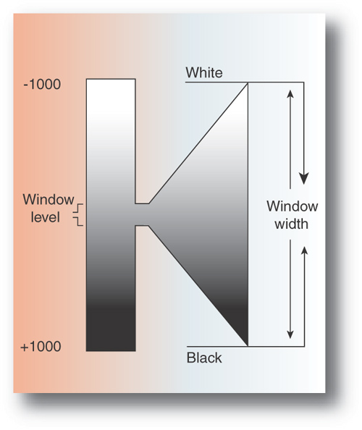

Slide 36
DSA
Digital Subtraction Angiography
Helps enhance image contrast through post-processing
Steps involved include creating a mask, applying an image with IV contrast, and subtracting out the information that is not needed

Slide 37
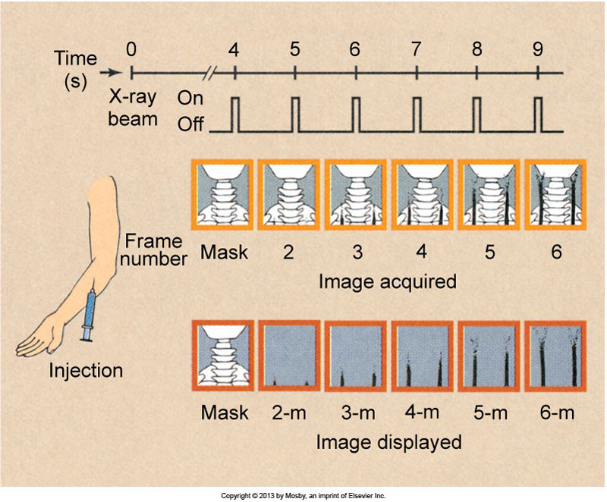

Slide 38
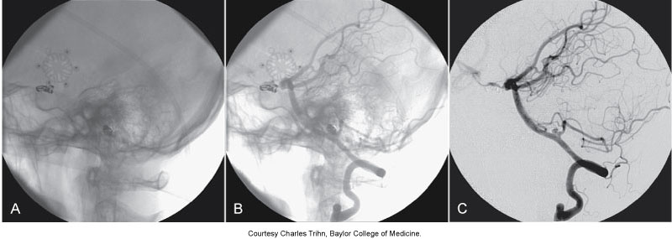
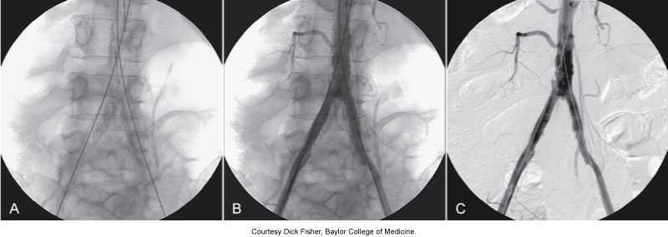

Slide 39
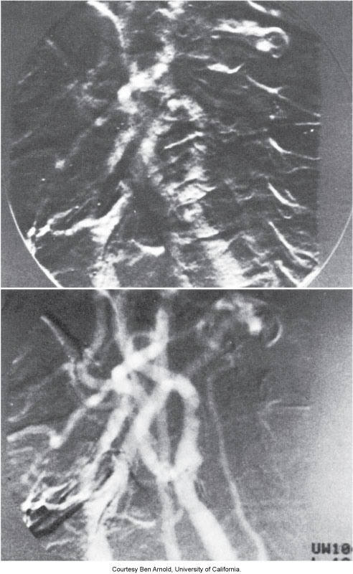
This is an example of misregistration artifacts. Typically happens when the patient moves between the mask image and a subsequent injected image. The subtraction image contains the artifacts.

Slide 40
Roadmapping
A special application of DSA
The mask image is stored, contrast is injected, and subtracted images are acquired
As the catheter is advanced, another mask is obtained showing the catheter in the vessel

Slide 41
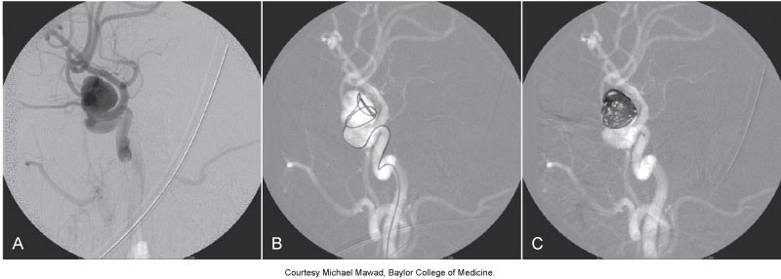
Roadmapping

Slide 42
PACS
Picture Archival & Communication System
Allows acquisition, interpretation, and storage of images
Four components: acquisition, display, network, and storage
Separate from any other network in the facility

Slide 43
DICOM
PACS can accept any image in a DICOM format
Digital Imaging and Communications in Medicine
DICOM is a standard
Prior to that, each vendor had its own way of storing images with no need to share

Slide 44
DICOM (cont)
Each manufacturer has its own proprietary image file which needs to be converted into DICOM
Within the image file, there are other pieces of information like patient and image information
DICOM is an object-oriented standard
Two classes of information

Slide 45
DICOM (cont)
Object class
Contains information about the study and the patient
Includes normalized and composite information
Service class
Describes what to do with the object
Includes image storage, image query, image retrieval, image print, storage resource, and composite information

Slide 46
HIS / RIS / EMR
HIS: Hospital Information System
Holds a patient’s full medical record (billing, inpatient ordering)
RIS: Radiology Information System
Holds radiology-specific patient data (patient scheduling, reports)
EMR: Electronic Medical Record
EHR: Electronic Health Record

Slide 47
HL 7 Standard
HL 7: Health Level 7
Oversees most clinical and administrative data
Demographics, reports, claims, orders (text based information)
A standard generally used to communicate between the HIS and RIS

Slide 48
HIPAA
Stands for the Health Insurance Portability and Accountability Act of 1996
Mandated governing the provision of health benefits, delivery and payment for healthcare services, and security / privacy of protected health information (PHI) in written, electronic or oral formats

