Slide 1
Setting up your profile

Slide 2
Profile Settings
Once you have logged into KPScholar, you have a few options that you are able to setup.
First click on the My Account tab on the top left corner of KPScholar.

Slide 3
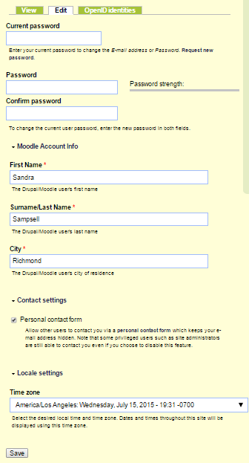
Profile Settings
Click the Edit tab in the middle of the page.
You will then see in the middle of the page that you are able to change your password, setup what city you are from, and set your time zone.
Once you are finished click Save at the bottom of the page to save your changes.

