Slide 1
PARK MD
SPRING 2017 MULTIMODALITY
METASTATIC COLON CANCER CASE STUDY
Primary (including echo) 03168275
RUQ US 12662829 6/2/2016
DVT 10175435 3/26/2015 04317346 02/07/17

Slide 2
OBJECTIVES
Be able to list at least 4 differential diagnosis
Be able to list 4 key characteristics of cholecystitis on ultrasound
Be able to list 3 ultrasound criteria for deep venous thrombosis
Be able to identify the key finding for diagnosing pulmonary embolism on CT
Identify the key findings of R. ventricular dysfunction on transthoracic echocardiogram (To be addressed by Dr. Kwai-Ben)
List common areas of metastasis for metastatic colon cancer
What is considered elevated FDG uptake for cancer (To be addressed by Badiee)

Slide 3
History
JN is a 55 year old female presenting with right upper quadrant pain.
What is your differential diagnosis
Cholecystitis, diverticulitis, indigestion, kidney stones
What types of studies would you be considering?
RUQ abdominal ultrasound

Slide 4
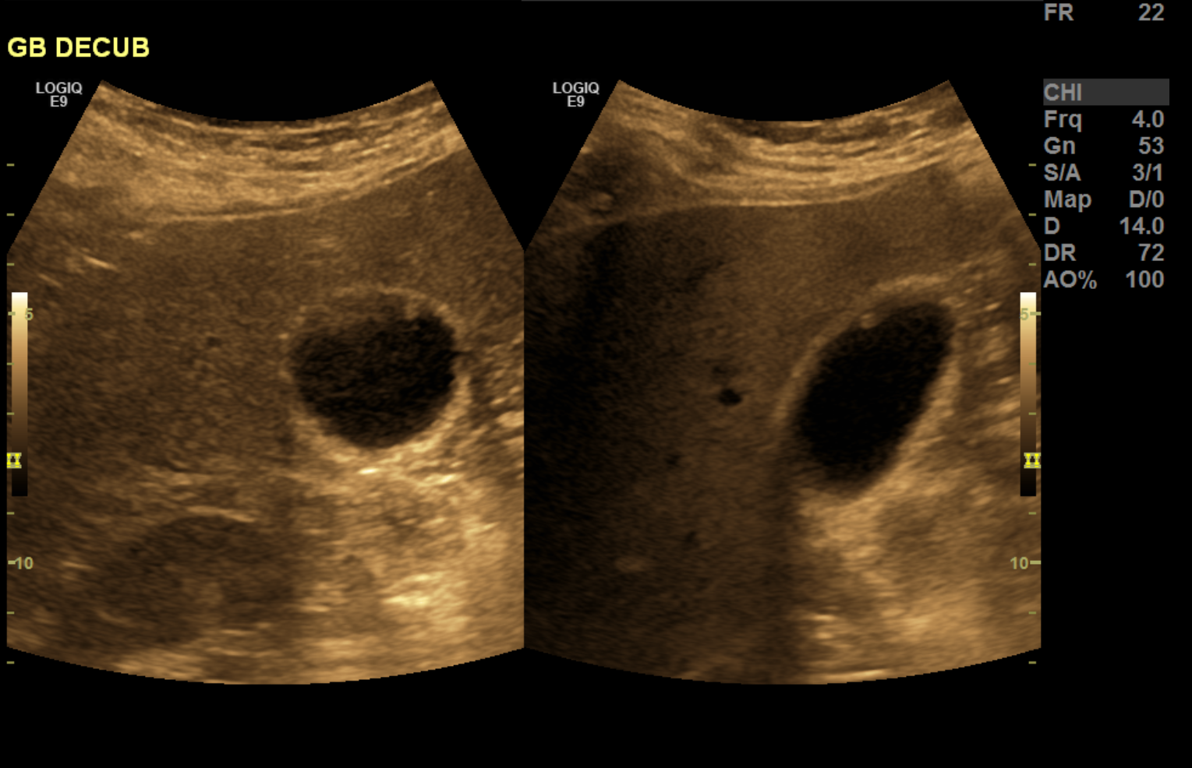

Slide 5
RUQ Ultrasound Exam
What does the ultrasound demonstrate
Ultrasound demonstrates a polyp
What are the key distinctions on ultrasound between a gallbladder polyp and gallstones?
Gallstones: mobile, cause posterior acoustic shadowing
Gallbladder polyp: fixed position, no posterior acoustic shadowing, internal blood flow
Would this polyp explain the RUQ pain?
What is the next study you would order?

Slide 6
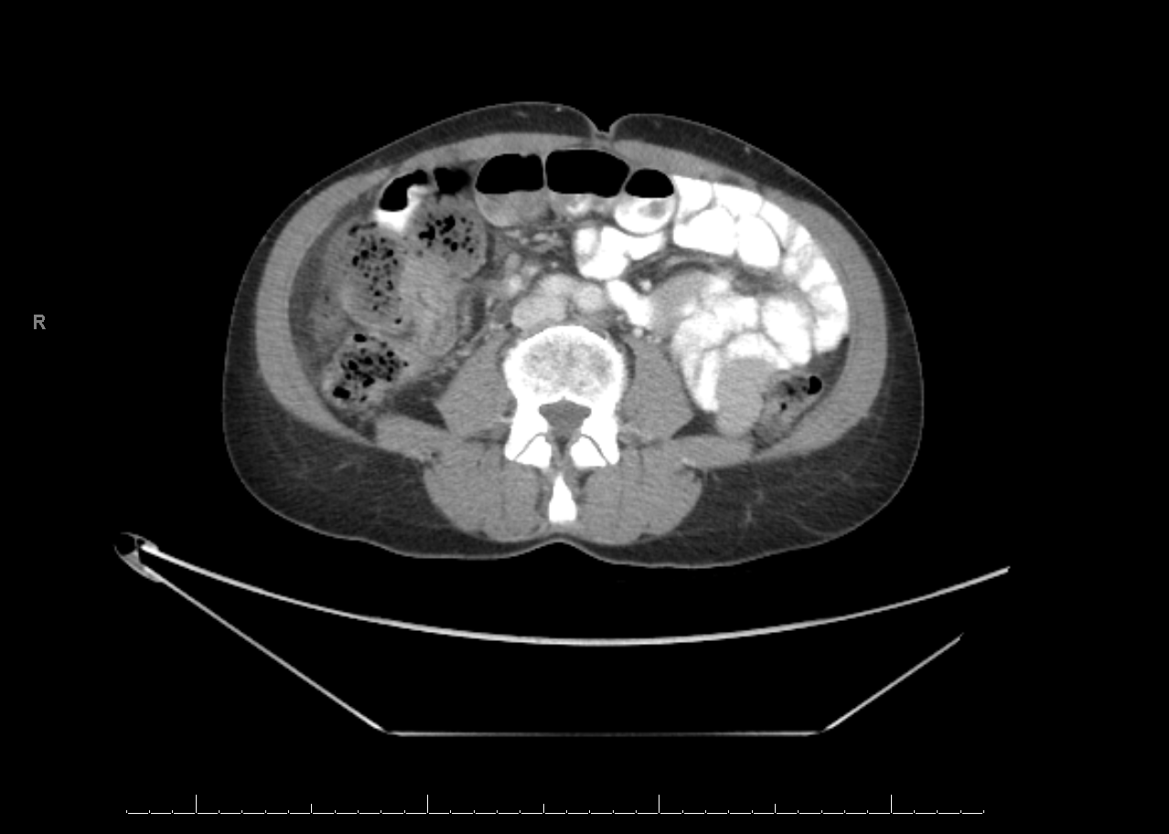

Slide 7
Abdominal CT Exam
Why was the Ultrasound performed before the CT?
Ultrasound is better for cholecystitis (imaging of gallstones and wall thickening)
Ultrasound is more cost effective
What did the CT Exam demonstrate?
Possible mass in the ascending colon
What is the next study you would order?
A mass was confirmed on a subsequent colonoscopy
Patient had surgery to have the mass removed
Patient was started on chemotherpy

Slide 8
Continuing History
1 year later, JN presents with right lower extremity swelling and pain.
What types of studies would you be considering?
Lab: Elevated D-dimer
Lower extremity Doppler ultrasound

Slide 9
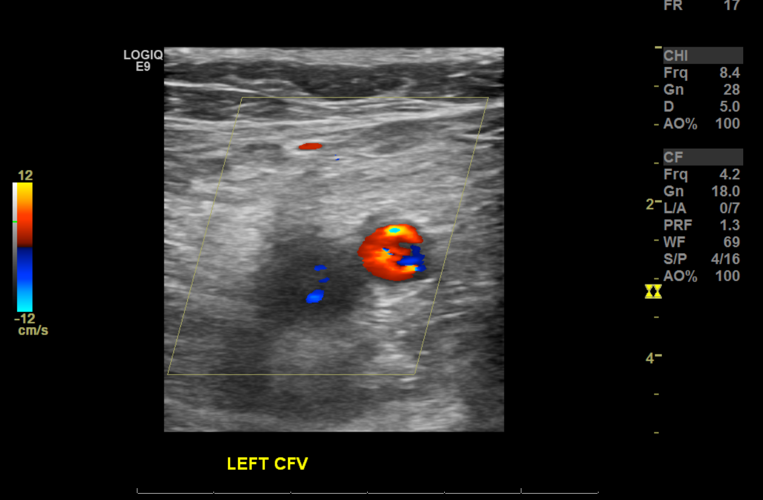

Slide 10
DVT Study
What does the ultrasound demonstrate
DVT
List 3 ultrasound criteria for deep venous thrombosis
Inability to compress, no color flow on color Doppler, no augmentation on spectral doppler
What is the most important criteria out of the above three?
Inability to compress
Patient started on anti coagulation therapy

Slide 11
Continuing History
Next day, JN presents with extreme chest pain and shortness of breath.
What is your differential diagnosis
Indigestion, heart attack, pulmonary embolism, pulmonary edema
What types of studies would you be considering?
Lab: EKG, Elevated D-dimer, cardiac enzymes
Imaging: Chest x-ray, CT angiogram chest, NM VQ scan

Slide 12
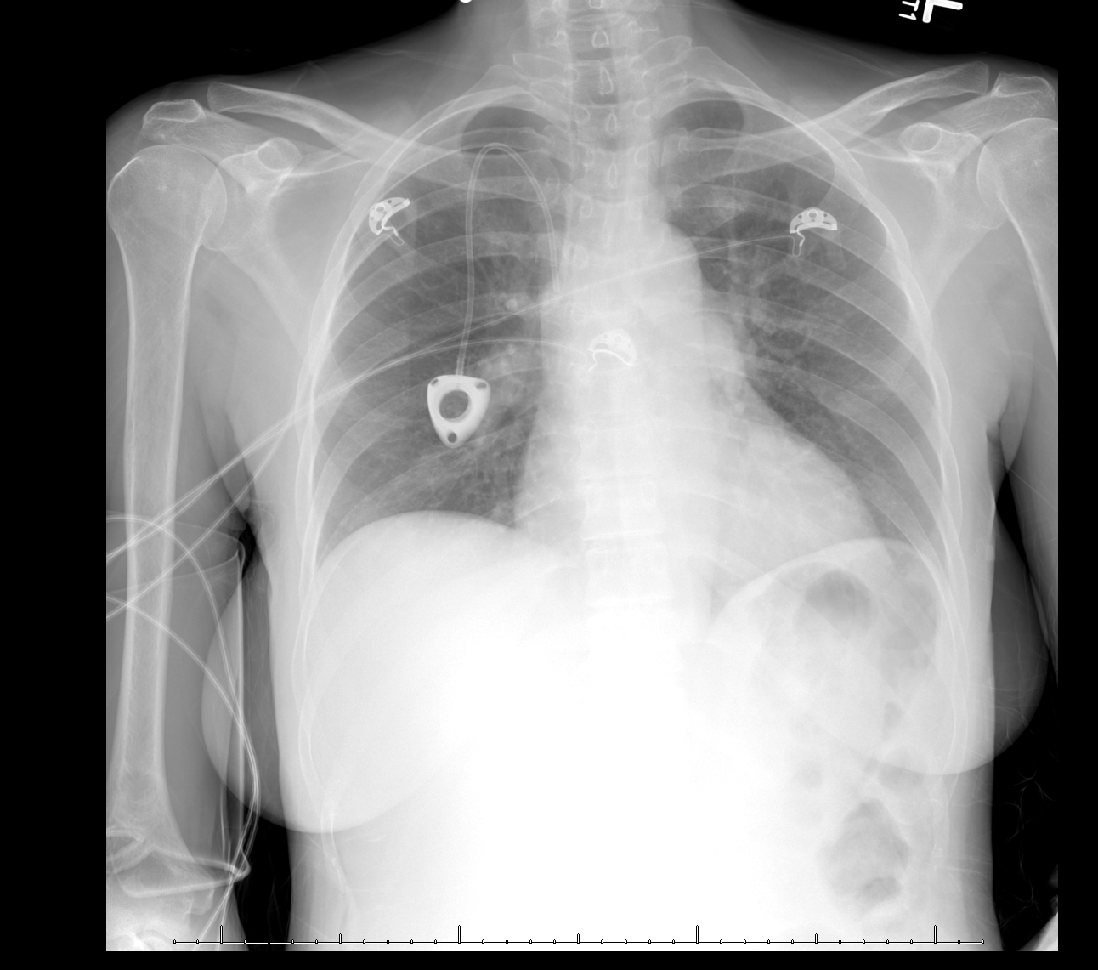

Slide 13
Chest X-ray
What does the chest x-ray demonstrate
No pulmonary edema
Mild basilar atelectasis
What are two possible chest x-ray findings for pulmonary embolism?
Hampton’s Hump
Westermark sign
What would be the appropriate follow up study if you are highly concerned for pulmonary embolism?
Chest CT angiogram

Slide 14
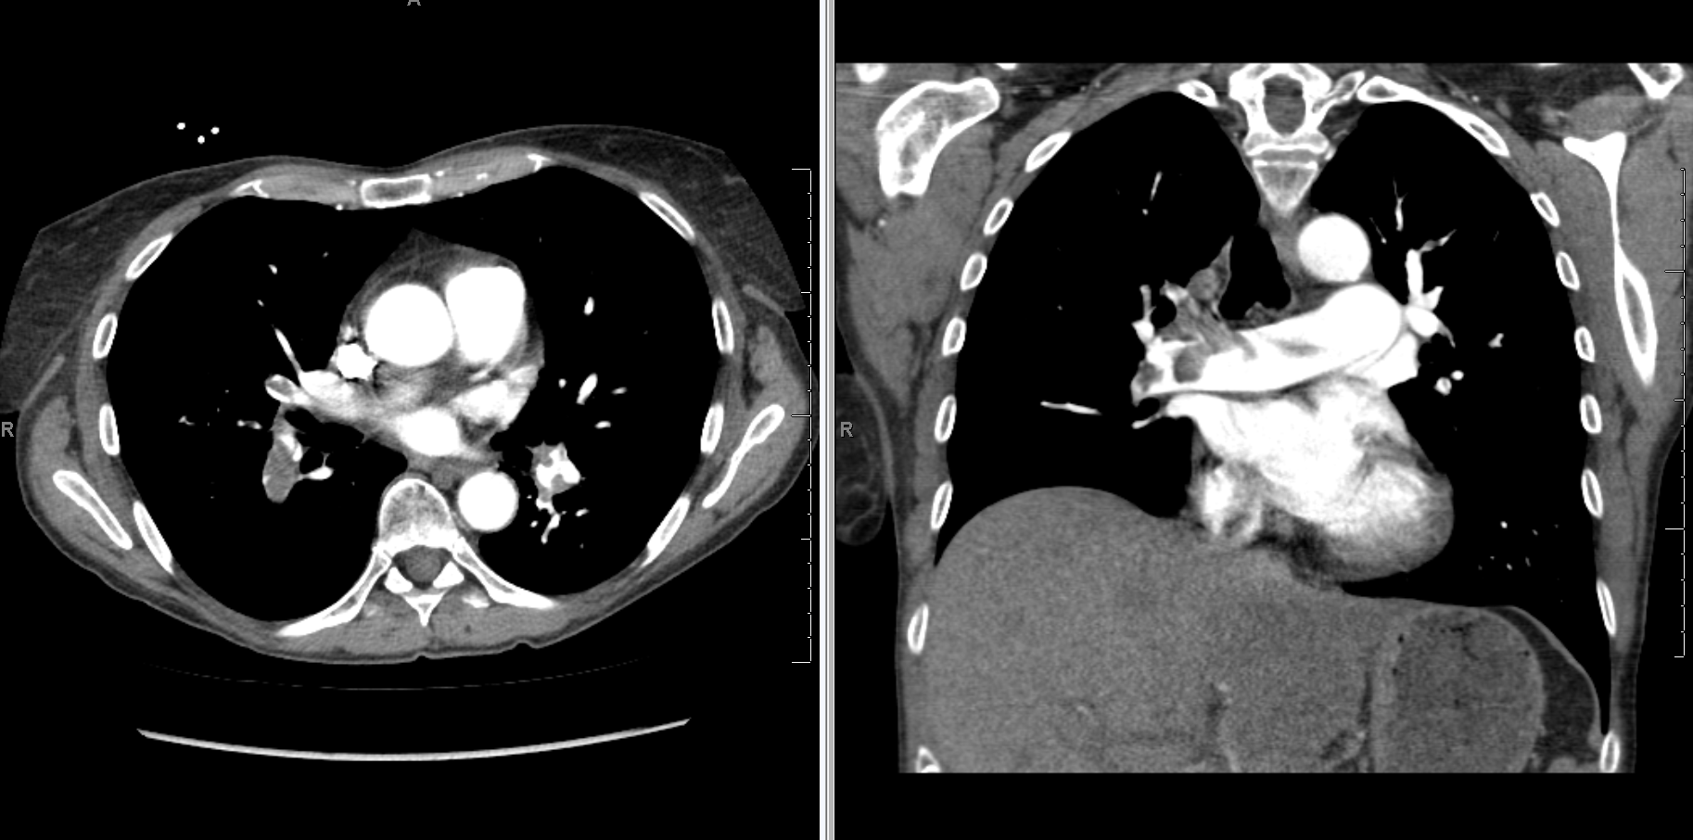

Slide 15
Chest CT Angiogram
What does the CT angiogram demonstrate
Massive pulmonary embolism (large filling defect within the pulmonary arteries)
Wedge shaped density at the right lung base (possible pulmonary infarct)
What would be the appropriate follow up be?
Continued anticoagulant therapy
Transthoracic echocardiogram

Slide 16
Transthoracic Echocardiogram (Kwai-Ben IMAGE)

Slide 19
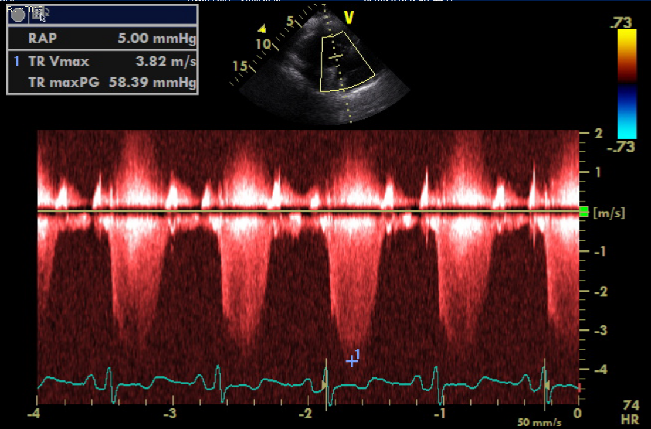

Slide 20
Transthoracic Echocardiogram (Kwai-Ben)
What does the transthoracic echocardiogram demonstrate
Massive pulmonary embolism (large filling defect within the pulmonary arteries)
Wedge shaped density at the right lung base (possible pulmonary infarct)
What would be the appropriate follow up be?
???

Slide 21
Continuing History
One week later, JN presents with diffuse abdominal pain
What is your initial imaging study?
Abdominal x-ray series

Slide 22
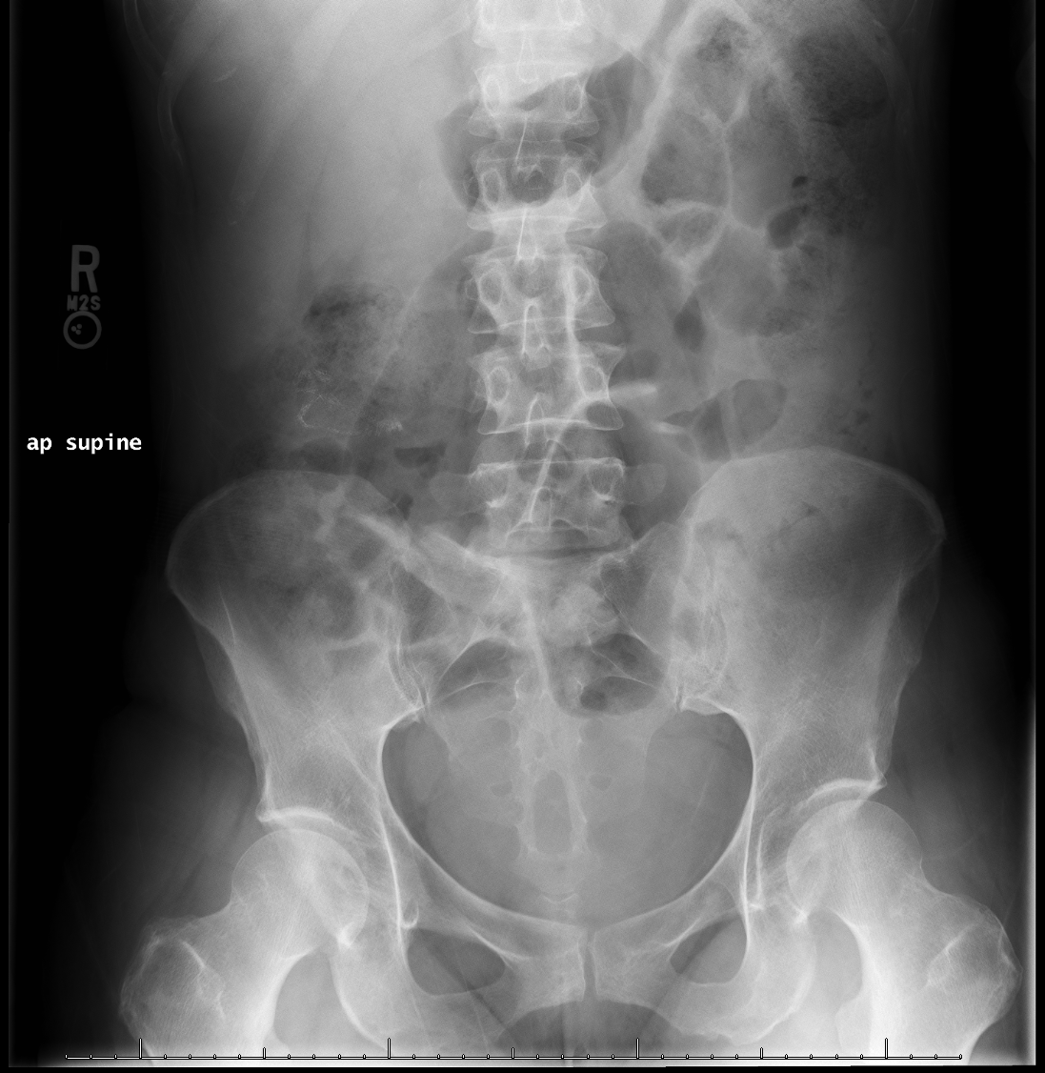

Slide 23
Abdominal X-ray Series
What does the x-ray series demonstrate?
No free intra-peritoneal air
No bowl obstruction
Where is the location of the colon surgery?
Can be identified by the placement of the sutures
What would be the next imaging study?
CT abdomen and pelvis

Slide 24
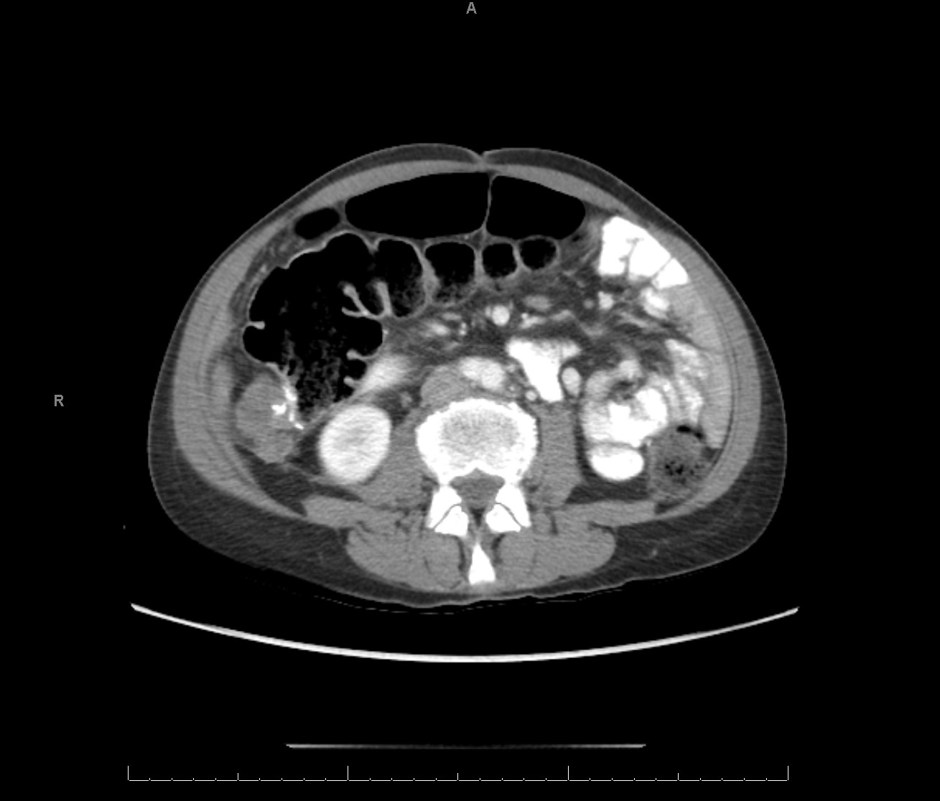

Slide 25
CT Abdomen and Pelvis
What does the CT exam demonstrate?
Post surgical change related to the ascending colon mass resection
Local tumor recurrence at the surgical site
Extensive liver metastatic disease
What would be the next imaging study?
CT Chest
PET/CT of the entire body

Slide 27
PET/CT (BADIEE)
What does the Maximum Intensity Projection (MIP) exam demonstrate?
Shows the whole body
Identify
Physiologic pattern of FDG uptake
Pathological activity

Slide 28
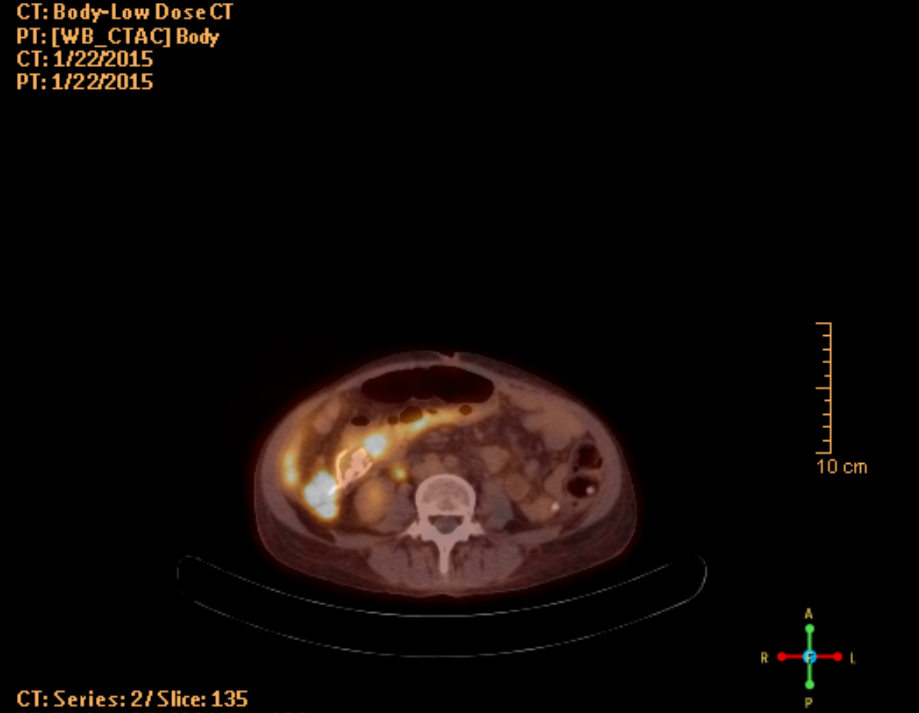
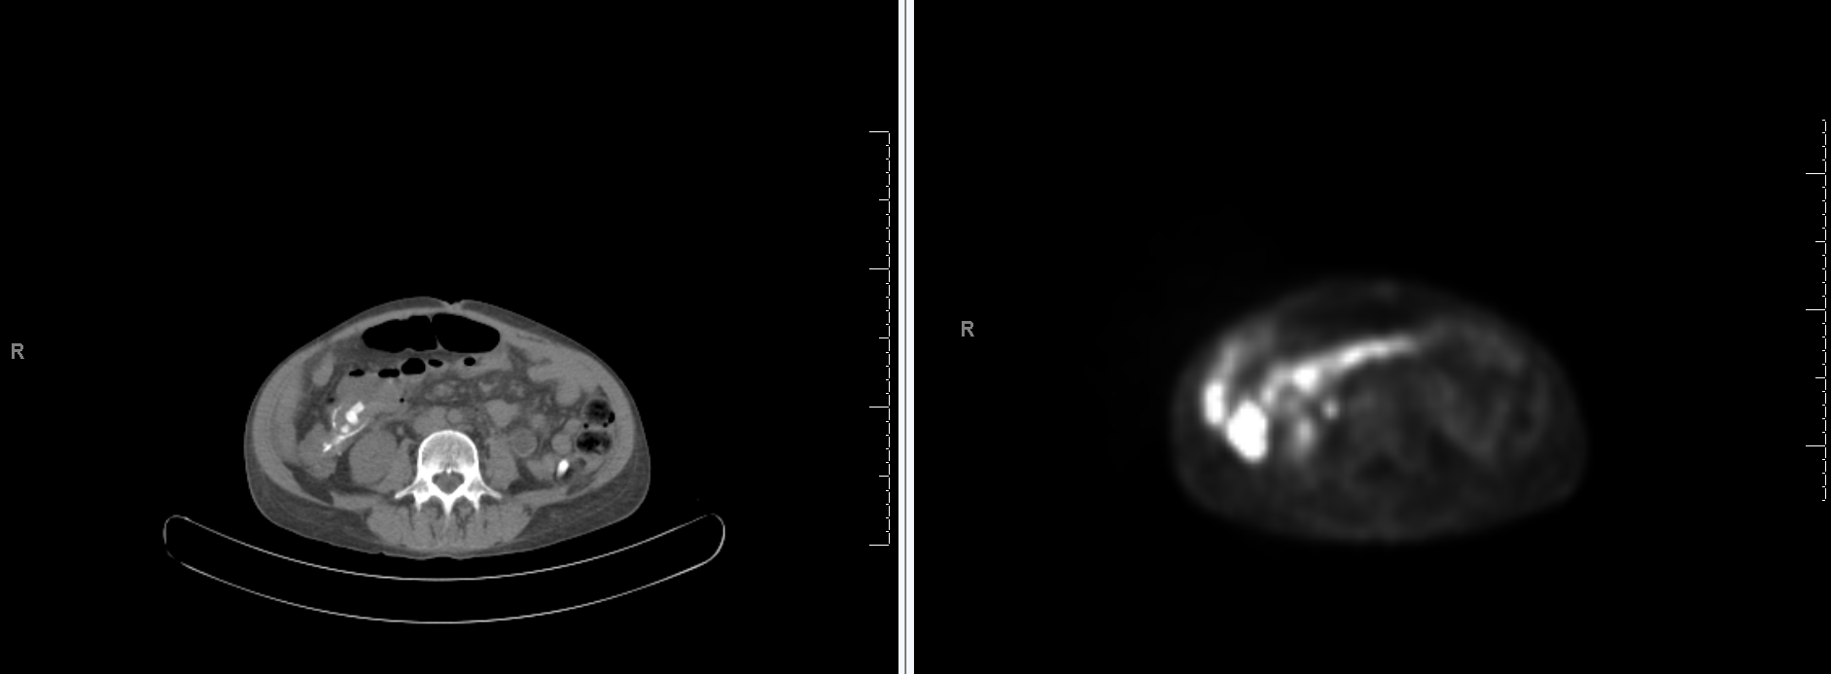

Slide 29
PET/CT (BADIEE)
What does the PET/CT exam demonstrate?
Local recurrence of disease at surgical site

Slide 30
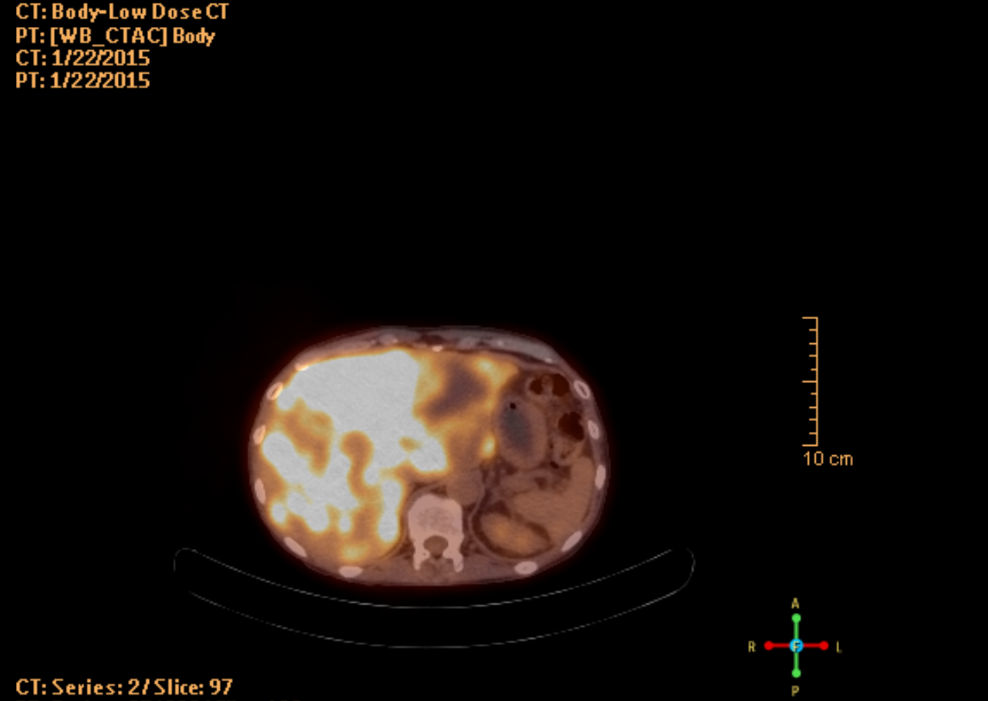
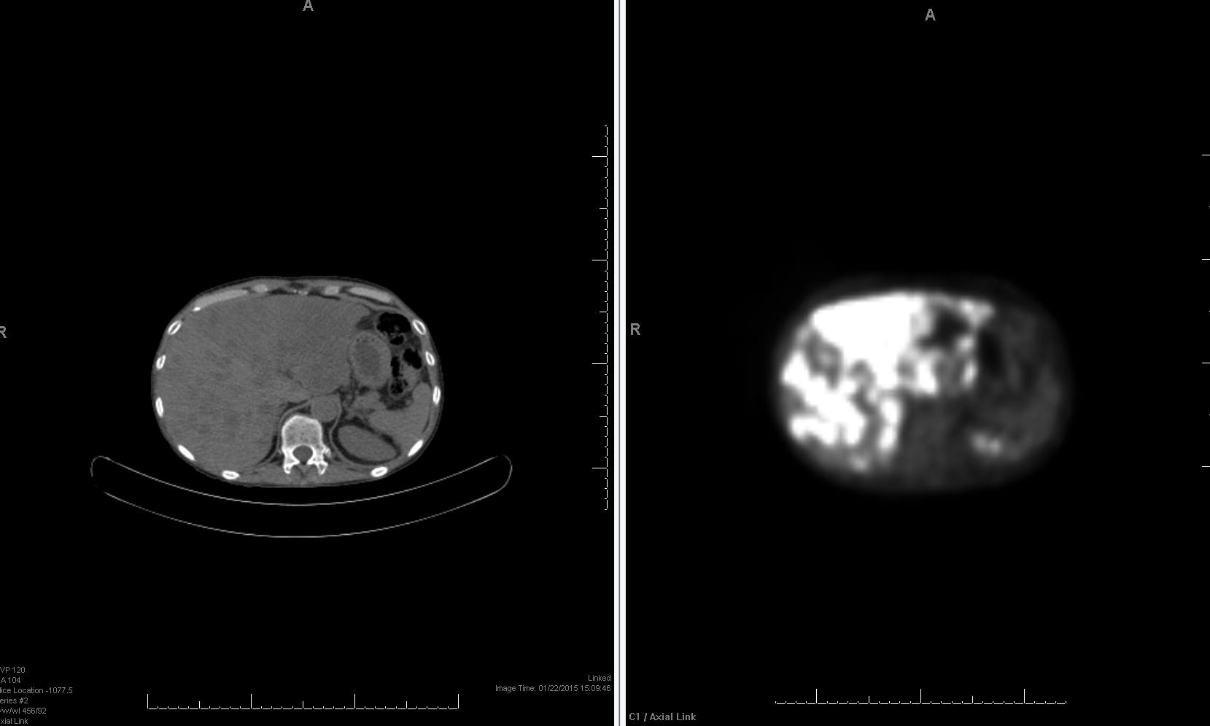

Slide 31
PET/CT (BADIEE)
What does the PET/CT exam demonstrate?
Diffuse and extensive liver metastases

Slide 32
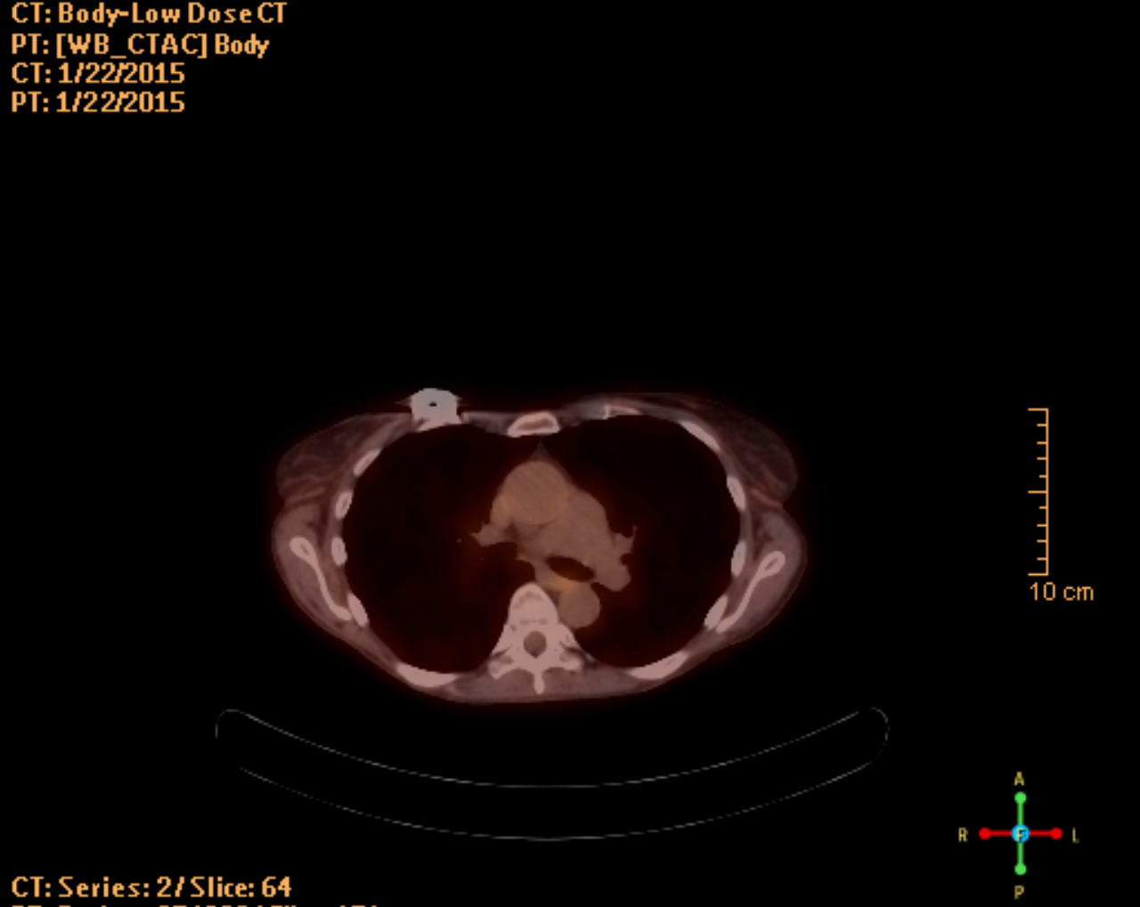
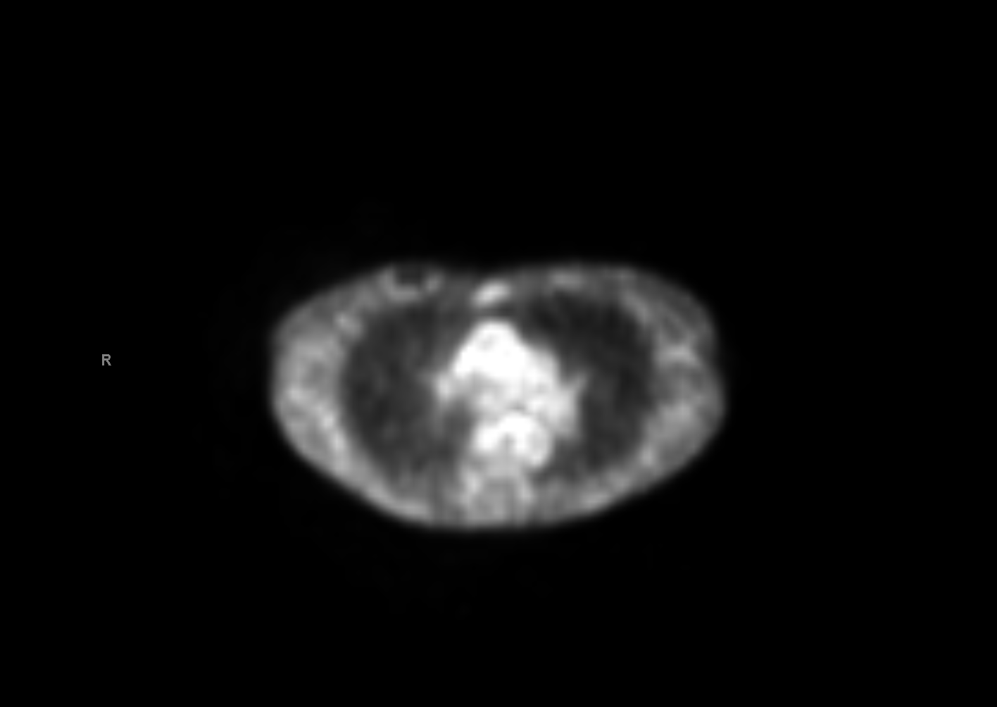
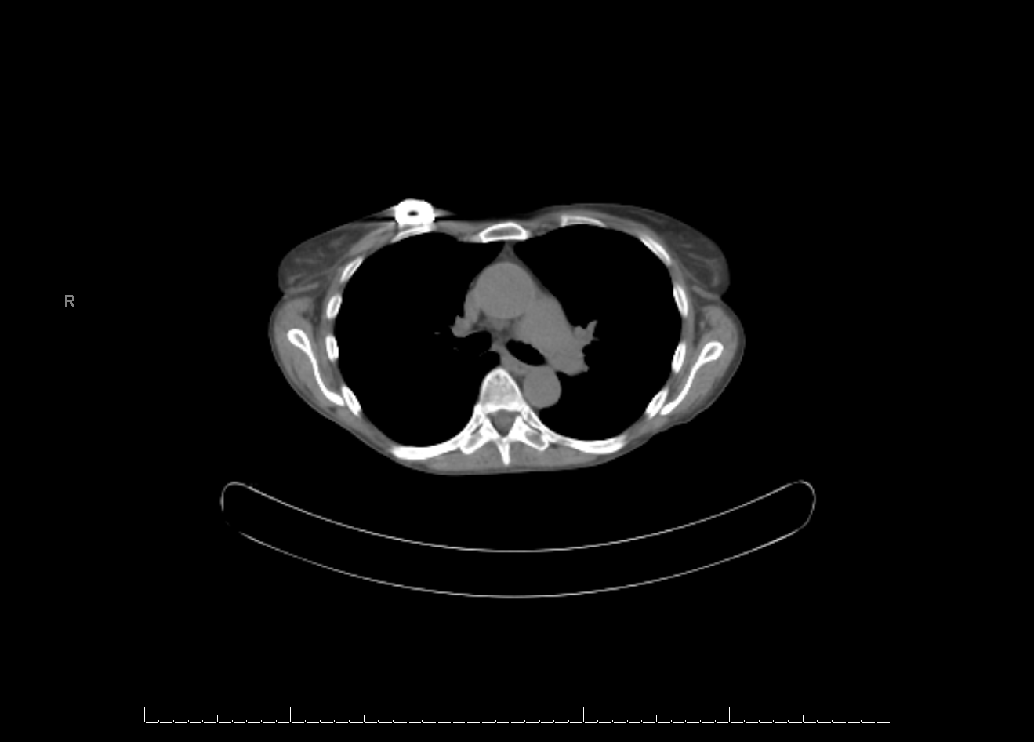

Slide 33
PET/CT (BADIEE)
What does the PET/CT exam demonstrate?
No Evidence of disease in the chest
Metal artifact

Slide 34
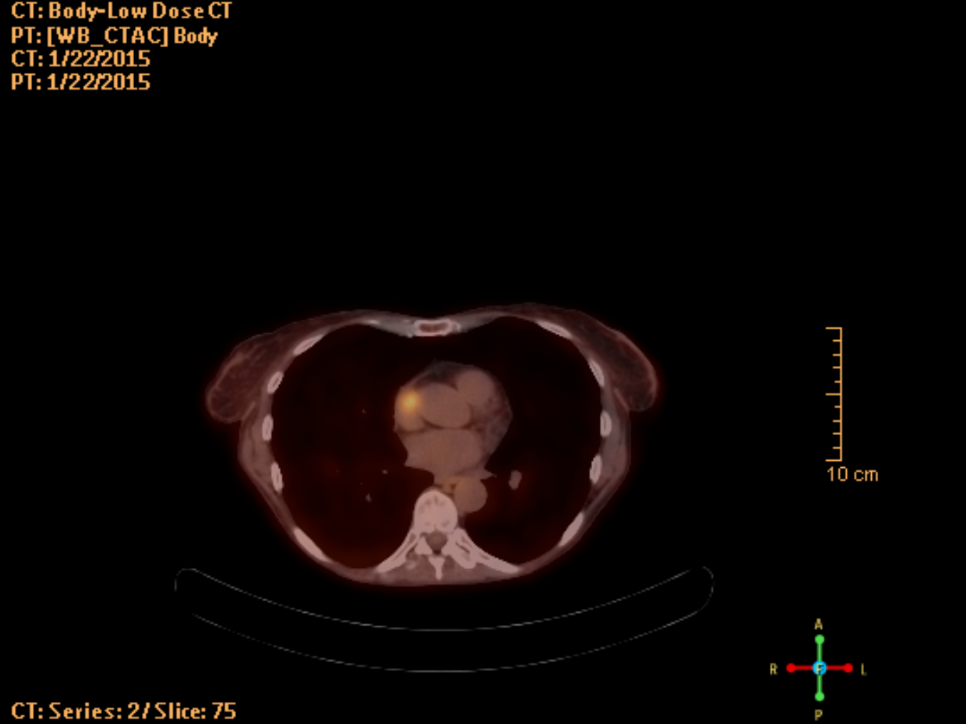
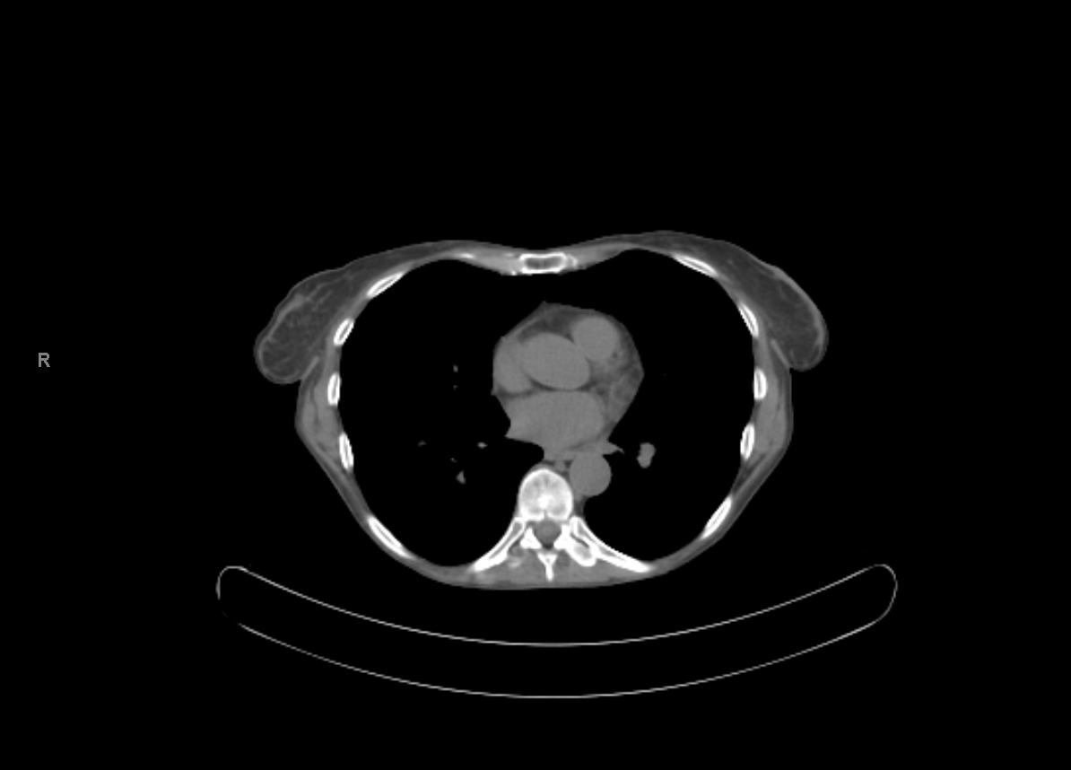
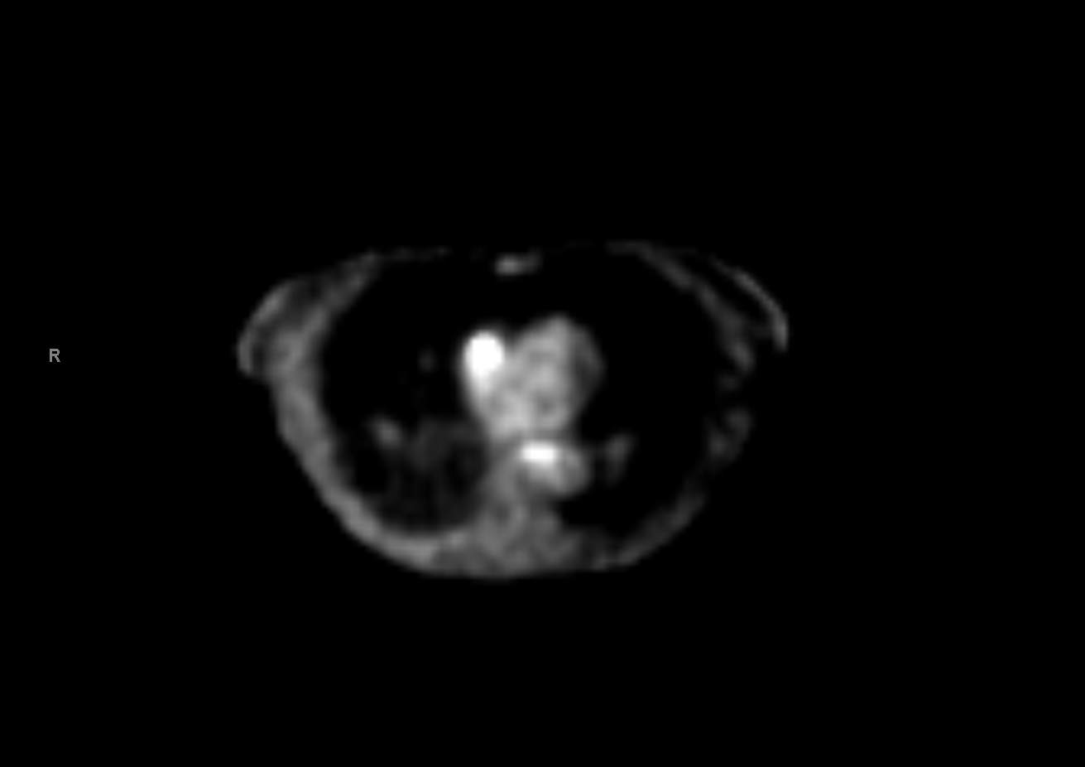

Slide 35
PET/CT (BADIEE)
What does the PET/CT exam demonstrate?
Incidental finding of focal cardiac uptake
Differential Diagnosis: Myocardial metabolism (normal), pathology??
What is the value of performing the PET/CT over just the CT?
Increased visible metabolic activity confirms metastasis
What is considered elevated FDG uptake for cancer

