Slide 1
Cardiac Views
Michelle Wilson Ed.D, RDMS, RDCS

Slide 2
Basic Planes to Cover
4 chamber | LVOT | RVOT | Great Vessels
Situs, Shape, Position | Aorta attached to actual LV | Pulmonary Artery attached to the actual RV: MODERATOR BAND | IVC and SVC flowing into RA
Conductivity-rate, concordancy | Any narrowing, expansion, morphology OK | Any narrowing, expansion, morphology OK | Pulmonary Veins seen in LA
Internally anatomical landmarks seen | Crosses under the RVOT or pulmonic artery | Crosses over the RVOT or pulmonic artery | Ao and PA criss cross. Ao creates an aortic arch or “Candy Cane” sign. PA creates the ductal arch or “Hockey Stick” sign

Slide 3
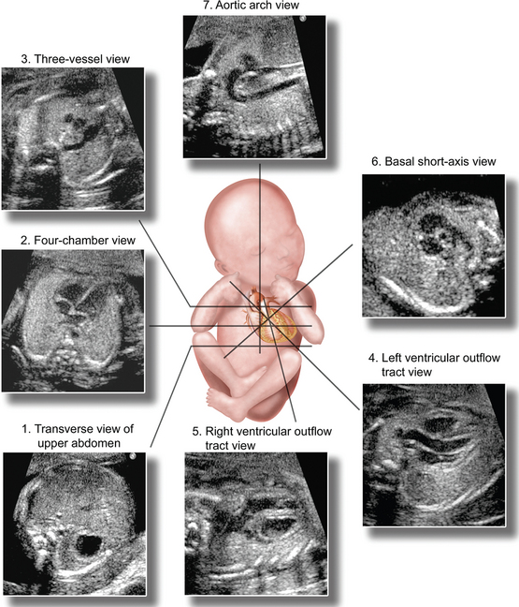
Views to Obtain

Slide 4
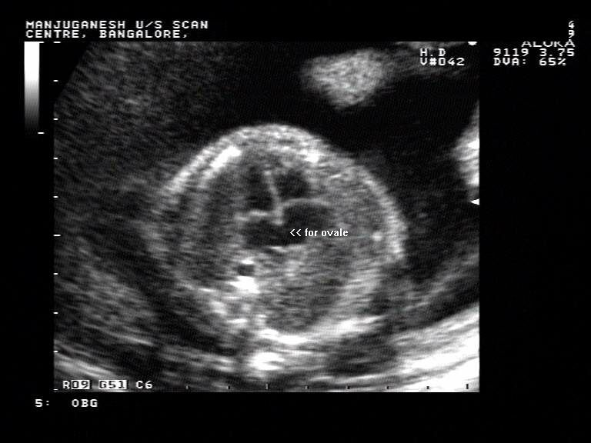
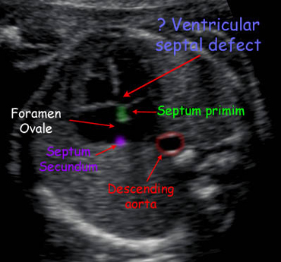
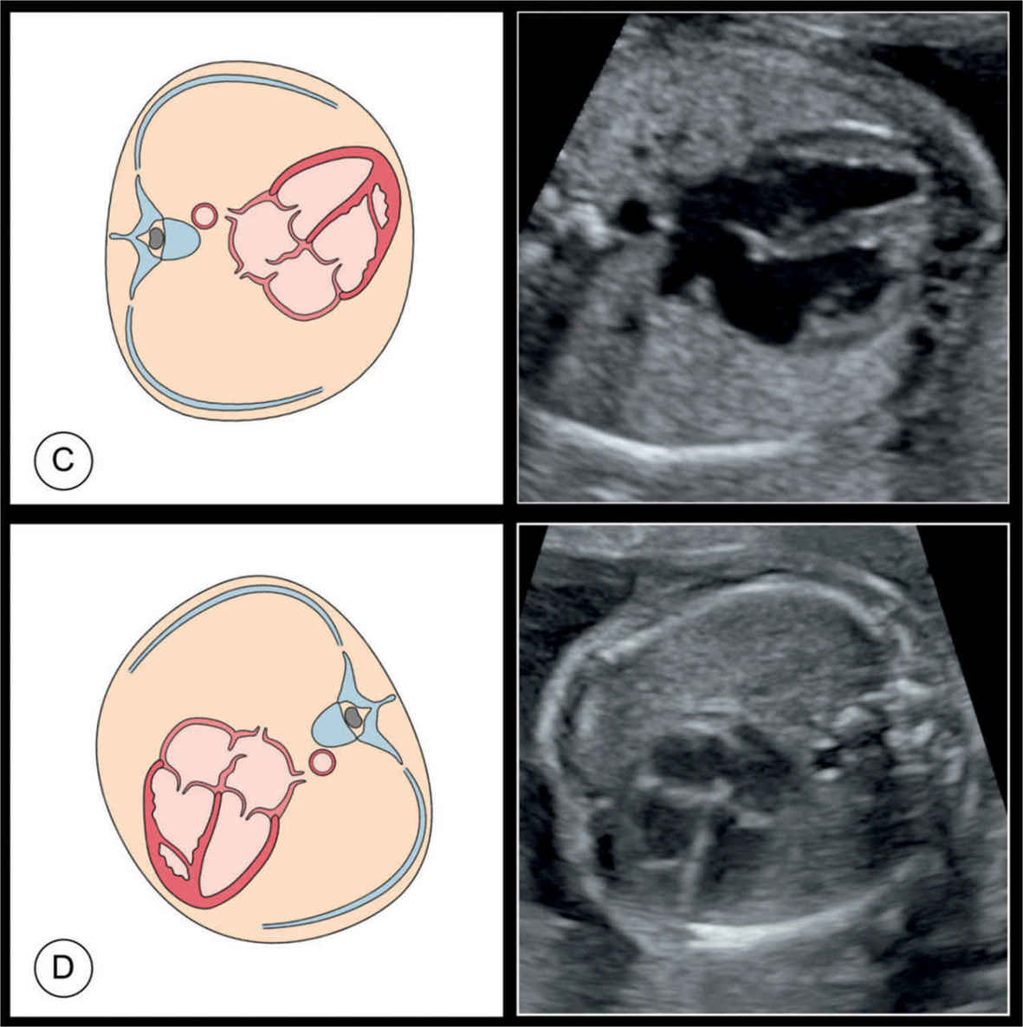
4 Chambers
Position, Size, Shape, Conductivity, 1/3 of the chest, Rate is normal, consistent, equal sizes of chambers, wall thickness normal, valves open and close normally, valves seated in correct place, moderator band in RV, septums are intact, foramen ovale moves freely into left atrim, AV valves seated approx. the same, TV seated slightly inferior on Vent Septum,

Slide 5
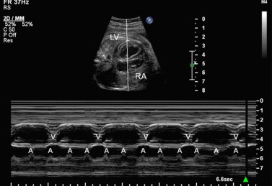
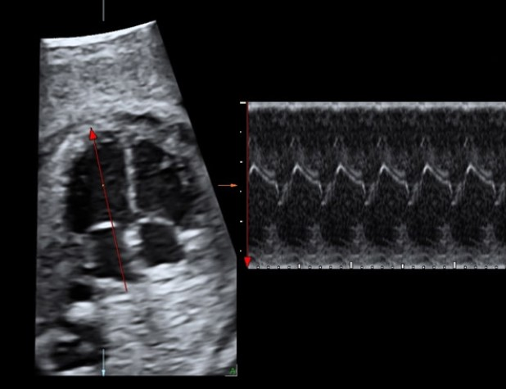

Slide 6
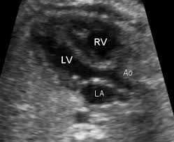
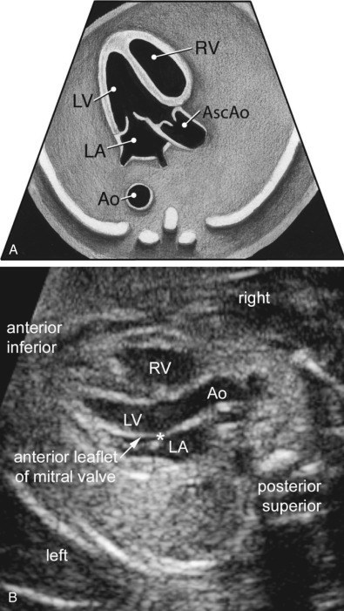
Left Ventricular Outflow Tract

Slide 7
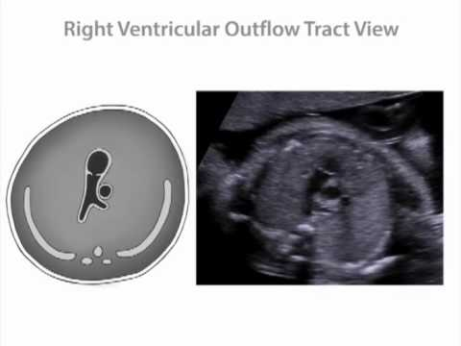
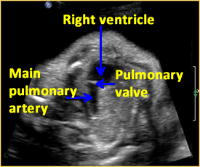
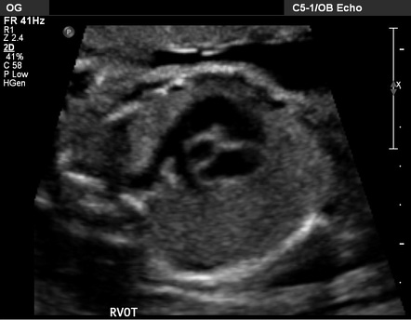
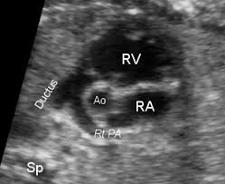
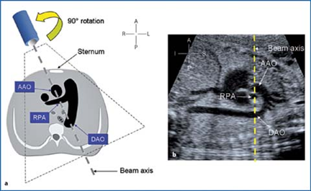
Right Ventricular Outlfow Tract

Slide 8
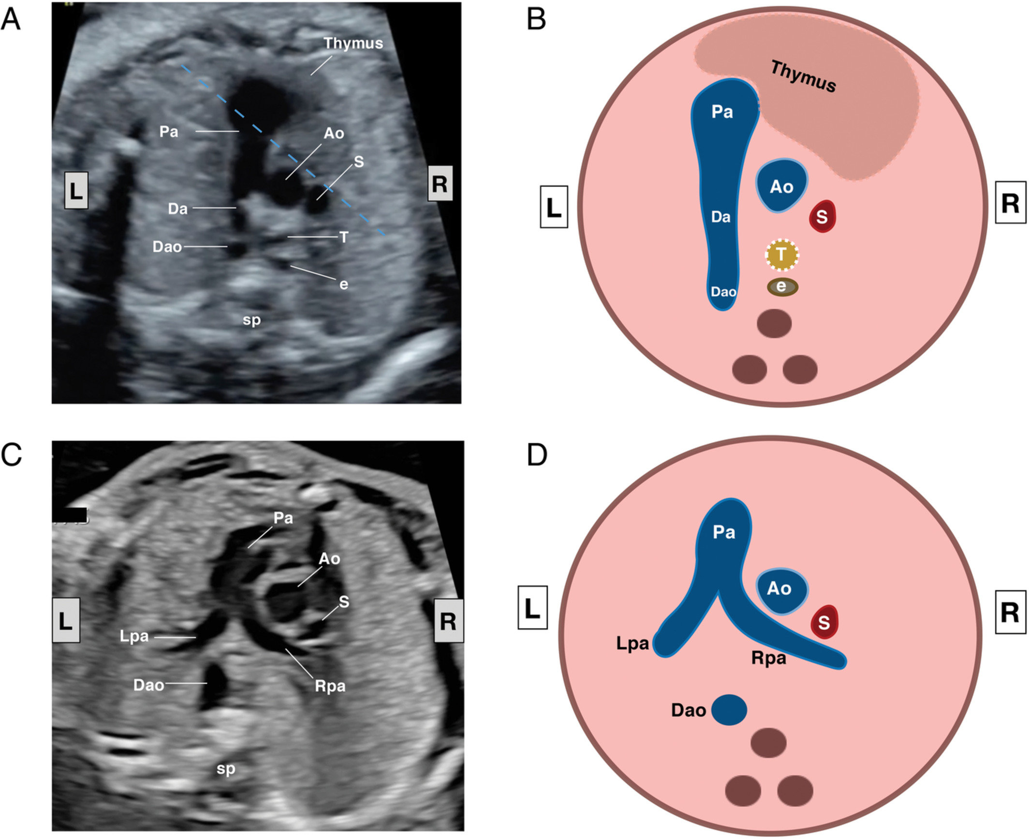
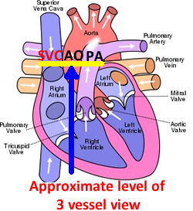
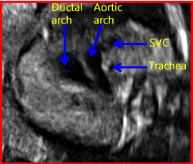
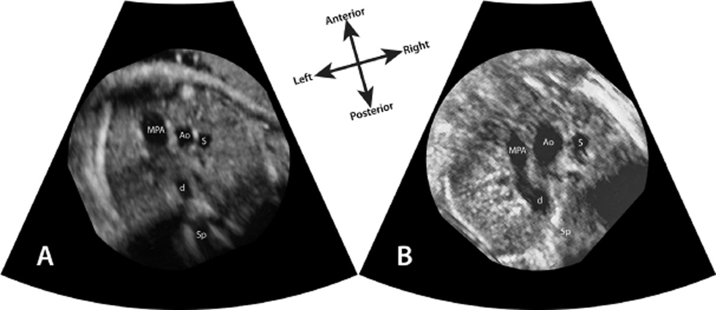
3VV or Tracheal View

Slide 9
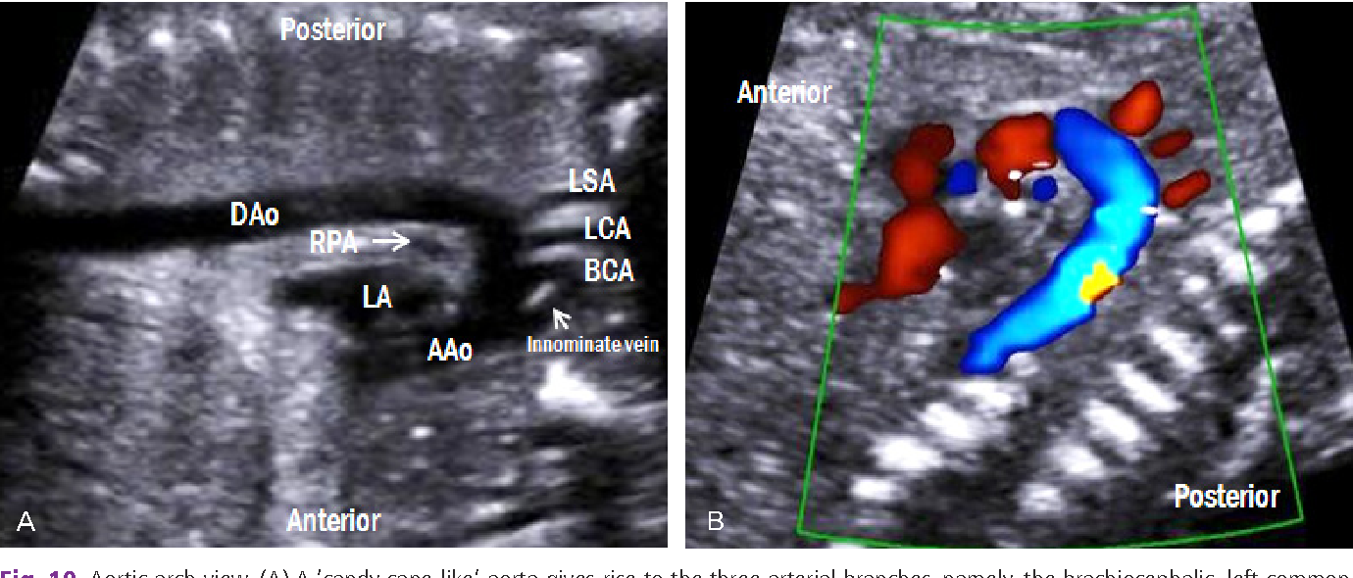
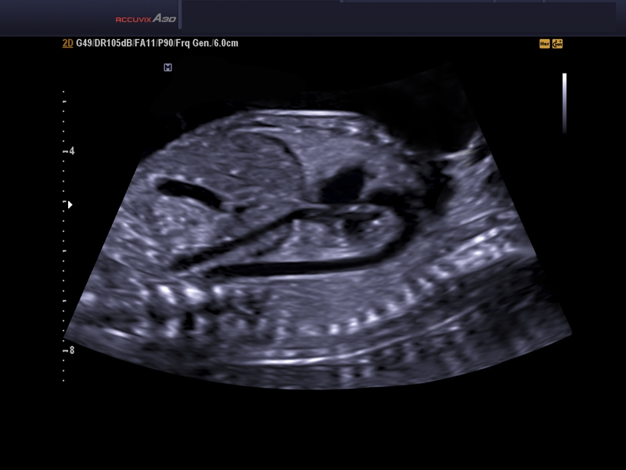
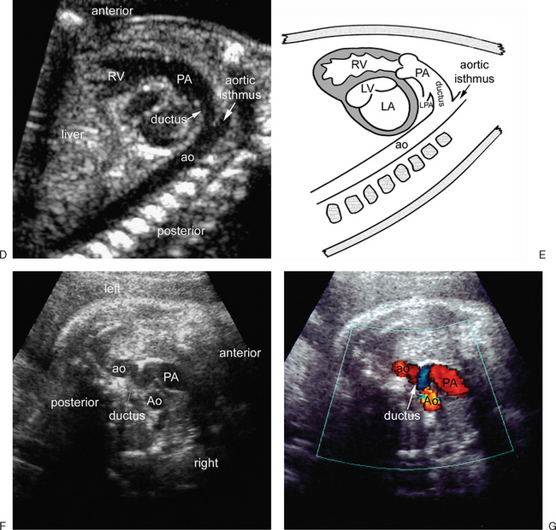
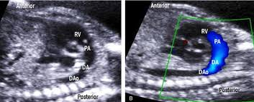
Inflows and Outflows

Slide 10
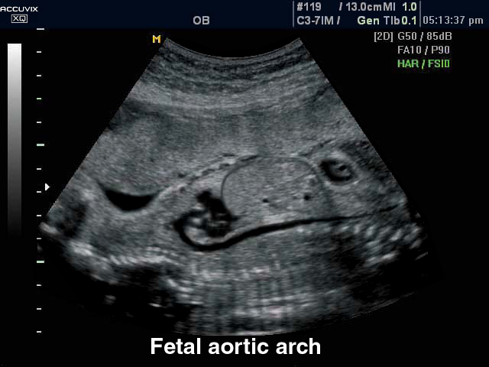
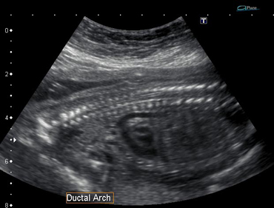
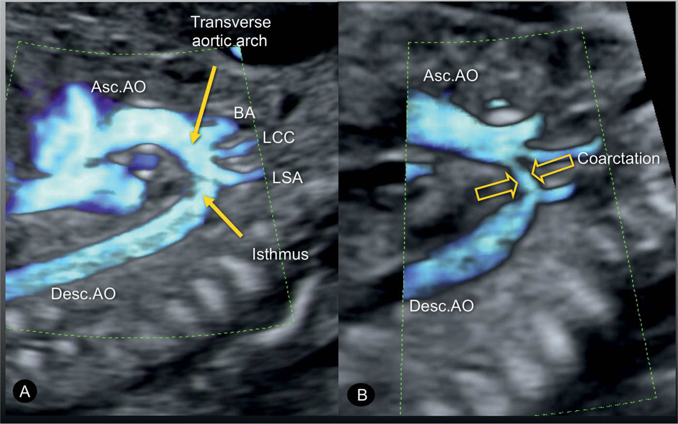
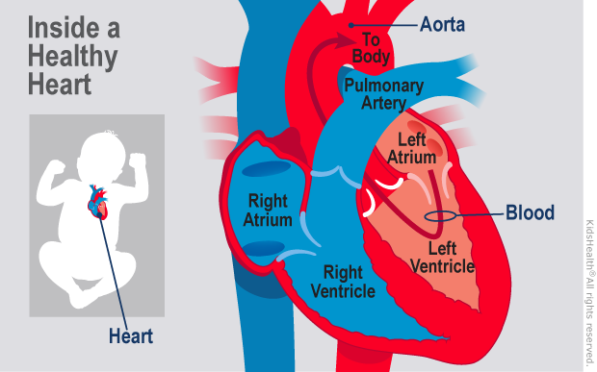
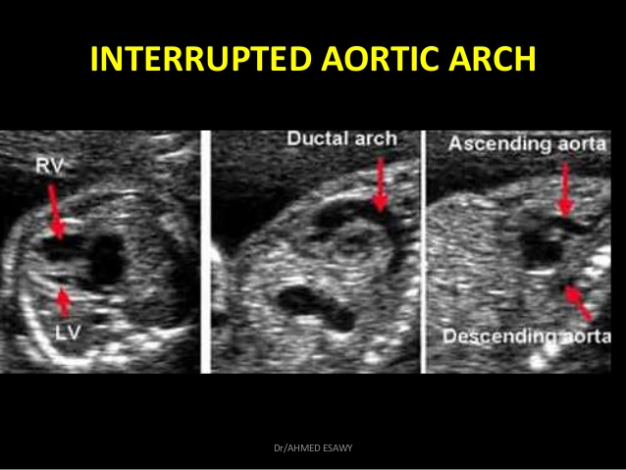
Aortic Issues

Slide 11
Steps to Eval Cardiac Structures
Split screen 4ch vs Stom
4Chamber over all view- Cine
4 chamber M-Mode Close Up
LVOT
RVOT
Split screen LVOT vs RVOT
IVC/SVC inflow
Ao Arch
Ductal Arch
Split screen Ao Arch vs Ductal Arch
https://www.youtube.com/watch?app=desktop&v=Wreu8FkQRQE

