Slide 1
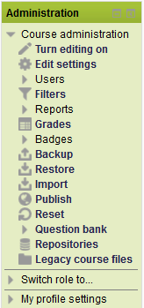
Course Administration
Here you have the Course Administration Block. This is listed on the left side of your course. As you can see you have many options listed in this block.

Slide 2
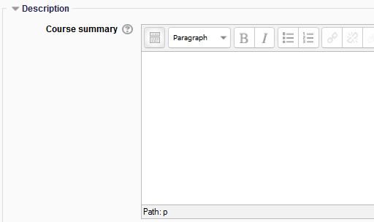
Course Edit
Turn editing on: This feature lets us edit our course and add activities, quizzes, lessons, and many more items to the course.
Edit settings: This allows us to make course edits like adding a course description, more weeks or topics to your course, theme, and file size.

Slide 3
Users
Users: You are able to see what users are enrolled in your course, Set up Groups for your course, Enroll users in your course, and setup permissions for users.

Slide 4
Reports
Reports: These provide different reports in your course. You can see what students log into the course, what they were working on, and get a course participation report.

Slide 5
Grades
Grades: This is a quick entry to your gradebook. You can setup how you want your gradebook to calculate and set up categories. You can even enter manual grades.

Slide 6
Badges
Badges: Badges are a good way of achievement and progress. Badges may be awarded based on a variety of resources. Badges created in Moodle can be displayed on a persons profile or pushed to their Open Badge Backpack and Mozilla’s Open Badge. These are presented in a persons backpack and will display in their Moodle profile.

Slide 7
Backup, Restore, Import
Backup: As an Instructor you will be able to backup your course. You can save selected options or the entire course. You can even download the backups.
Restore: You can restore a backup file at any time to a course that you have permission too.
Import: You may import activities and resources from another course you have editing rights too.

Slide 8
Publish and Reset
Publish: A community hub is a place that you can publish your courses.
Reset: You can reset your course of user data and keep resources and other settings.

Slide 9
Question Bank
Question Bank: You can import and export questions, add new questions, and set categories in your course.

Slide 10
Repository and Legacy Course Files
Repositories: People can upload files, you can add files from Google docs and other external repositories.
Legacy Course Files: Files are stored in different areas, instead of together in the course files area.

