Slide 1
Cardiovascular Pharmacology (A Primer)
This lecture is designed to:
Prep you for a deeper clinical experience
Assist you in understanding your board questions
Help you pass this class
Give you a global perspective (reduce academic myopia)
This lecture is designed to not:
Make you into an MD or PharmD
Make you crazy
Sourced: Drugs for the Heart by Opie & Gersh
Cecil Textbook of Internal Med.
Harrison’s Principals of Internal Med.

Slide 2
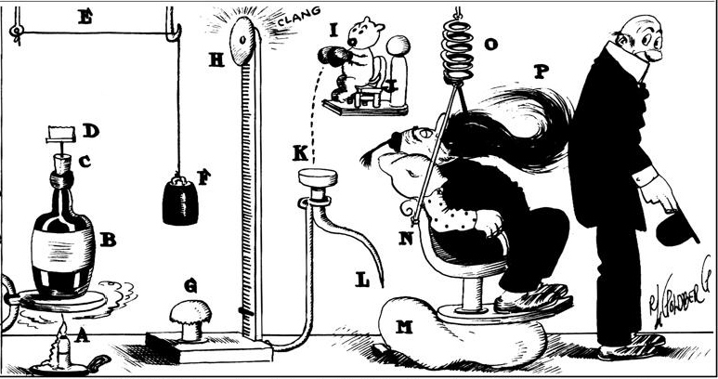
First an Overview of Pathology
Because:
Reviewing this is good for you
You need to know the problem before you know the fix
This will allow you to understand where your patients are in the scheme of their prognosis and treatment
Pathology is complicated like a Rube Goldberg Device.
*Please note that the following pathologies and their relationship to one another can be reorganized or classified to suit the field of study or an individual’s preference, but doing so simply amounts to rearranging the deck chairs on the Titanic.

Slide 3
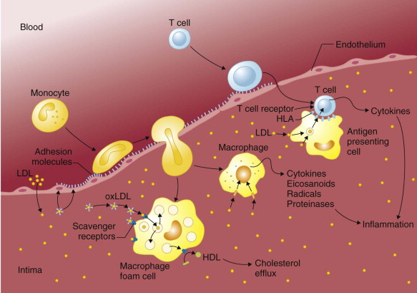
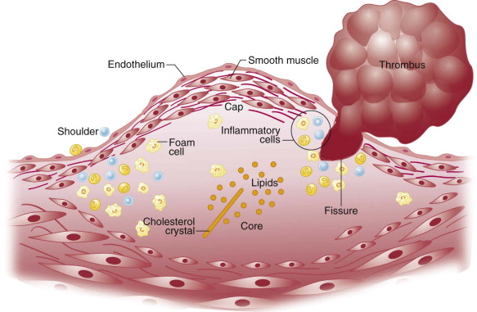
LDL, Inflammation, Triglyceride
The Triple Threat

Slide 4
Note:
Arteriosclerosis is a general term describing any hardening (and loss of elasticity) of medium or large arteries; arteriolosclerosis is any hardening of arterioles (small arteries); atherosclerosis is a hardening of an artery specifically due to an atheromatous plaqing.
Note: While not part of this lecture per se, You should be aware of that this same pattern evolves in other organs (kidney, brain, etc.)
Peripheral Artery DX.
Note: ACS and it’s various manifestations should be thought of as a spectrum of disease.
Isch. & Hem Events(Stroke)
Embolism/Aneurysm
Arteriosclerosis
(Athero/Arteriol)
Ischemic Heart Dx.
Angina
Acute Coronary Syndrome
NSTEMI
Cardiomyopathy
STEMI
Cardiac Arrest
Arrhythmia
Heart Failure
Valvular Dx.
Right
Left
(Arterial)
Hypertensionw/ Edema
(Pulmonary)
Hypertension w/ Edema

Slide 5
Note:
Arteriosclerosis is a general term describing any hardening (and loss of elasticity) of medium or large arteries; arteriolosclerosis is any hardening of arterioles (small arteries); atherosclerosis is a hardening of an artery specifically due to an atheromatous plaqing.
Note: While not part of this lecture per se, You should be aware of that this same pattern evolves in other organs (kidney, brain, etc.)
Metabolic Syndrome
Elevated BP
>130/85
Dyslipidemia
Tri>150
LDL<40
(pre)Diabetic
FGluc>110
Enlarged waist
>40in men
>35in wo
Note: Diet, exercise, and smoking cessation can directly or indirectly modify (or even reverse if caught early) all the conditions listed to the left.
Metabolic Syndrome
Peripheral Artery DX.
Note: ACS and it’s various manifestations should be thought of as a spectrum of disease.
Isch. & Hem Events(Stroke)
Embolism/Aneurysm
Arteriosclerosis
(Athero/Arteriol)
Ischemic Heart Dx.
Angina
Acute Coronary Syndrome
NSTEMI
Cardiomyopathy
STEMI
Cardiac Arrest
Arrhythmia
Heart Failure
Valvular Dx.
Right
Left
(Arterial)
Hypertensionw/ Edema
(Pulmonary)
Hypertension w/ Edema

Slide 6
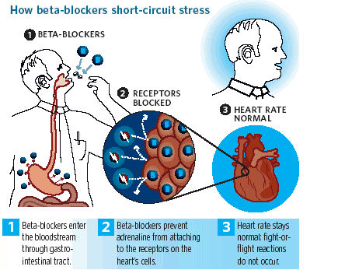
Beta-Blockers
Beta blockers block the action of endogenous catecholamines epinephrine (adrenaline) and norepinephrine (noradrenaline) in particular, on β-adrenergic receptors, part of the sympathetic nervous system, which mediates the fight-or-flight response. Slows heart rate, contraction thereby reducing workload and pumping action of the heart.
For: Arrhythmia, ACS, Hypertension, CHF
Contraindicated: Asthmatics (bronchospasm)
Increase Risk: Diabetes (glycogenolysis inhibition)
Note: Beta receptors have multiple subtypes and are themselves only one type of sympathetic receptor. Avoid using with cocaine addicts.
Identified by the suffix "-olo"
Propranolol
Acebutolol
Atenolol

Slide 7
Nitrates & Antianginals
Action: Nitrites (including oral nitroglycerine) stimulate nitric oxide production which is a naturally occurring vasodialator. Allows greater perfusion of organs and relief of angina symptoms along with decreased BP.
New alternatives to nitrites are possibly fatty acid inhibitors.
For: ACS, Hypertension, Ischemic Heart Dx
Contraindicated: Viagra (synergistic effects)
Increase Risk: Diabetes (glycogenolysis inhibition)
Note: Due to the vasodilation effects massive headaches can occur.
Identified by the root “-nitri-"
Mononitrite
Dinitrite
Nitroglycerine
Trinitrin

Slide 8
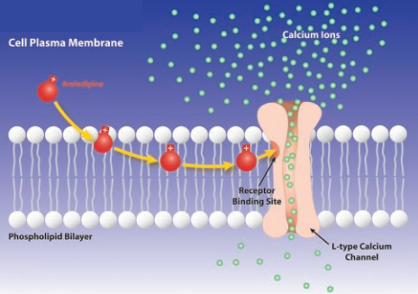
Calcium Channel Blockers
Action: CCBs used as medications primarily have three effects:
by acting on vascular smooth muscle they reduce contraction of the arteries and cause an increase in arterial diameter, a phenomenon called vasodilation (CCBs do not work on venous smooth muscle)
by acting on cardiac muscles (myocardium), they reduce the force of contraction of the heart
by slowing down the conduction of electrical activity within the heart, they slow down the heart beat.
For: ACS, Hypertension, Ischemic Dx.
Identified by the suffix "-dipine"
Amlodipine
Felodipine
Dihydropyridines

Slide 9
Diuretics
Loop Diuretic:
Inhibits sodium and chloride reabsorption in the Loop of Henley. Calcium loss.
Eg: Furosemide
Thiazide Diuretic:
Inhibits sodium and chloride reabsorption in distal convoluted tubule. Calcium retention. First line choice.
Eg: Hydrochlorothiazide
Potassium Sparing Diuretic:
Directly blocks aldosterone and does not promote potassium loss. Used in conjunction with loop diuretics.
Eg: Spironolactone
For: Edema, Hypertension, CHF
Avoid: Pregnancy (breast milk & and aware of electrolyte imbalance
Caution: Electrolyte imbalances

Slide 10
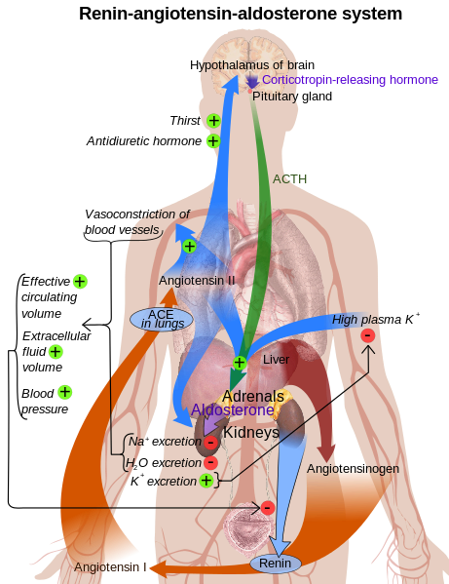
Renin-Angiotensin-Aldosterone Inhb.
ACEI:
Inhibits conversion of angiotensin 1 into 2. and reduces BP. Often causes cough.
Eg: Catopril, Benzopril, Ramipril
ARB:
Blocks angiotensin altogether and reduces BP. Relatively new and only limited trials, significantly low side effects.
Eg: Candesartan, Irbesartan, Valsartan
For: Edema, Hypertension, CHF

Slide 11
Antiarrhythmic
There are five main classes in the Singh Vaughan Williams classification of antiarrhythmic agents:
Class I agents interfere with the sodium (Na+) channel. Eg: Lidocane
Class II agents are anti-sympathetic nervous system agents. Most agents in this class are beta blockers. Eg: Propranolol
Class III agents affect potassium (K+) efflux. Eg: Ibutilide
Class IV agents affect calcium channels and the AV node. Eg: Verapamil
Class V agents work by other or unknown mechanisms. Eg: Digoxin slows AV node impulses
The new “Sicilian Gambit” is now gaining popularity as a classification method

Slide 12
Antithrombotics
Aspirin - Primary and secondary usage as a arachadonic acid inhibitor causes platelet inhibition by blocking the COX-1 pathway (and cancer too?). Causes gastric upset.
Clopidigril & Dipyridamole – Combination therapy as antithrombotic causes ADP binding and prevents thrombosis.
Warfarin (Coumadin) – Oral administration inactivates vit. K which prevents thrombosis.
Heparin – IV administered prevents platelets from agglutinating through the thrombin-prothrombin pathway.
Fibrinolytic and Thrombolytic Drugs (AKA Reprofusion)
tPA – Tissue Plasminogen Activating Factor (Activase) and it’s family simulate the arterial wall’s natural thrombolytic enzymes.

Slide 13
Lipid & Antiatherosclerotic Drugs
Statins – Lovastatin, Atorvastatin, inhibits HMG-CoA reductase and slows cholesterol formation in the liver (can cause severe liver damage, diabetes, and cognitive side effects).
Bile Acid Sequestrates – Questran, Welchol, bind to bile acid to promote their secretion into the intestine along with liver cholesterol.
Niacin – Over the counter availability, reduces the mobilization of free fatty acids from adipose.
Fibrates – Gemfibrozil, reduces triglycerides and there by increases LDL production.
Cholesterol Absorbtion Inhibitors – Zetia, disrupt intestinal absorption of cholesterol.

Slide 14
Gene Therapy
Goal: Remodel cellular structures and tissues by changing the genome of the patient and having their existing metabolism grow/repair the tissues in question.
Uses two primary methods to introduce the vector:
Transfection
Transduction

Slide 15
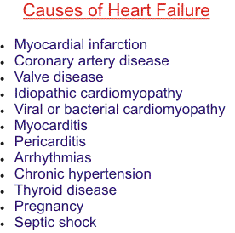
Case Study: Heart Failure

Slide 16
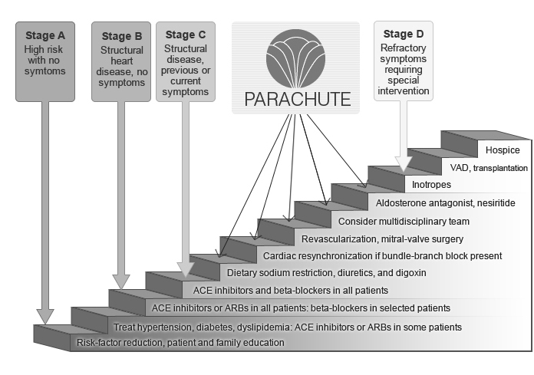
Case Study: Heart Failure

Slide 17
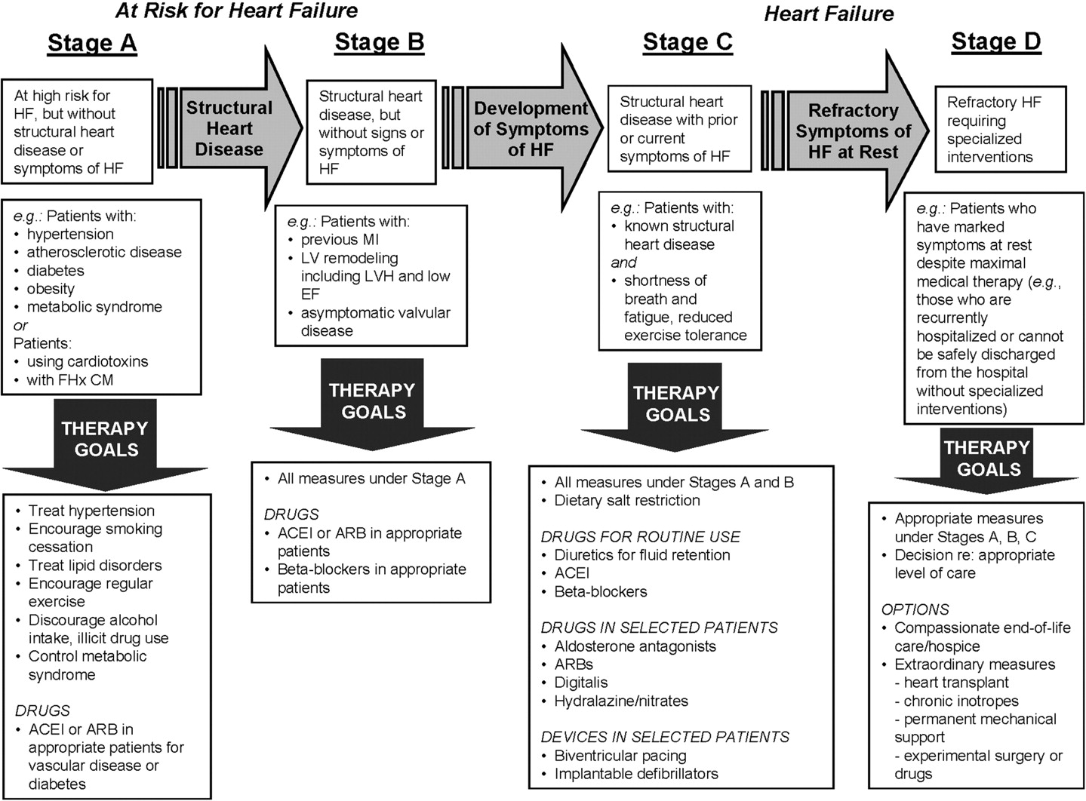
Case Study: Heart Failure

Slide 18
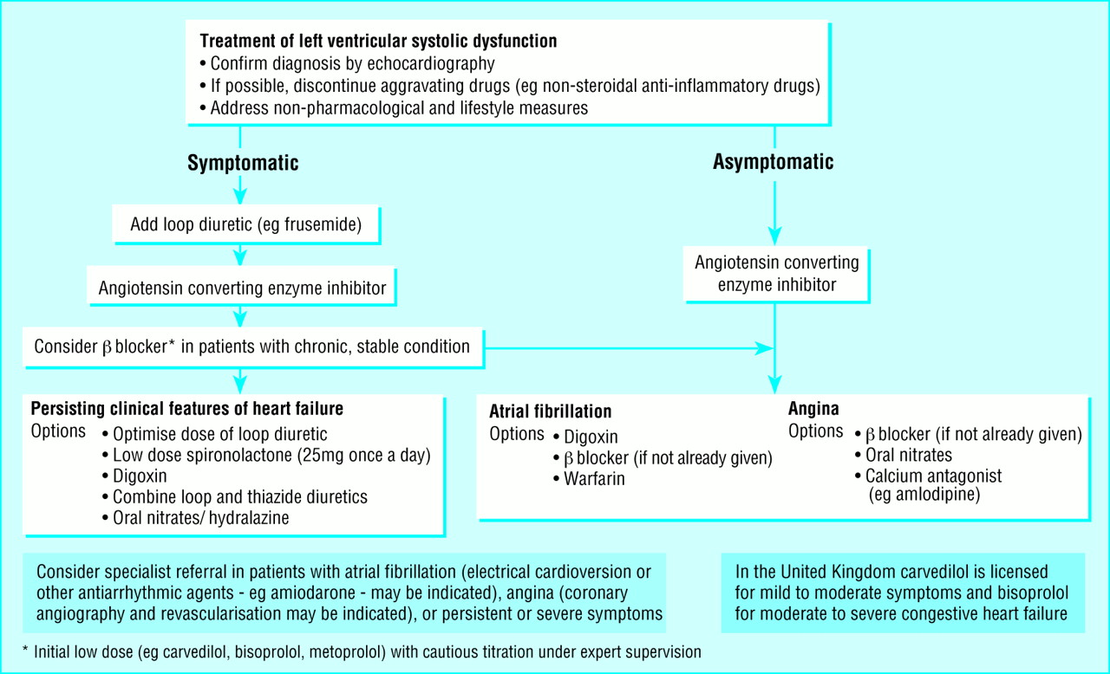
Case Study: Heart Failure

